Slide 1
Disclaimer: These slides are copyrighted and strictly for personal use only
• This document is reserved for people enrolled into the Ultimate
AWS Certified Solutions Architect Professional course
• Please do not share this document, it is intended for personal use and exam preparation only, thank you.
• If you’ve obtained these slides for free on a website that is not the course’s website, please reach out to info@sunshinelearning.in Thanks!
• Best of luck for the exam and happy learning!

Slide 2
AWS Certified Solutions
Architect Professional Course
SAP-C01

Slide 3
Setting the right expectations for this course
This course is all slides based
• I’m assuming you have experience using AWS
• No hands-on will come with the course. You should know the basics
• It’s fast paced. Your time is valuable. Feel free to slow me down to 0.75x
If you just passed the AWS Certified Solutions Architect Associate cert
• I recommend you go through AWS Certified Developer, SysOps & DevOps
• I know you are eager to get the SAP certification, but take your time
The AWS knowledge needed for the SA Pro exam
• Is extremely similar to the knowledge for SAA
• The questions are more complex, and knowing details is very important
• It’s possible that multiple answers are correct, but one is the most appropriate

Slide 4
The AWS Certified Solutions Architect Professional Exam
• Is HARD
• Tests real AWS experience
• Will test you on some very subtle service features
• I have included quizzes for every single section BUT…
• The quizzes are not “scenario based” / ”exam-like”
• They only help you extract some important notions out of what you’re learning
• This is my optimal way of teaching you about specific topics
• Please trust my teaching process

Slide 5
Practice Exams
This course does not come with practice exams
• I recommend you look on Udemy for extra practice exams
• I really want to focus this course on the knowledge needed
• I may come up with a practice exam at some point (to be purchased separately)
Warning:
• This course is on the NEW CERTIFICATION (SAP-C01)
• You may see outdated content in other practice exams, other courses, etc...
• This course is not incomplete, it’s more targeted towards the knowledge you
actually need to know to pass the exam

Slide 6
Identity & Federation

Slide 7
IAM –What should you know by now
Users: long term credentials
Groups
Roles: short-term credentials, uses STS
• EC2 Instance Roles: uses the EC2 metadata service. One role at a time per instance
• Service Roles: API Gateway, CodeDeploy, etc…
• Cross Account roles
Policies
• AWS Managed
• Customer Managed
• Inline Policies
Resource Based Policies (S3 bucket, SQS queue, etc…)

Slide 8
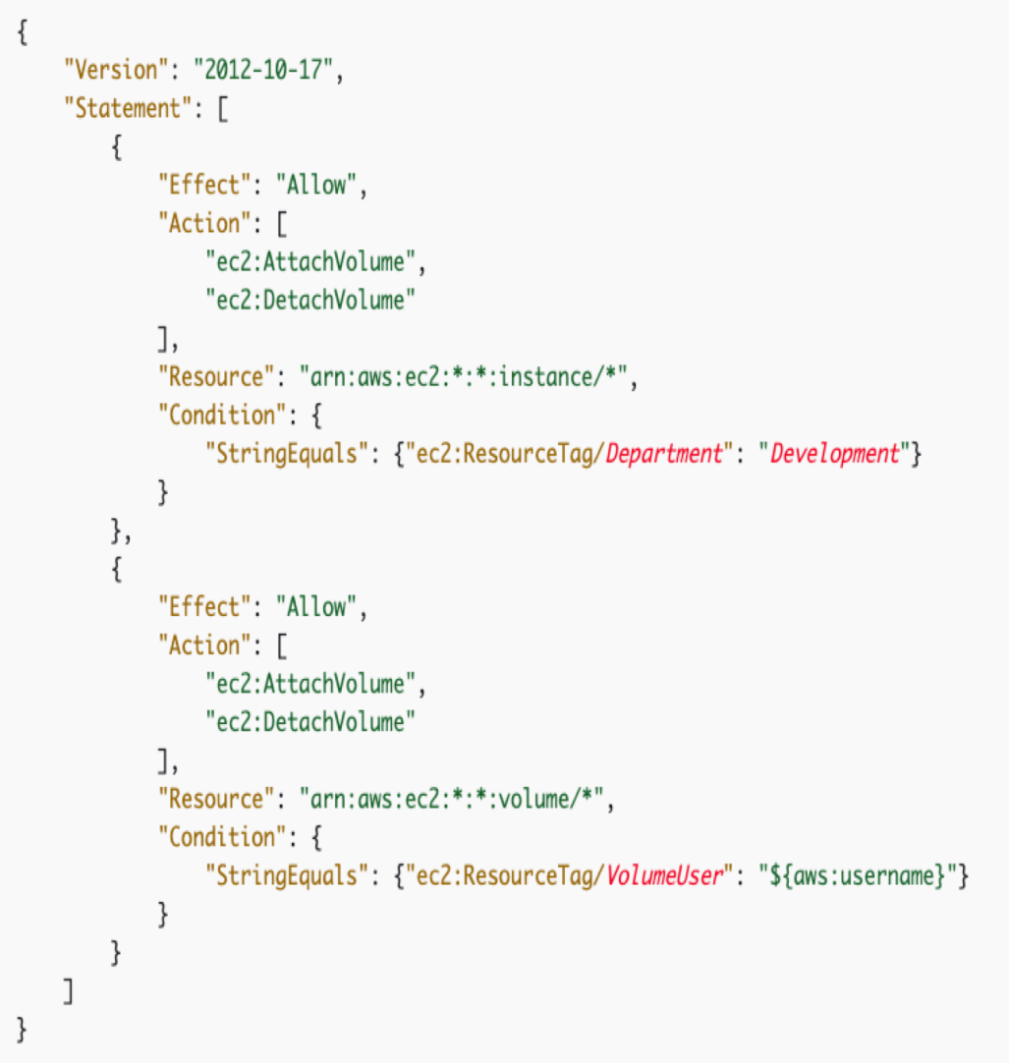
IAM Policies Deep Dive
• Anatomy of a policy: JSON doc with Effect,
Action, Resource, Conditions, Policy Variables
• Explicit DENY has precedence over ALLOW
• Best practice: use least privilege for
maximum security
• Access Advisor: See permissions granted and
when last accessed
• Access Analyzer: Analyze resources that are
shared with external entity
• Navigate Examples at:
https://docs.aws.amazon.com/IAM/latest/User
Guide/access_policies_examples.html

Slide 9
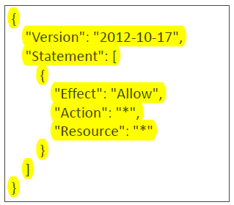
IAM AWS Managed Policies
AdministrativeAccess

Slide 10
IAM AWS Managed Policies
{
"Version": "2012-10-17",
"Statement": [
{
"Effect": "Allow",
"NotAction": [
"iam:*",
"organizations:*",
"account:*"
],
"Resource": "*"
},…
…{
"Effect": "Allow",
"Action": [
"iam:CreateServiceLinkedRole",
"iam:DeleteServiceLinkedRole",
"iam:ListRoles",
"organizations:DescribeOrganization”,
"account:ListRegions"
],
"Resource": "*"
}
]
}

Slide 11
IAM Policies Conditions
"Condition" : { "{condition-operator}" : { "{condition-key}" : "{condition-value}" }}
Operators:
• String (StringEquals, StringNotEquals, StringLike…)
• "Condition": {"StringEquals": {"aws:PrincipalTag/job-category": "iamuser-admin"}}
• "Condition": {"StringLike": {"s3:prefix": [ "", "home/", "home/${aws:username}/" ]}}
• Numeric (NumericEquals, NumericNotEquals, NumericLessThan…)
• Date (DateEquals, DateNotEquals, DateLessThan…)
• Boolean (Bool):
• “Condition": {"Bool": {"aws:SecureTransport": "true"}}
• "Condition": {"Bool": {"aws:MultiFactorAuthPresent": "true"}}
• (Not)IpAddress:
• "Condition": {"IpAddress": {"aws:SourceIp": "203.0.113.0/24"}}
• ArnEquals, ArnLike
• Null: "Condition":{"Null":{"aws:TokenIssueTime":"true"}}

Slide 12
IAM Policies Variables and Tags
Example: ${aws:username}
• "Resource": ["arn:aws:s3:::mybucket/${aws:username}/*"]
AWS Specific:
• aws:CurrentTime, aws:TokenIssueTime, aws:principaltype, aws:SecureTransport,
aws:SourceIp, aws:userid, ec2:SourceInstanceARN
Service Specific:
• s3:prefix, s3:max-keys, s3:x-amz-acl, sns:Endpoint, sns:Protocol…
Tag Based:
• iam:ResourceTag/key-name, aws:PrincipalTag/key-name…

Slide 13

IAM Roles vs Resource Based Policies
• Attach a policy to a resource (example: S3 bucket policy) versus attaching of a using a role as a proxy
User Account A
Role Account B
Amazon S3
Account B
User Account A
S3 Bucket Policy
Amazon S3
Account B

Slide 14
IAM Roles vs Resource Based Policies
• When you assume a role (user, application or service), you give up your
original permissions and take the permissions assigned to the role
• When using a resource based policy, the principal doesn’t have to give
up any permissions
• Example: User in account A needs to scan a DynamoDB table in
Account A and dump it in an S3 bucket in Account B.
• Supported by: Amazon S3 buckets, SNS topics, SQS queues

Slide 15






Using STS to Assume a Role
AssumeRole API
• Define an IAM Role within your
account or cross-account
• Define which principals can access
this IAM Role
• Use AWS STS (Security Token
Service) to retrieve credentials and
impersonate the IAM Role you
have access to (AssumeRole API)
• Temporary credentials can be valid
between 15 minutes to 1 hour
user
temporary
security
credential
permissions
Role (same or
other account)
IAM

Slide 16
Assuming a Role with STS
• Provide access for an IAM user in one AWS account that you own to access
resources in another account that you own
• Provide access to IAM users in AWS accounts owned by third parties
• Provide access for services offered by AWS to AWS resources
• Provide access for externally authenticated users (identity federation)
• Ability to revoke active sessions and credentials for a role
(by adding a policy using a time statement – AWSRevokeOlderSessions)
When you assume a role (user, application or service), you give up your original
permissions and take the permissions assigned to the role

Slide 17

Providing Access to an IAM User in Your or Another AWS Account That You Own
• You can grant your IAM users permission to switch to roles within your AWS
account or to roles defined in other AWS accounts that you own.
• Benefits:
• You must explicitly grant your users permission to assume the role.
• Your users must actively switch to the role using the AWS Management Console or
assume the role using the AWS CLI or AWS API
• You can add multi-factor authentication (MFA) protection to the role so that only users
who sign in with an MFA device can assume the role
• Least privilege + auditing using CloudTrail
User Account A
Role Account A*
Terminate EC2 Instance

Slide 18
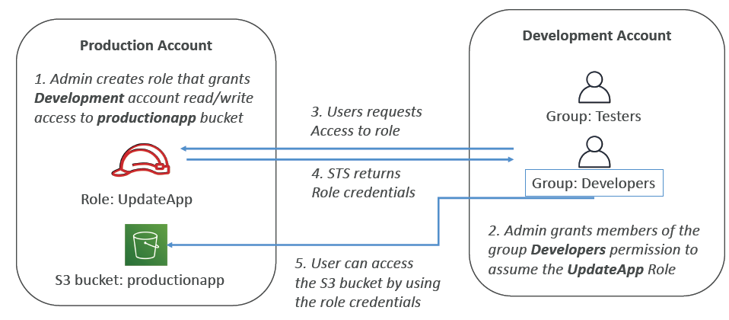
Cross account access with STS

Slide 19
Providing Access to AWS Accounts Owned byThird Parties
• Zone of trust = accounts, organizations that you own
• Outside Zone of Trust = 3rd parties
• Use IAM Access Analyzer to find out which resources are exposed
• For granting access to a 3rd party:
• The 3rd party AWS account ID
• An External ID (secret between you and the 3rd party)
• To uniquely associate with the role between you and 3rd party
• Must be provided when defining the trust and when assuming the role
• Must be chosen by the 3rd party
• Define permissions in the IAM policy

Slide 20
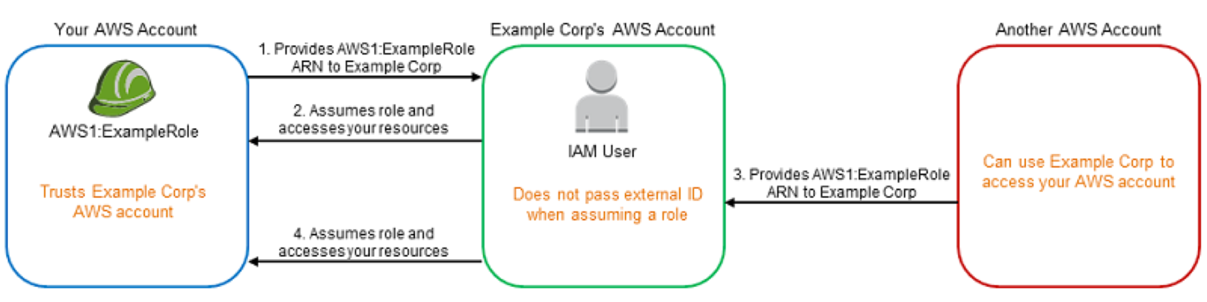
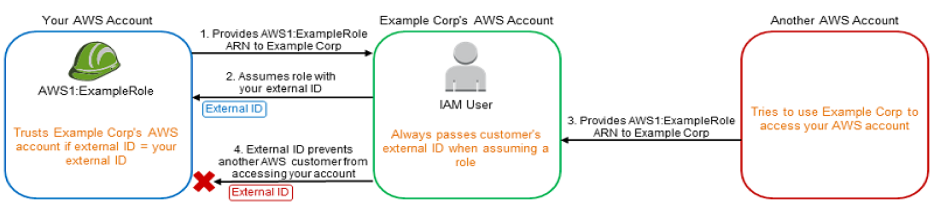
The confused deputy

Slide 21
STS Important APIs
• AssumeRole: access a role within your account or cross-account
• AssumeRoleWithSAML: return credentials for users logged with SAML
• AssumeRoleWithWebIdentity: return creds for users logged with an IdP
• Example providers include Amazon Cognito, Login with Amazon, Facebook,
Google, or any OpenID Connect-compatible identity provider
• AWS recommends using Cognito instead
• GetSessionToken: for MFA, from a user or AWS account root user
• GetFederationToken: obtain temporary creds for a federated user,
usually a proxy app that will give the creds to a distributed app inside a
corporate network

Slide 22
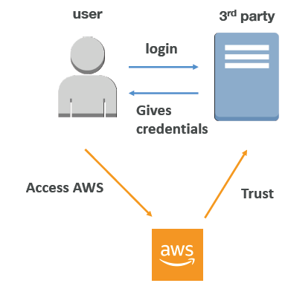
Identity Federation in AWS
• Federation lets users outside of AWS to assume
temporary role for accessing AWS resources.
• These users assume identity provided access role.
• Federations can have many flavors:
• SAML 2.0
• Custom Identity Broker
• Web Identity Federation with Amazon Cognito
• Web Identity Federation without Amazon Cognito
• Single Sign On
• Non-SAML with AWS Microsoft AD
• Using federation, you don’t need to create IAM users
(user management is outside of AWS)

Slide 23
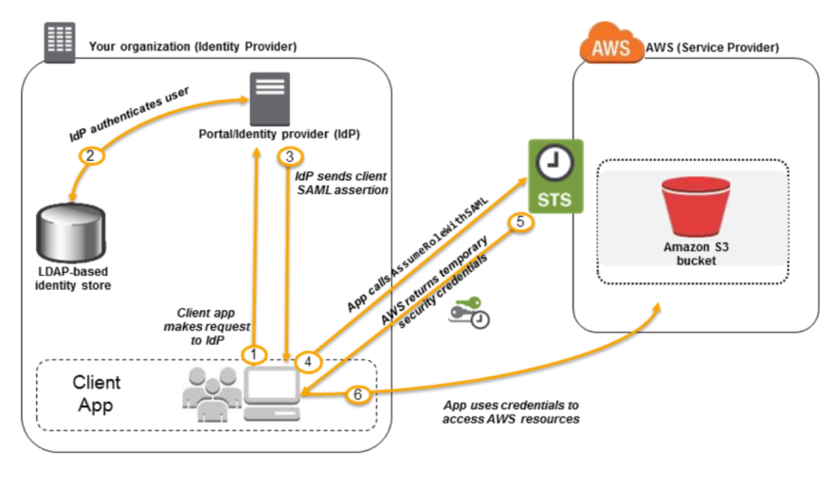
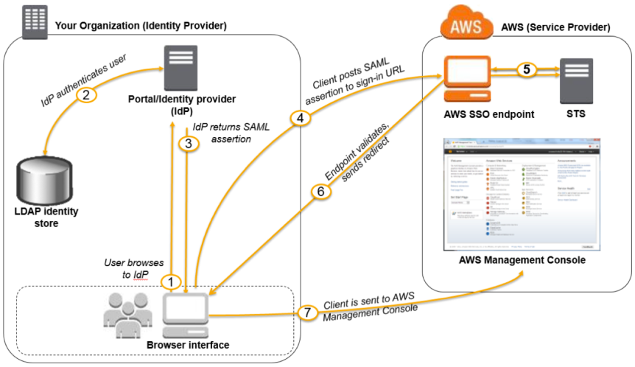
SAML 2.0 Federation
• To integrate Active Directory / ADFS with AWS (or any SAML 2.0)
• Provides access to AWS Console or CLI (through temporary creds)
• No need to create an IAM user for each of your employees
https://docs.aws.amazon.com/IAM/latest/UserGuide/id_roles_providers_saml.html

Slide 24
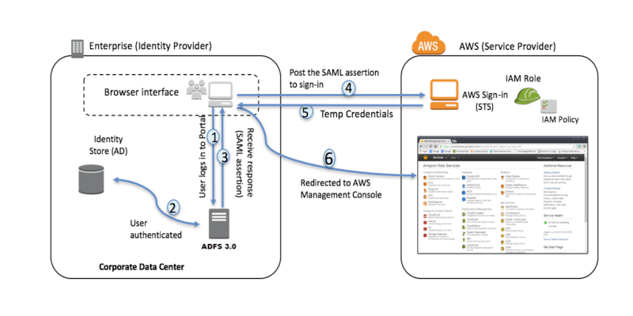
SAML 2.0 Federation – Active Directory FS
• Same process as with any SAML 2.0 compatible IdP

Slide 25
SAML 2.0 Federation
• Needs to setup a trust between AWS IAM and SAML (both ways)
• SAML 2.0 enables web-based, cross domain SSO
• Uses the STS API: AssumeRoleWithSAML
• Note federation through SAML is the “old way” of doing things
• Amazon Single Sign On (SSO) Federation is the new managed and
simpler way
• Read more here: https://aws.amazon.com/blogs/security/enabling-federation-toaws-
using-windows-active-directory-adfs-and-saml-2-0/

Slide 26
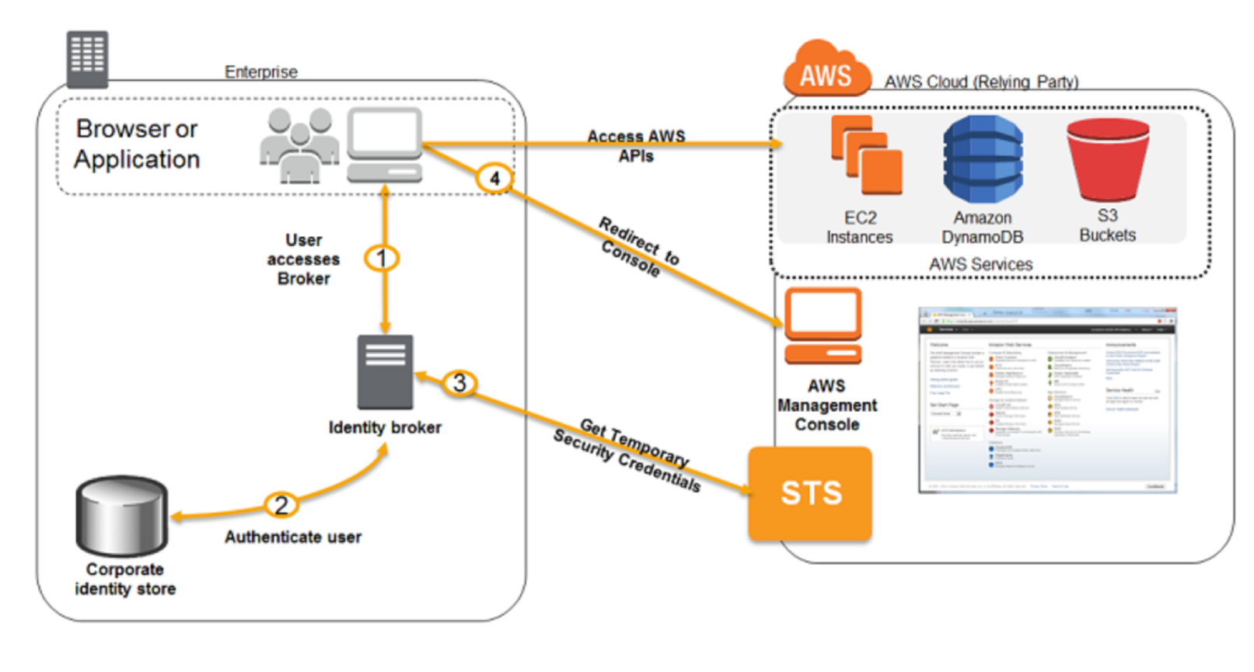
Custom Identity Broker Application
• Use only if identity provider is not compatible with SAML 2.0
• The identity broker must determine the appropriate IAM policy
• Uses the STS API: AssumeRole or GetFederationToken
https://docs.aws.amazon.com/IAM/latest/UserGuide/id_roles_
common-scenarios_federated-users.html

Slide 27
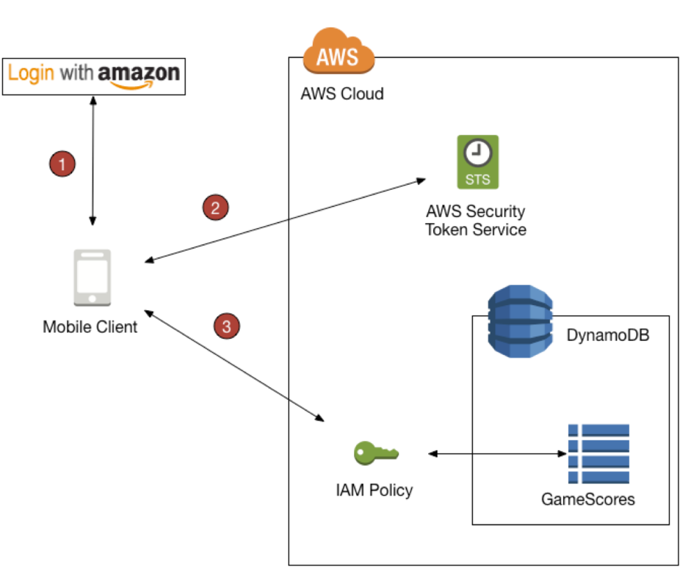
Web Identity Federation – AssumeRoleWithWebIdentity
• Not recommended by AWS –
use Cognito instead (allows for
anonymous users, data
synchronization, MFA)
https://docs.amazonaws.cn/en_us/amazondynamodb/latest/developerguide/WIF.html

Slide 28
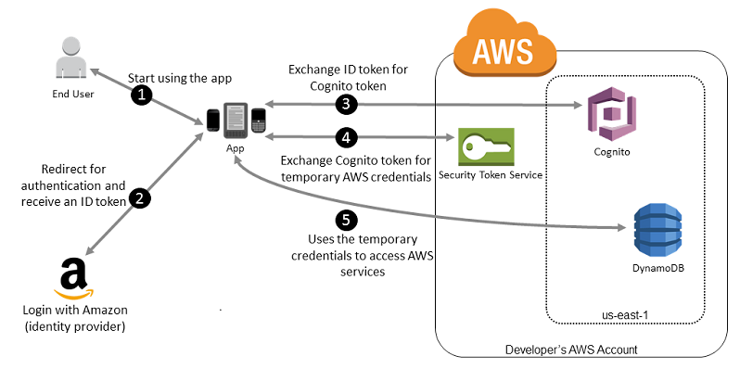
Web Identity Federation – AWS Cognito
• Preferred way for Web Identity
Federation
• Create IAM Roles using Cognito with
the least privilege needed
• Build trust between the OIDC IdP and
AWS
• Cognito benefits:
• Support for anonymous users
• Support for MFA
• Data synchronization
• Cognito replaces a Token Vending
Machine (TVM)
https://docs.aws.amazon.com/IAM/latest/UserGuide/id_roles_providers_oidc_cognito.html

Slide 29
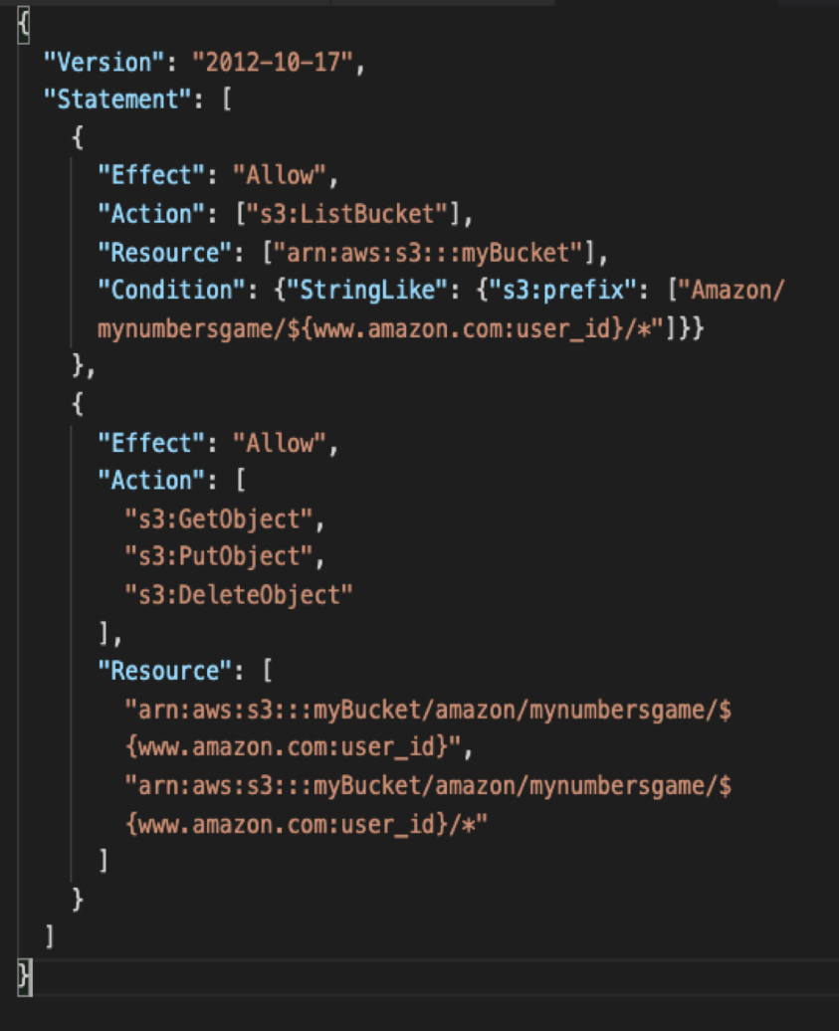
Web Identity Federation – IAM Policy
• After being authenticated
with Web Identity Federation,
you can identify the user with
an IAM policy variable.
• Examples:
• cognitoidentity.
amazonaws.com:sub
• www.amazon.com:user_id
• graph.facebook.com:id
• accounts.google.com:sub

Slide 30
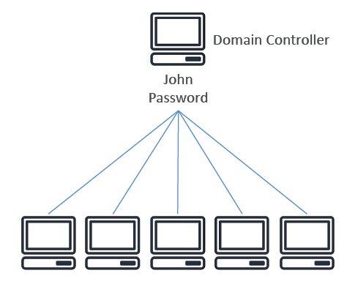
What is Microsoft Active Directory (AD)?
• Found on any Windows Server
with AD Domain Services
• Database of objects: User
Accounts, Computers, Printers,
File Shares, Security Groups
• Centralized security
management, create account,
assign permissions
• Objects are organized in trees
• A group of trees is a forest

Slide 31
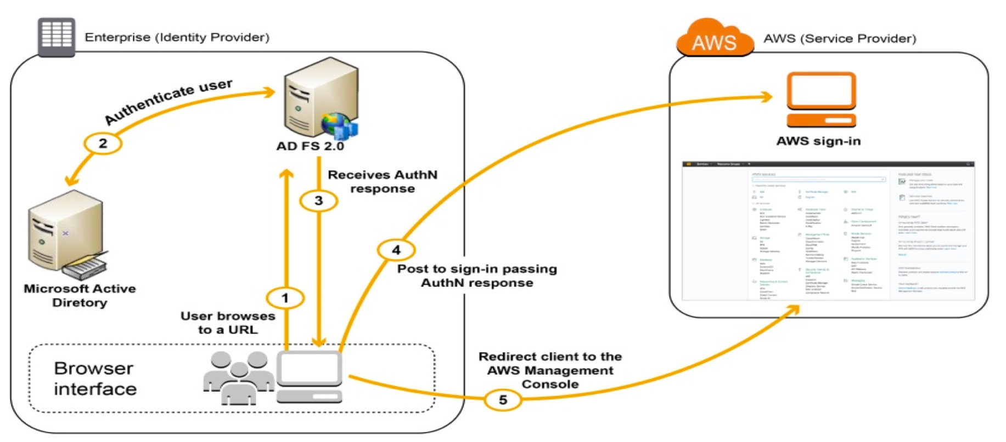
What is ADFS (AD Federation Services)?
• ADFS: provide single sign-on across applications
• SAML across 3rd party: AWS Console, Dropbox, Office365, etc…
https://aws.amazon.com/blogs/security/how-to-establish-federated-access-to-your-awsresources-
by-using-active-directory-user-attributes/

Slide 32
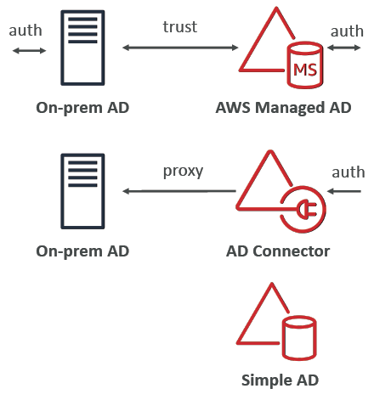
AWS Directory Services
• AWS Managed Microsoft AD
• Create your own AD in AWS, manage users
locally, supports MFA
• Establish “trust” connections with your onpremise
AD
• AD Connector
• Directory Gateway (proxy) to redirect to onpremise
AD
• Users are managed on the on-premise AD
• Simple AD
• AD-compatible managed directory on AWS
• Cannot be joined with on-premise AD

Slide 33
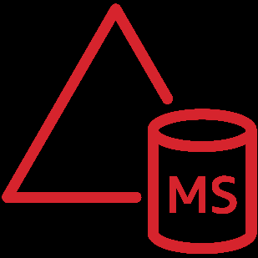
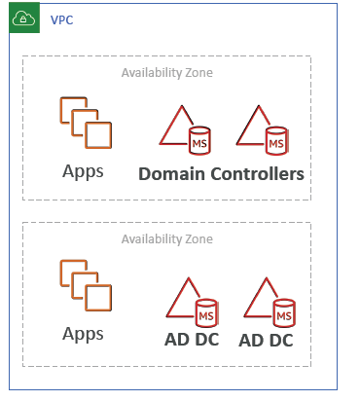
AWS Directory Services AWS Managed Microsoft AD
• Managed Service: Microsoft AD in your AWS VPC
• EC2 Windows Instances:
• EC2 Windows instances can join the domain and run
traditional AD applications (sharepoint, etc)
• Seamlessly Domain Join Amazon EC2 Instances from
Multiple Accounts & VPCs
• Integrations:
• RDS for SQL Server, AWS Workspaces, Quicksight…
• AWS SSO to provide access to 3rd party applications
• Standalone repository in AWS or joined to onpremise
AD
• Multi AZ deployment of AD in 2 AZ, # of DC
(Domain Controllers) can be increased for scaling
• Automated backups

Slide 34
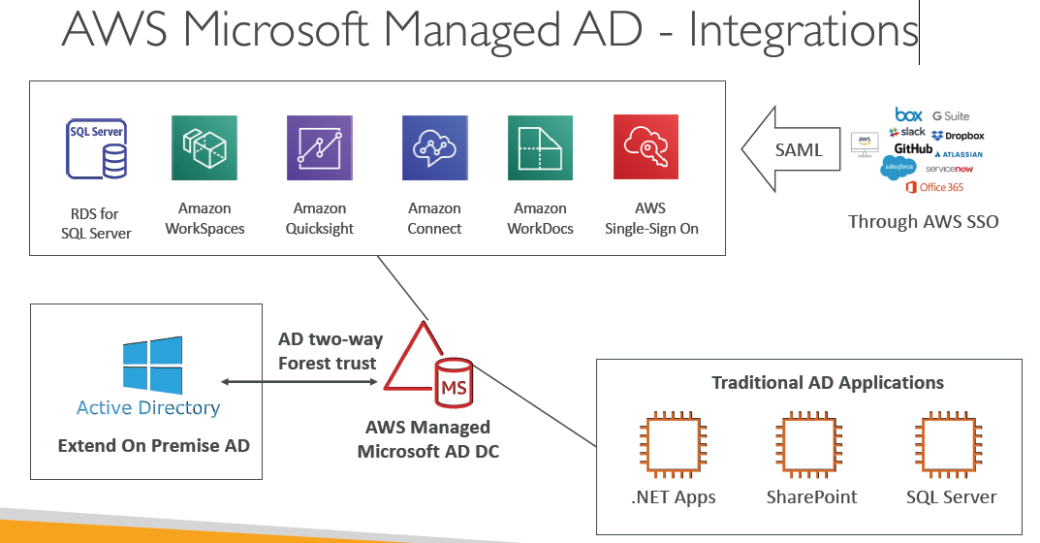
AWS Microsoft Managed AD - Integrations

Slide 35
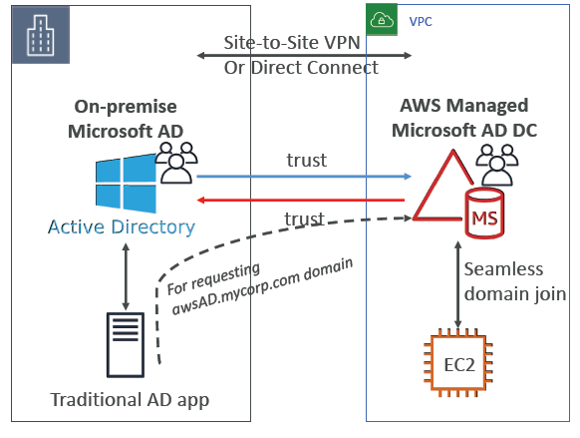
Connect to on- premise AD
• Ability to connect your on-premise
Active Directory to AWS Managed
Microsoft AD
• Must establish a Direct Connect
(DX) or VPN connection
• Can setup three kinds of forest
trust:
• One-way trust:
AWS => On-Premise
• One-way trust:
On-Premise => AWS
• Two-way forest trust:
AWS ó On-Premise
• Forest trust is different than
synchronization (replication is not
supported

Slide 36
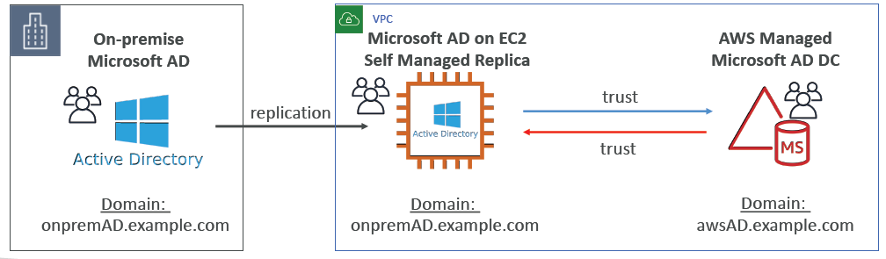
Solution Architecture: Active Directory Replication
• You may want to create a replica of your AD on EC2 in the cloud to minimize latency of in case DX or VPN goes down
• Establish trust between the AWS Managed Microsoft AD and EC2

Slide 37

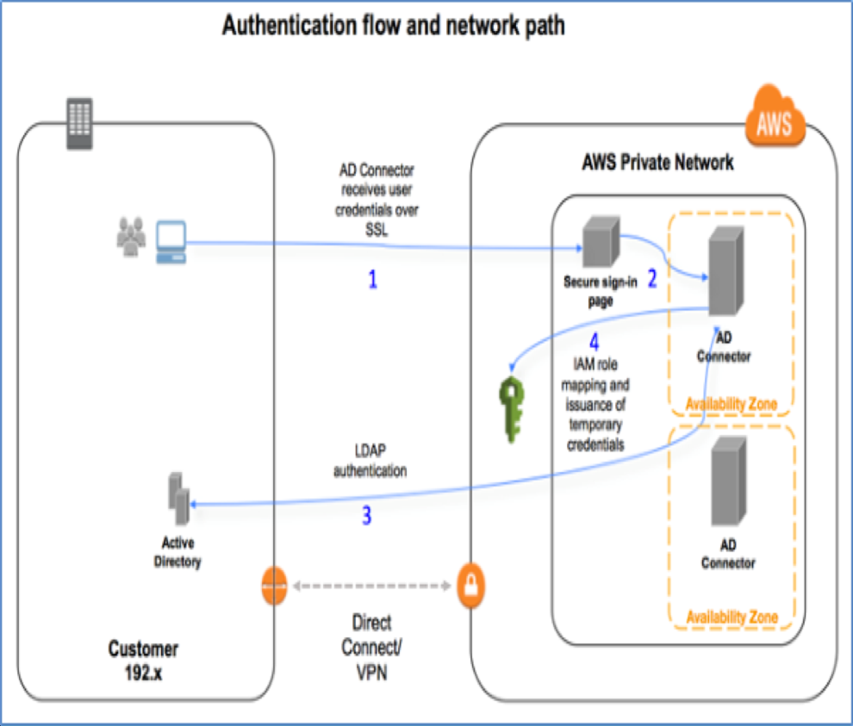
AWS Directory Services AD Connector
• AD Connector is a directory
gateway to redirect directory
requests to your on-premises
Microsoft Active Directory
• No caching capability
• Manage users solely on-premise, no
possibility of setting up a trust
• VPN or Direct Connect
• Doesn’t work with SQL Server,
doesn’t do seamless joining, can’t
share directory
https://aws.amazon.com/blogs/security/how-to-connect-your-on-premises-active-directory-toaws-
using-ad-connector/

Slide 38
AWS Directory Services Simple AD
• Simple AD is an inexpensive Active Directory–compatible service with
the common directory features.
• Supports joining EC2 instances, manage users and groups
• Does not support MFA, RDS SQL server, AWS SSO
• Small: 500 users, large: 5000 users
• Powered by Samba 4, compatible with Microsoft AD
• lower cost, low scale, basic AD compatible, or LDAP compatibility
• No trust relationship

Slide 39
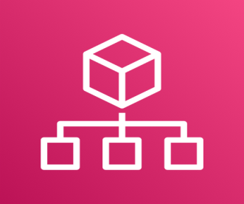
AWS Organizations
• Master accounts must invite Child Accounts
• Master accounts can create Child Accounts
• Master can access child accounts using:
• CloudFormation StackSets to create IAM roles in target accounts
• Assume the roles using the STS Cross Account capability
• Strategy to create a dedicated account for logging or security
• API is available to automate AWS account creation
• Integration with AWS Single Sign-On (SSO)

Slide 40
AWS Organizations - Features
Consolidated billing features:
• Consolidated Billing across all accounts - single payment method
• Pricing benefits from aggregated usage (volume discount for EC2, S3…)
All Features (Default):
• Includes consolidated billing features
• You can use SCP
• Invited accounts must approve enabling all features
• Ability to apply an SCP to prevent member accounts from leaving the org
• Can’t switch back to Consolidated Billing Features only

Slide 41
Multi Account Strategies
• Create accounts per department, per cost center, per dev / test /prod, based on regulatory restrictions (using SCP), for better resource isolation (ex: VPC), to have separate per-account service limits, isolated account for logging,
• Multi Account vs One Account Multi VPC
• Use tagging standards for billing purposes
• Enable CloudTrail on all accounts, send logs to central S3 account
• Send CloudWatch Logs to central logging account
• Establish Cross Account Roles for Admin purposes

Slide 42
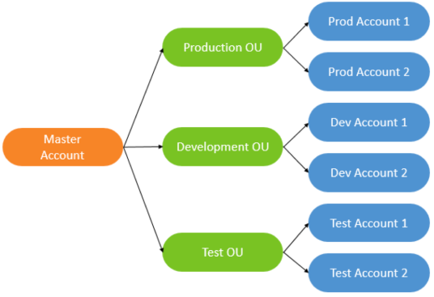
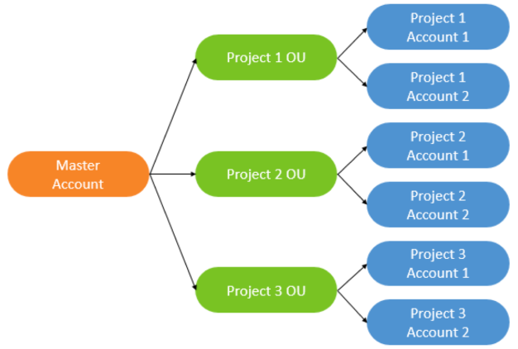
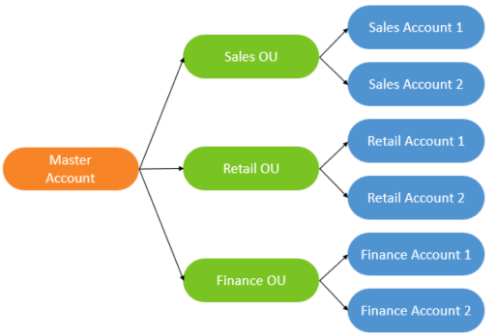
Organizational Units (OU) – Examples
Business Unit
Environmental Lifecycle
Project-based
https://aws.amazon.com/answers/account management/awsmulti-
account-billing-strategy/

Slide 43
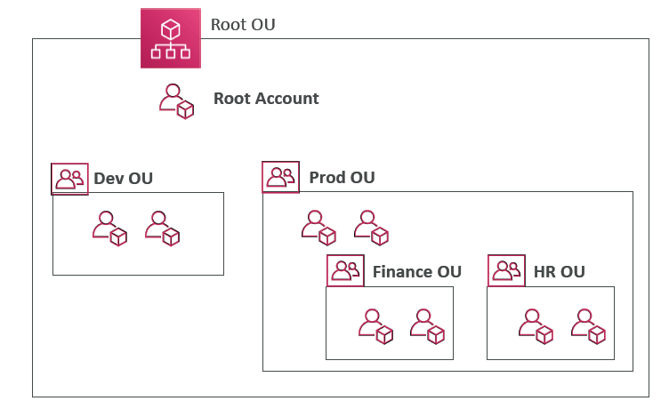
AWS Organization

Slide 44
Service Control Policies (SCP)
• Whitelist or blacklist IAM actions
• Applied at the Root, OU or Account level
• SCP is applied to all the Users and Roles of the Account, including Root
• The SCP does not affect service-linked roles
• Service-linked roles enable other AWS services to integrate with AWS Organizations
and can't be restricted by SCPs.
• SCP must have an explicit Allow (does not allow anything by default)
• Use cases:
• Restrict access to certain services (for example: can’t use EMR)
• Enforce PCI compliance by explicitly disabling services

Slide 45
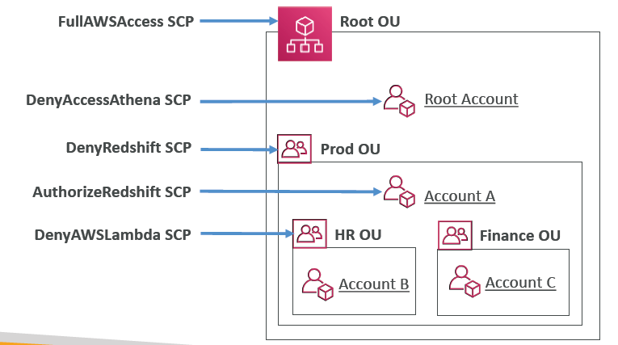
SCP Hierarchy
• Root Account
• Can do anything
• EXCEPT access Athena
• Account A
• Can do anything
• EXCEPT access Redshift
(explicit Deny from OU)
• Account B
• Can do anything
• EXCEPT access Redshift
(explicit Deny from Prod OU)
• EXCEPT access Lambda
(explicit Deny from HR OU)
• Account C
• Can do anything
• EXCEPT access Redshift
(explicit Deny from Prod OU)

Slide 46
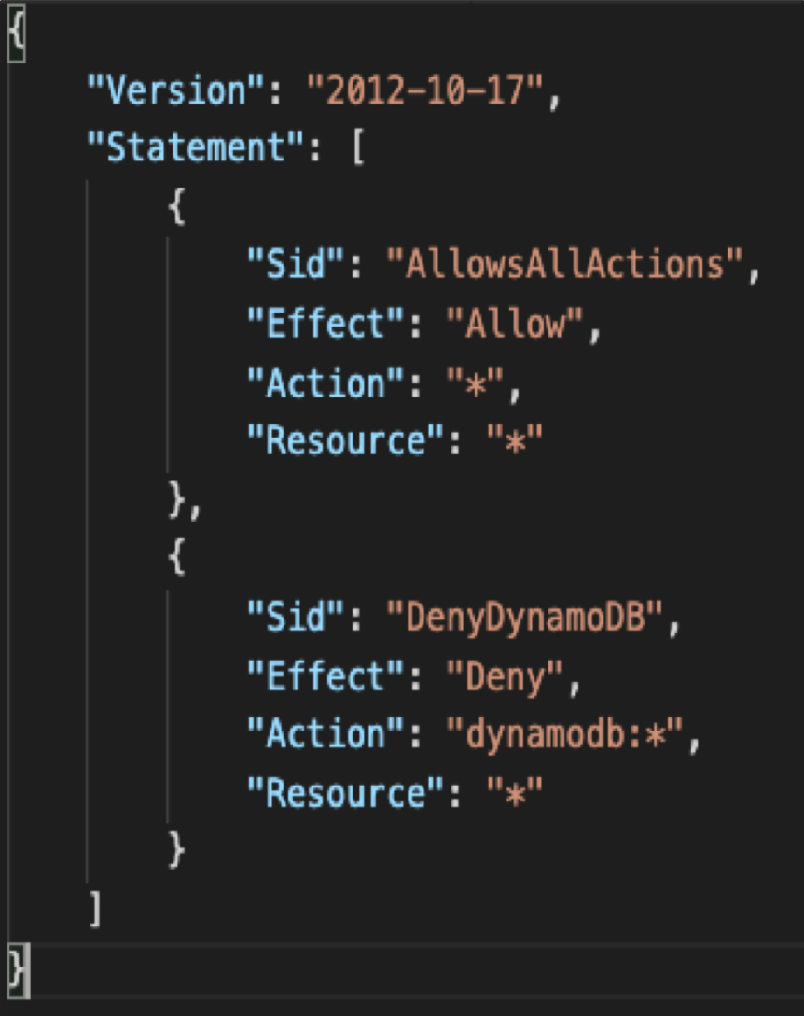
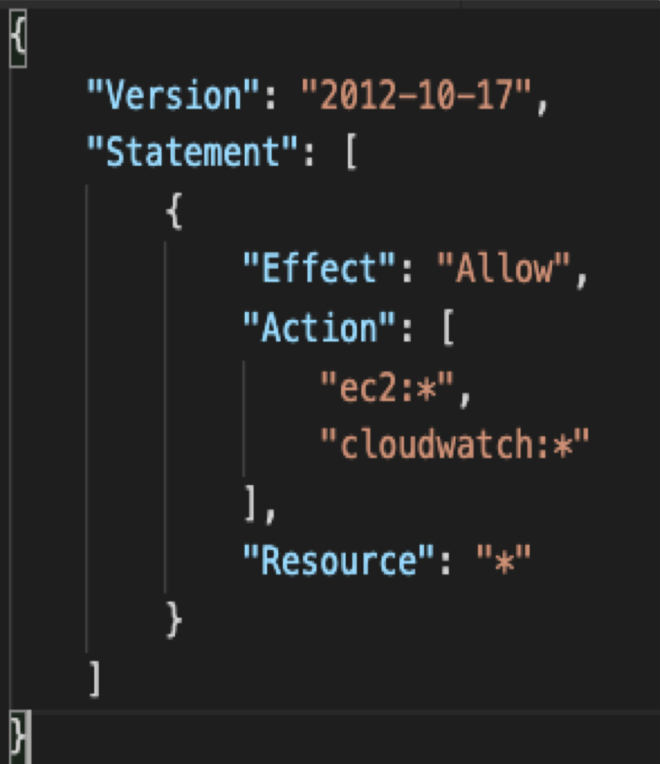
SCP Examples Blacklist and Whitelist strategies

Slide 47
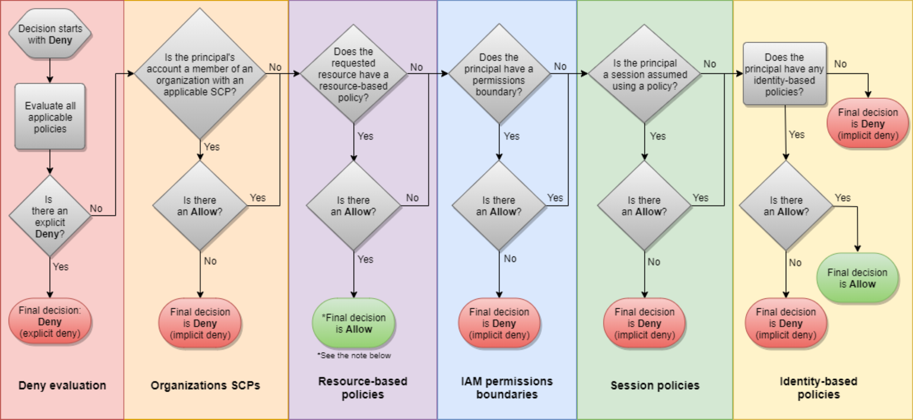
IAM Policy Evaluation Logic

Slide 48
AWS Organizations – Reserved Instances
• For billing purposes, the consolidated billing feature of AWS Organizations treats all the accounts in the organization as one account.
• This means that all accounts in the organization can receive the hourly cost benefit of Reserved Instances that are purchased by any other account.
• The payer account (master account) of an organization can turn off Reserved Instance (RI) discount and Savings Plans discount sharing for any accounts in
that organization, including the payer account
• This means that RIs and Savings Plans discounts aren't shared between any
accounts that have sharing turned off.
• To share an RI or Savings Plans discount with an account, both accounts must have sharing turned on.

Slide 49
AWS Resource Access Manager (RAM)
• Share AWS resources that you own with other AWS accounts
• Share with any account or within your Organization
• Avoid resource duplication!
• VPC Subnets:
• allow to have all the resources launched in the same subnets
• must be from the same AWS Organizations.
• Cannot share security groups and default VPC
• Participants can manage their own resources in there
• Participants can't view, modify, delete resources that belong to other participants or the owner
• AWS Transit Gateway
• Route53 Resolver Rules
• License Manager Configurations

Slide 50
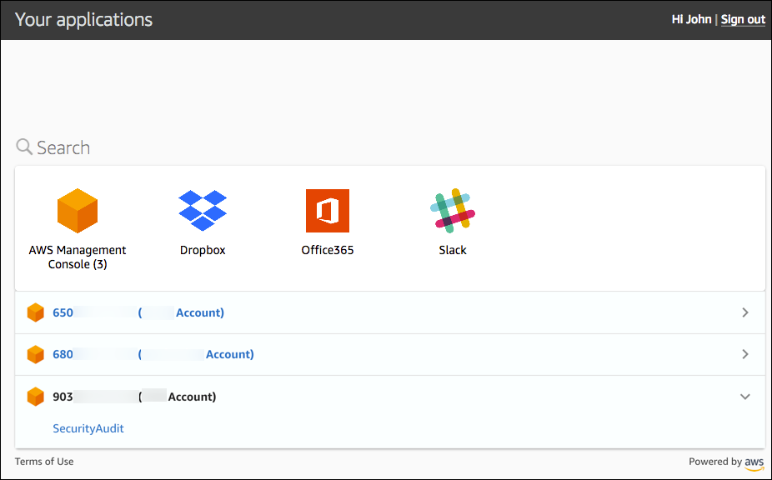
AWS Single Sign-On (SSO)
• Centrally manage Single Sign-On
to access multiple accounts and
3rd-party business applications.
• Integrated with AWS
Organizations
• Supports SAML 2.0 markup
• Integration with on-premise
Active Directory
• Centralized permission
management
• Centralized auditing with
CloudTrail
https://aws.amazon.com/blogs/security/introducing-aws-single-sign-on/

Slide 51
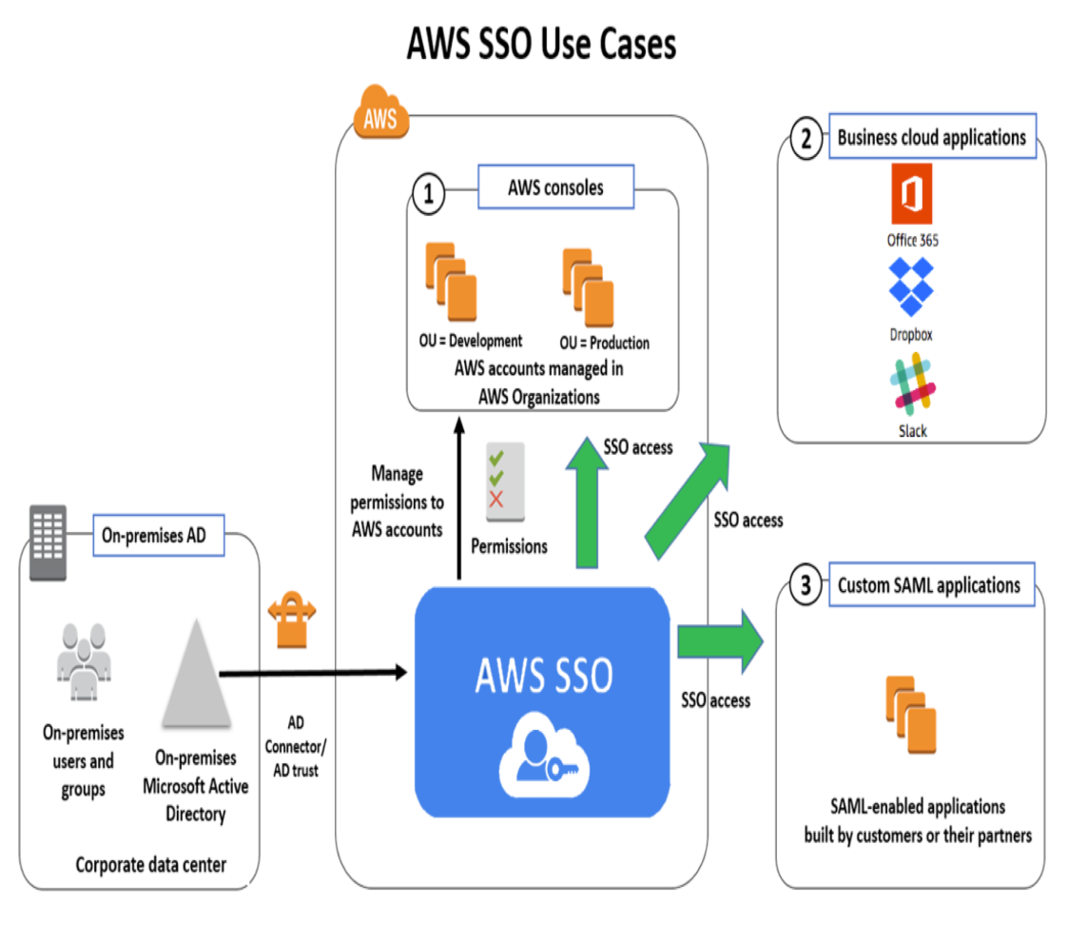
AWS Single Sign-On (SSO) – Setup with AD
Options for integration
1. Standalone AWS
Managed Microsoft
AD
2. AD Connector to
on-premise AD
3. AWS Managed
Microsoft AD with
two-way forest trust
with on-premise AD

Slide 52
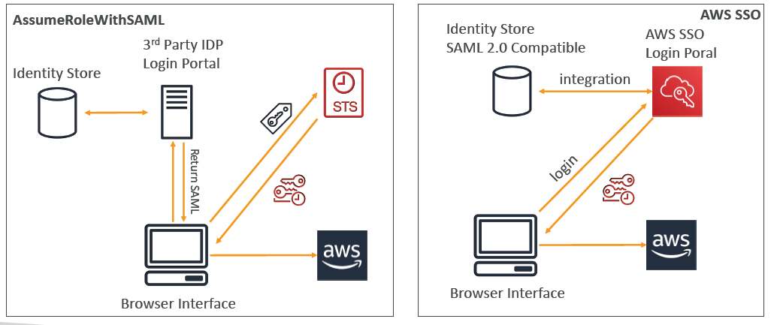
SSO – vs AssumeRoleWithSAML

Slide 53
Summary of Identity & Federation
• Users and Accounts all in AWS
• AWS Organizations
• Federation with SAML
• Federation without SAML with a custom IdP (GetFederationToken)
• Federation with SSO for multiple accounts with AWS Organizations
• Web Identity Federation (not recommended)
• Cognito for most web and mobile applications (has anonymous mode, MFA)
• Active Directory on AWS:
• Microsoft AD: standalone or setup trust AD with on-premise, has MFA, seamless join, RDS integration
• AD Connector: proxy requests to on-premise
• Simple AD: standalone & cheap AD-compatible with no MFA, no advanced capabilities
• Single Sign On to connect to multiple AWS Accounts (Organization) and SAML apps

Slide 54
Security

Slide 55
AWS CloudTrail
• Provides governance, compliance and audit for your AWS Account
• CloudTrail is enabled by default!
• Get an history of events / API calls made within your AWS Account by:
• Console
• SDK
• CLI
• AWS Services
• Can put logs from CloudTrail into CloudWatch Logs
• If a resource is deleted in AWS, look into CloudTrail first!

Slide 56
CloudTrail continued…
• CloudTrail console shows the past 90 days of activity
• The default UI only shows “Create”, “Modify” or “Delete” events
CloudTrail Trail:
• Get a detailed list of all the events you choose
• Can include events happening at the object level in S3
• Ability to store these events in S3 for further analysis
• Can be region specific or be global & include global events (IAM, etc)

Slide 57
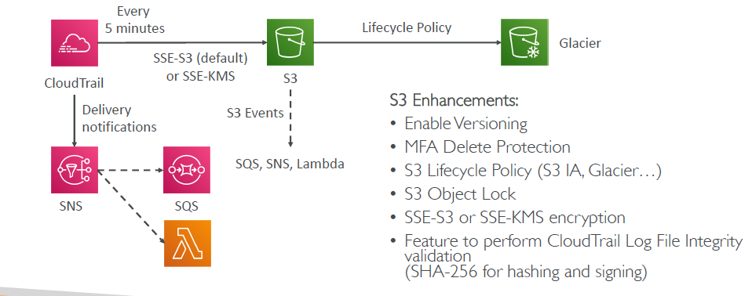
CloudTrail – Solution Architecture: Delivery to S3

Slide 58
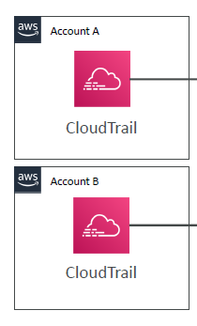
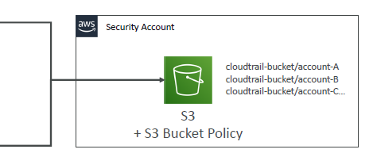
CloudTrail - Solution Architecture: Multi Account, Multi Region Logging
Observations:
• The S3 bucket policy is necessary for cross-account delivery
• If Account A wants to access its CloudTrail files:
• Option 1: create a cross-account role and assume the role
• Option 2: edit the bucket policy

Slide 59

CloudTrail - Solution Architecture: Alert for API calls
CloudTrail
CW Logs
Metric Filters
CW Alarm
SNS
• Log filter metrics can be used to detect a high level of API happening
• Ex: Count occurrences of EC2 TerminateInstances API
• Ex: Count of API calls per user
• Ex: Detect high level of Denied API calls

Slide 60
CloudTrail: How to react to events the fastest?
Overall, CloudTrail may take up to 15 minutes to deliver events
CloudWatch Events:
• Can be triggered for any API call in CloudTrail
• The fastest, most reactive way
CloudTrail Delivery in CloudWatch Logs:
• Events are streamed
• Can perform a metric filter to analyze occurrences and detect anomalies
CloudTrail Delivery in S3:
• Events are delivered every 5 minutes
• Possibility of analyzing logs integrity, deliver cross account, long-term storage

Slide 61

AWS KMS (Key Management Service)
• Anytime you hear “encryption” for an AWS service, it’s most likely KMS
• Easy way to control access to your data, AWS manages keys for us
• Fully integrated with IAM for authorization
• Seamlessly integrated into:
• Amazon EBS: encrypt volumes
• Amazon S3: Server side encryption of objects
• Amazon Redshift: encryption of data
• Amazon RDS: encryption of data
• Amazon SSM: Parameter store
• Etc…
• But you can also use the CLI / SDK

Slide 62
AWS KMS 101
• The value in KMS is that the CMK used to encrypt data can never be retrieved by the user, and the CMK can be rotated for extra security
• Never ever store your secrets in plaintext, especially in your code!
• Encrypted secrets can be stored in the code / environment variables
• KMS can only help in encrypting up to 4KB of data per call
• If data > 4 KB, use Envelope Encryption
• To give access to KMS to someone:
• Make sure the Key Policy allows the user
• Make sure the IAM Policy allows the API calls
• Track API calls made to KMS in CloudTrail

Slide 63
Types of KMS Keys
• Customer Manager CMK:
• Create, manage and use, can enable or disable
• Possibility of rotation policy (new key generated every year, old key preserved)
• Can add a key policy (resource policy)
• Leverage for envelope encryption
• AWS managed CMK:
• Used by AWS service (aws/s3, aws/ebs, aws/redshift)
• Managed by AWS

Slide 64
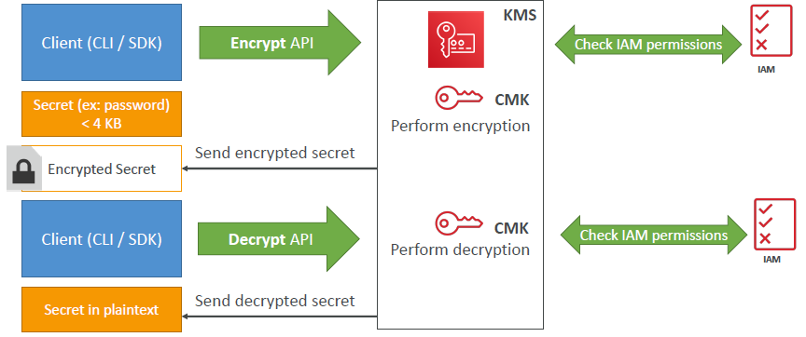
How does KMS work? API – Encrypt and Decrypt

Slide 65
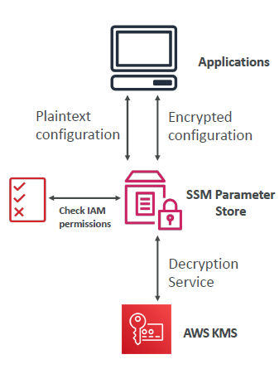
AWS Parameter Store
• Secure storage for configuration and secrets
• Optional Seamless Encryption using KMS
• Serverless, scalable, durable, easy SDK, free
• Version tracking of configurations / secrets
• Configuration management using path & IAM
• Notifications with CloudWatch Events
• Integration with CloudFormation
• Can retrieve secrets from Secrets Manager using
the SSM Parameter Store API

Slide 66
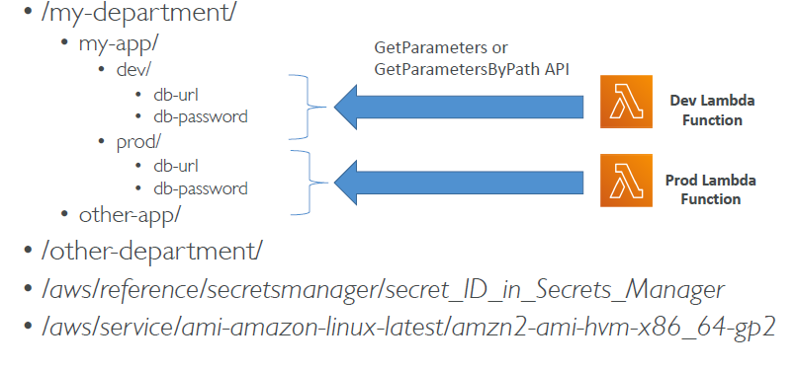
AWS Parameter Store Hierarchy

Slide 67

AWS Secrets Manager
• Newer service, meant for storing secrets
• Capability to force rotation of secrets every X days
• Automate generation of secrets on rotation (uses Lambda)
• Integration with Amazon RDS (MySQL, PostgreSQL, Aurora)
• Secrets are encrypted using KMS
• Mostly meant for RDS integration

Slide 68
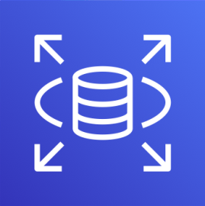
RDS - Security
• KMS encryption at rest for underlying EBS volumes / snapshots
• Transparent Data Encryption (TDE) for Oracle and SQL Server
• SSL encryption to RDS is possible for all DB (in-flight)
• IAM authentication for MySQL and PostgreSQL
• Authorization still happens within RDS (not in IAM)
• Can copy an un-encrypted RDS snapshot into an encrypted one
• CloudTrail cannot be used to track queries made within RDS

Slide 69
SSL/TLS - Basics
• SSL refers to Secure Sockets Layer, used to encrypt connections
• TLS refers to Transport Layer Security, which is a newer version
• Nowadays, TLS certificates are mainly used, but people still refer as SSL
• Public SSL certificates are issued by Certificate Authorities (CA)
• Comodo, Symantec, GoDaddy, GlobalSign, Digicert, Letsencrypt, etc…
• SSL certificates have an expiration date (you set) and must be renewed

Slide 70
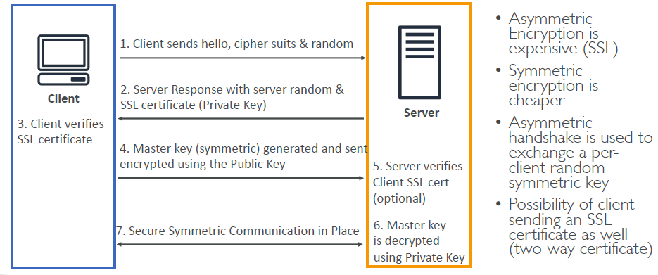
SSL Encryp8tion – How it works

Slide 71





SSL – Server Name Indication (SNI)
• SNI solves the problem of loading multiple SSL certificates onto one web server (to serve multiple websites)
• It’s a “newer” protocol, and requires the client to indicate the hostname of the target server in the initial SSL handshake
• The server will then find the correct certificate, or return the default one
Note:
• Only works for ALB & NLB (newer generation), CloudFront
• Does not work for CLB (older gen)
Target group for
www.mycorp.com
I would like
www.mycorp.com
Client
Target group for
Domain1.example.com
ALB
SSL Cert:
Domain1.example.com
Use the correct
SSL cert
SSL Cert:
www.mycorp.com

Slide 72
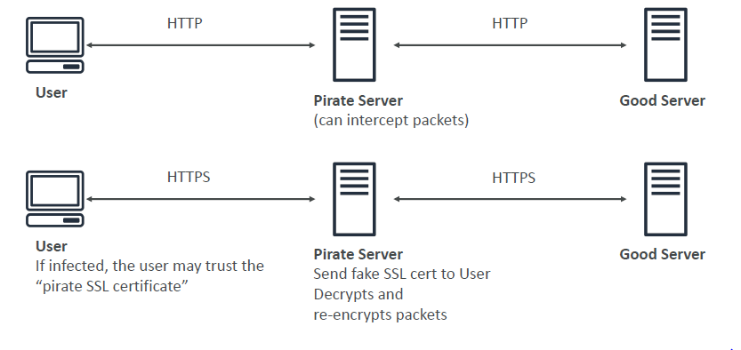
SSL – Man in the Middle Attacks

Slide 73
SSL – Man in the Middle Attack How to prevent
1. Don’t use public-facing HTTP, use HTTPS (meaning, use SSL/TLS certicates)
2. Use a DNS that has DNSSEC
• To end send a client to a pirate server, a DNS response needs to be “forged” by a server which intercepts them
• It is possible to protect your domain name by configuring DNSSEC
• Amazon Route 53 supports DNSSEC for domain registration. However, Route 53 does not support DNSSEC for DNS service, regardless of whether the domain is registered with Route 53. If you want to configure DNSSEC for a domain that is registered with Route 53, you must use another DNS service provider.
• You could run a custom DNS server on Amazon EC2 for example (Bind is the most popular, dnsmasq, KnotDNS, PowerDNS).

Slide 74
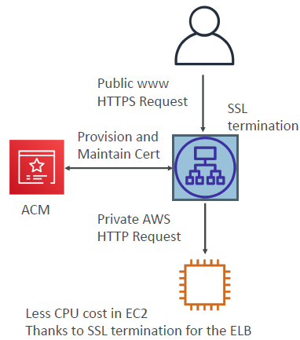
AWS Certificate Manager (ACM)
• To host public SSL certificates in AWS, you can:
• Buy your own and upload them using the CLI
• Have ACM provision and renew public SSL
certificates for you (free of cost)
• ACM loads SSL certificates on the following integrations:
• Load Balancers (including the ones created by EB)
• CloudFront distributions
• APIs on API Gateways
• SSL certificates is overall a pain to manually manage, so ACM is great to leverage in your AWS infrastructure

Slide 75
ACM – Good to know
• Possibility of creating public certificates
• Must verify public DNS
• Must be issued by a trusted public certificate authority (CA)
• Possibility of creating private certificates
• For your internal applications
• You create your own private CA
• Your applications must trust your private CA
• Certificate renewal:
• Automatically done if generated provisioned by ACM
• Any manually uploaded certificates must be renewed manually and re-uploaded
• ACM is a regional service
• To use with a global application (multiple ALB for example), you need to issue an SSL certificate in each region where you application is deployed.
• You cannot copy certs across regions

Slide 76

CloudHSM
• KMS => AWS manages the software for encryption
• CloudHSM => AWS provisions encryption hardware
• Dedicated Hardware (HSM = Hardware Security Module)
• You manage your own encryption keys entirely (not AWS)
• HSM device is tamper resistant, FIPS 140-2 Level 3 compliance
• Supports both symmetric and asymmetric encryption (SSL/TLS keys)
• No free tier available
• Must use the CloudHSM Client Software
• Redshift supports CloudHSM for database encryption and key management
• Good option to use with SSE-C encryption

Slide 77
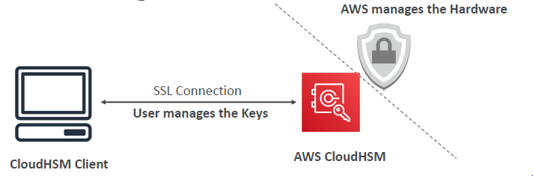
CloudHSM Diagram
IAM permissions:
• CRUD an HSM Cluster
CloudHSM Software:
• Manage the Keys
• Manage the Users

Slide 78


CloudHSM – High Availability
• CloudHSM clusters are spread across Multi AZ (HA)
• Great for availability and durability
Availability Zone 1
CloudHSM 1
CloudHSM Client
Availability Zone 2
CloudHSM 2

Slide 79
CloudHSM vs KMS
Feature | AWS KMS | AWS CloudHSM
Tenancy | Uses multi-tenant key storage | Single tenant key storage, dedicated to one customer
Keys | Keys owned and managed by AWS | Customer managed Keys
Encryption | Supports only symmetric key encryption | Supports both symmetric and asymmetric encryption
Cryptographic Acceleration | none | SSL/TLS Acceleration Oracle TDE Acceleration
Key Storage and Management | Accessible from multiple regions Centralized management from IAM | Deployed and managed from a customer VPC. Accessible and can be shared across VPCs using VPC peering
Free Tier Availability | Yes | No

Slide 80
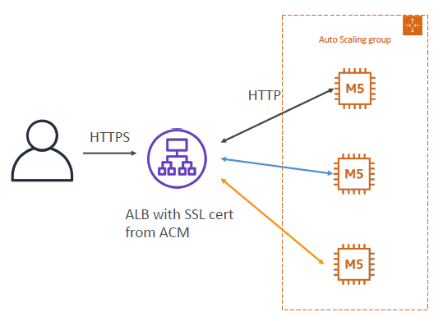
Solution Architecture: SSL on ALB

Slide 81
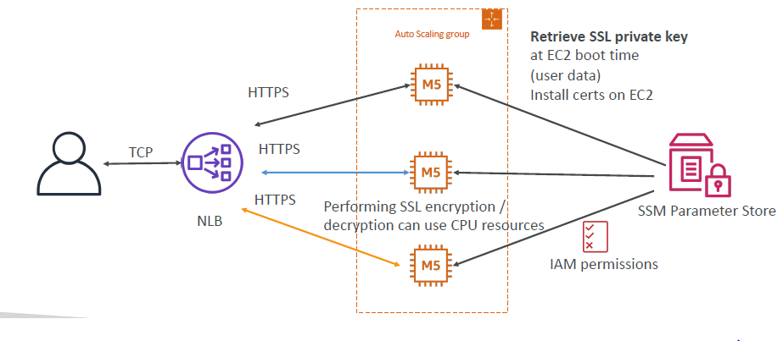
Solution Architecture: SSL on web server EC2 instances

Slide 82
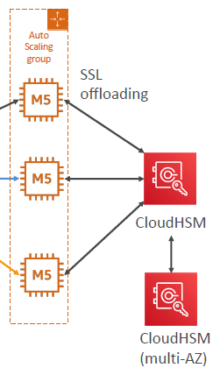
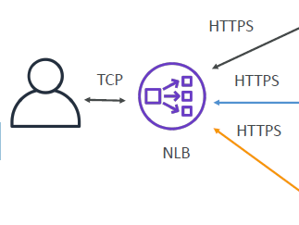
Solution Architecture: CloudHSM – SSL Offloading
• You can offload SSL to
CloudHSM (SSL
Acceleration)
• Supported by NGINX &
Apache Web servers
• Extra security: the SSL
private key never leaves the HSM device
• Must setup a cryptographic user (CU) on the CloudHSM device

Slide 83
S3 Encryption for Objects
• There are 4 methods of encrypting objects in S3
• SSE-S3: encrypts S3 objects using keys handled & managed by AWS
• SSE-KMS: leverage AWS Key Management Service to manage encryption keys
• SSE-C: when you want to manage your own encryption keys
• Client Side Encryption
• Glacier: all data is AES-256 encrypted, key under AWS control

Slide 84
Encryption in transit (SSL)
• AWS S3 exposes:
• HTTP endpoint: non encrypted
• HTTPS endpoint: encryption in flight
• You’re free to use the endpoint you want, but HTTPS is recommended
• HTTPS is mandatory for SSE-C
• Encryption in flight is also called SSL / TLS

Slide 85
Events in S3 Buckets
• S3 Access Logs:
• Detailed records for the requests that are made to a bucket
• Might take hours to deliver
• Might be incomplete (best effort)
• S3 Events Notifications:
• Receive notifications when certain events happen in your bucket
• E.g.: new objects created, object removal, restore objects, replication events
• Destinations: SNS, SQS queue, Lambda
• Typically delivered in seconds but can take minutes, notification for every object if versioning is enabled, else risk of one notification for two same object write done simultaneously
• Trusted Advisor:
• Check the bucket permission (is the bucket public?)
• CloudWatch Events:
• Need to enable CloudTrail object level logging on S3 first
• Target can be Lambda, SQS, SNS, etc…

Slide 86
S3 Security
• User based
• IAM policies - which API calls should be allowed for a specific user from IAM console
• Resource Based
• Bucket Policies - bucket wide rules from the S3 console - allows cross account
• Object Access Control List (ACL) – finer grain
• Bucket Access Control List (ACL) – less common

Slide 87
S3 Bucket Policies
• Use S3 bucket for policy to:
• Grant public access to the bucket
• Force objects to be encrypted at upload
• Grant access to another account (Cross Account)
• Optional Conditions on:
• Public IP or Elastic IP (not on Private IP)
• Source VPC or Source VPC Endpoint – only works with VPC Endpoints
• CloudFront Origin Identity
• MFA
• Examples here: https://docs.aws.amazon.com/AmazonS3/latest/dev/examplebucket-policies.html

Slide 88
S3 pre-signed URLs
• Can generate pre-signed URLs using SDK or CLI
• For downloads (easy, can use the CLI)
• For uploads (harder, must use the SDK)
• Valid for a default of 3600 seconds, can change timeout with --expires-in
[TIME_BY_SECONDS] argument
• Users given a pre-signed URL inherit the permissions of the person who
generated the URL for GET / PUT
• Examples :
• Allow only logged-in users to download a premium video on your S3 bucket
• Allow an ever changing list of users to download files by generating URLs dynamically
• Allow temporarily a user to upload a file to a precise location in our bucket

Slide 89
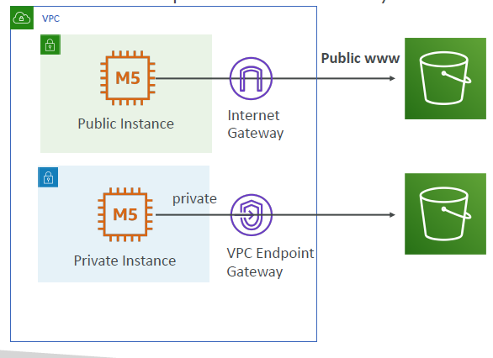
VPC Endpoint Gateway for S3
S3 Bucket
Bucket policy by AWS:SourceIP (public IP)
S3 Bucket
Bucket policy by
AWS:SourceVpce
(one or few endpoints)
OR
AWS:SourceVpc
(encompass all possible VPC endpoints)

Slide 90

S3 Object Lock & Glacier Vault Lock
• S3 Object Lock
• Adopt a WORM (Write Once Read
Many) model
• Block an object version deletion for a
specified amount of time
• Glacier Vault Lock
• Adopt a WORM (Write Once Read
Many) model
• Lock the policy for future edits (can no
longer be changed)
• Helpful for compliance and data retention

Slide 91

Network Security
• Security Groups
• Attached to ENI (Elastic Network Interfaces) – EC2,
RDS, Lambda in VPC, etc
• Are stateful (any traffic in is allowed to go out, any traffic
out can go back in)
• Can reference by CIDR and security group id
• Supports security group references for VPC peering
• Default: inbound denied, outbound all allowed
• NACL (Network ACL):
• Attached at the subnet level
• Are stateless (inbound and outbound rules apply for all
traffic)
• Can only reference a CIDR range (no hostname)
• Default: denies all inbound, denies all outbound
• Host Firewall
• Software based, highly customizable

Slide 92



What’s a DDOS* Attack? *Distributed Denial-of-Service

Slide 93
Type of Attacks on your infrastructure
• Distributed Denial of Service (DDoS):
• When your service is unavailable because it’s receiving too many requests
• SYN Flood (Layer 4): send too many TCP connection requests
• UDP Reflection (Layer 4): get other servers to send many big UDP requests
• DNS flood attack: overwhelm the DNS so legitimate users can’t find the site
• Slow Loris attack: a lot of HTTP connections are opened and maintained
• Application level attacks:
• more complex, more specific (HTTP level)
• Cache bursting strategies: overload the backend database by invalidating cache

Slide 94
DDoS Protection on AWS
• AWS Shield Standard: protects against DDoS attack for your website and applications, for all customers at no additional costs
• AWS Shield Advanced: 24/7 premium DDoS protection
• AWS WAF: Filter specific requests based on rules
• CloudFront and Route 53:
• Availability protection using global edge network
• Combined with AWS Shield, provides DDoS attack mitigation at the edge
• Be ready to scale – leverage AWS Auto Scaling
• Separate static resources (S3 / CloudFront) from dynamic ones (EC2 / ALB)
• Read the whitepaper for details:
https://d1.awsstatic.com/whitepapers/Security/DDoS_White_Paper.pdf

Slide 95

Sample Reference Architecture
https://aws.amazon.com/answers/networking/aws-ddos-attack-mitigation/

Slide 96
AWS Shield
• AWS Shield Standard:
• Free service that is activated for every AWS customer
• Provides protection from attacks such as SYN/UDP Floods, Reflection attacks and other layer 3/layer 4 attacks
• AWS Shield Advanced:
• Optional DDoS mitigation service ($3,000 per month per organization)
• Protect against more sophisticated attack on Amazon EC2, Elastic Load Balancing (ELB), Amazon CloudFront, AWS Global Accelerator, and Route 53
• 24/7 access to AWS DDoS response team (DRP)
• Protect against higher fees during usage spikes due to DDoS

Slide 97

AWS WAF – Web Application Firewall
• Protects your web applications from common web exploits (Layer 7)
• Deploy on Application Load Balancer (localized rules)
• Deploy on API Gateway (rules running at the regional or edge level)
• Deploy on CloudFront (rules globally on edge locations)
• Used to front other solutions: CLB, EC2 instances, custom origins, S3 websites)
• WAF is not for DDoS protection
• Define Web ACL (Web Access Control List):
• Rules can include: IP addresses, HTTP headers, HTTP body, or URI strings
• Protects from common attack - SQL injection and Cross-Site Scripting (XSS)
• Size constraints, Geo match
• Rate-based rules (to count occurrences of events)

Slide 98

AWS Firewall Manager
• Manage rules in all accounts of an AWS Organization
• Common set of security rules
• WAF rules (Application Load Balancer, API Gateways, CloudFront)
• AWS Shield Advanced (ALB, CLB, Elastic IP, CloudFront)
• Security Groups for EC2 and ENI resources in VPC

Slide 99

Blocking an IP address

Slide 100

Blocking an IP address – with an ALB

Slide 101

Blocking an IP address – with an NLB

Slide 102

Blocking an IP address – ALB + WAF

Slide 103

Blocking an IP address – ALB, CloudFront WAF

Slide 104
AWS Inspector
• Only for EC2 instances (started from an AMI)
• Analyze the running OS against known vulnerabilities
• Analyze against unintended network accessibility
• AWS Inspector Agent must be installed on OS in EC2 instances
• Define template (rules package, duration, attributes, SNS topics)
• No own custom rules possible – only use AWS managed rules
• After the assessment, you get a report with a list of vulnerabilities

Slide 105
AWS Config
• Helps with auditing and recording compliance of your AWS resources
• Helps record configurations and changes over time
• AWS Config Rules does not prevent actions from happening (no deny)
• Questions that can be solved by AWS Config:
• Is there unrestricted SSH access to my security groups?
• Do my buckets have any public access?
• How has my ALB configuration changed over time?
• You can receive alerts (SNS notifications) for any changes
• AWS Config is a per-region service
• Can be aggregated across regions and accounts

Slide 106


AWS Config Resource
• View compliance of a resource over time
• View configuration of a resource over time
• View CloudTrail API calls if enabled

Slide 107
AWS Config Rules
• Can use AWS managed config rules (over 75)
• Can make custom config rules (must be defined in AWS Lambda)
• Evaluate if each EBS disk is of type gp2
• Evaluate if each EC2 instance is t2.micro
• Rules can be evaluated / triggered:
• For each config change
• And / or: at regular time intervals
• Can trigger CloudWatch Events if the rule is non-compliant (and chain with Lambda)
• Rules can have auto remediations:
• If a resource is not compliant, you can trigger an auto remediation
• Define the remediation through SSM Automations
• Ex: remediate security group rules, stop instances with non-approved tags

Slide 108
AWS Managed Logs
• Load Balancer Access Logs (ALB, NLB, CLB) => to S3
• Access logs for your Load Balancers
• CloudTrail Logs => to S3 and CloudWatch Logs
• Logs for API calls made within your account
• VPC Flow Logs => to S3 and CloudWatch Logs
• Information about IP traffic going to and from network interfaces in yourVPC
• Route 53 Access Logs => to CloudWatch Logs
• Log information about the queries that Route 53 receives
• S3 Access Logs => to S3
• Server access logging provides detailed records for the requests that are made to a bucket
• CloudFront Access Logs => to S3
• Detailed information about every user request that CloudFront receives
• AWS Config => to S3

Slide 109
Scalable and Performant Solutions

Slide 110






Solution Architecture on AWS

Slide 111
EC2 Instance Types – Main ones
• R: applications that needs a lot of RAM – in-memory caches
• C: applications that needs good CPU – compute / databases
• M: applications that are balanced (think “medium”) – general / web app
• I: applications that need good local I/O (instance storage) – databases
• G: applications that need a GPU – video rendering / machine learning
• T2 / T3: burstable instances (up to a capacity)
• T2 / T3 - unlimited: unlimited burst
• Real-world tip: use https://www.ec2instances.info

Slide 112
EC2 - Placement Groups
• Control the EC2 Instance placement strategy using placement groups
• Group Strategies:
• Cluster—clusters instances into a low-latency group in a single Availability Zone
• Spread—spreads instances across underlying hardware (max 7 instances per group per
AZ) – critical applications
• Partition—spreads instances across many different partitions (which rely on different sets
of racks) within an AZ. Scales to 100s of EC2 instances per group (Hadoop, Cassandra,
Kafka)
• You can move an instance into or out of a placement group
• Your first need to stop it
• You then need to use the CLI (modify-instance-placement)
• You can then start your instance

Slide 113
Placement Groups Cluster
• Pros: Great network (10 Gbps bandwidth between instances)
• Cons: If the rack fails, all instances fails at the same time
• Note: choose than instance type that has Enhanced Networking
• Use case:
• Big Data job that needs to complete fast
• Application that needs extremely low latency and high network throughput
Ec2
Ec2
Ec2
Same Rack
Same AZ
Placement group
Cluster
Low latency
10Gbps network
Ec2
Ec2
Ec2

Slide 114

Placement Groups Spread
• Pros:
• Can span across Availability
Zones (AZ)
• Reduced risk is simultaneous
failure
• EC2 Instances are on different
physical hardware
• Cons:
• Limited to 7 instances per AZ
per placement group
• Use case:
• Application that needs to
maximize high availability
• Critical Applications where
each instance must be isolated
from failure from each other

Slide 115

Placements Groups Partition
• Up to 7 partitions per AZ
• Up to 100s of EC2 instances
• The instances in a partition do
not share racks with the instances
in the other partitions
• A partition failure can affect many
EC2 but won’t affect other
partitions
• EC2 instances get access to the
partition information as metadata
• Use cases: HDFS, HBase,
Cassandra, Kafka

Slide 116
EC2 Instance Launch Types
• On Demand Instances: short workload, predictable pricing, reliable
• Spot Instances: short workloads, for cheap, can lose instances (not reliable)
• Reserved: (MINIMUM 1 year)
• Reserved Instances: long workloads
• Convertible Reserved Instances: long workloads with flexible instances
• Scheduled Reserved Instances: example – every Thursday between 3 and 6 pm
• Dedicated Instances: no other customers will share your hardware
• Dedicated Hosts: book an entire physical server, control instance placement
• Great for software licenses that operate at the core, or CPU socket level
• Can define host affinity so that instance reboots are kept on the same host

Slide 117
EC2 included metrics
• CPU: CPU Utilization + Credit Usage / Balance
• Network: Network In / Out
• Status Check:
• Instance status = check the EC2 VM
• System status = check the underlying hardware
• Disk: Read / Write for Ops / Bytes (only for instance store)
• RAM is NOT included in the AWS EC2 metrics

Slide 118

EC2 Instance Recovery
• Status Check:
• Instance status = check the EC2 VM
• System status = check the underlying hardware
• Recovery: Same Private, Public, Elastic IP, metadata, placement group

Slide 119
Auto Scaling – Scaling Policies
• Simple / Step Scaling: increase or decrease instances based on two CW alarms
• Target Tracking: select a metric and a target value, ASG will smartly adjust
• Keep average CPU at 40%
• Keep request count per target at 1000
• To scale based on RAM, you must use a Custom CloudWatch Metric

Slide 120
Auto Scaling – Good to know
• Spot Fleet support (mix on Spot and On-Demand instances)
• To upgrade an AMI, must update the launch configuration / template
• You must terminate instances manually
• CloudFormation can help with that step (we’ll see it later)
• Scheduled scaling actions:
• Modify the ASG settings (min / max / desired) at pre-defined time
• Helpful when patterns are known in advance
• Lifecycle Hooks:
• Perform actions before an instance is in service, or before it is terminated
• Examples: cleanup, log extraction, special health checks

Slide 121
Auto Scaling – Scaling Processes
• Launch: Add a new EC2 to the group, increasing the capacity
• Terminate: Removes an EC2 instance from the group, decreasing its capacity.
• HealthCheck: Checks the health of the instances
• ReplaceUnhealthy: Terminate unhealthy instances and re-create them
• AZRebalance: Balancer the number of EC2 instances across AZ
• AlarmNotification: Accept notification from CloudWatch
• ScheduledActions: Performs scheduled actions that you create.
• AddToLoadBalancer: Adds instances to the load balancer or target group
• We can suspend these processes!

Slide 122

Auto Scaling – Health Checks
• Health checks available:
• EC2 Status Checks
• ELB Health Checks (HTTP)
• ASG will launch a new instance after terminating an unhealthy one
• Make sure the health check is simple and checks the correct thing

Slide 123

Auto Scaling – Updating an application

Slide 124

Auto Scaling – Solution Architecture

Slide 125

Auto Scaling – Solution Architecture

Slide 126
EC2 Spot Instances
• Can get a discount of up to 90% compared to On-demand
• Define max spot price and get the instance while current spot price < max
• The hourly spot price varies based on offer and capacity
• If the current spot price > your max price you can choose to stop or terminate your
instance with a 2 minutes grace period.
• Other strategy: Spot Block
• “block” spot instance during a specified time frame (1 to 6 hours) without interruptions
• In rare situations, the instance may be reclaimed
• Used for batch jobs, data analysis, or workloads that are resilient to failures.
• Not great for critical jobs or databases

Slide 127

EC2 Spot Instances

Slide 128

Spot Fleets
• Collection (Fleet) of Spot Instances and optionally on-demand instances
• Set a maximum price you’re willing to pay per Spot Instances or all
• Can have a mix of instance types (M5.large, M5.xlarge, C5.2xlarge, etc..)
• Supports: EC2 standalone, Auto Scaling Groups (launch template), ECS (underlying ASG), AWS Batch (Managed Compute Environment)
• Soft limits:
• Target capacity per Spot Fleet or EC2 fleet: 10,000
• Target capacity across all Spot Fleet and EC2 Fleet in a region: 100,000

Slide 129

AWS ECS – Elastic Container Service
• ECS is a container orchestration service
• ECS helps you run Docker containers on EC2 machines
• ECS is complicated, and made of:
• “ECS Core”: Running ECS on user-provisioned EC2 instances
• Fargate: Running ECS tasks on AWS-provisioned compute (serverless)
• EKS: Running ECS on AWS-powered Kubernetes (running on EC2)
• ECR: Docker Container Registry hosted by AWS
• ECS & Docker are very popular for microservices

Slide 130

What’s Docker?
• Docker is a “container technology”
• Run a containerized application on any machine with Docker installed
• Containers allows our application to work the same way anywhere
• Containers are isolated from each other
• Control how much memory / CPU is allocated to your container
• Ability to restrict network rules
• More efficient than Virtual machines
• Scale containers up and down very quickly (seconds)

Slide 131
AWS ECS – Use cases
• Run microservices
• Ability to run multiple docker containers on the same machine
• Easy service discovery features to enhance communication
• Direct integration with Application Load Balancers
• Auto scaling capability
• Run batch processing / scheduled tasks
• Schedule ECS containers to run on On-demand / Reserved / Spot instances
• Migrate applications to the cloud
• Dockerize legacy applications running on premise
• Move Docker containers to run on ECS

Slide 132

AWS ECS – Concepts
• ECS cluster: set of EC2
instances
• ECS service: applications
definitions running on ECS
cluster
• ECS tasks + definition:
containers running to create
the application
• ECS IAM roles: roles assigned
to tasks to interact with
AWS

Slide 133

AWS ECS – ALB integration
• Application Load Balancer (ALB)
has a direct integration feature
with ECS called “port mapping”
• This allows you to run multiple
instances of the same application
on the same EC2 machine
• Use cases:
• Increased resiliency even if running
on one EC2 instance
• Maximize utilization of CPU / cores
• Ability to perform rolling upgrades
without impacting application uptime

Slide 134

Fargate
• When launching an ECS Cluster, we have to create our EC2 instances
• If we need to scale, we need to add EC2 instances
• So we manage infrastructure…
• With Fargate, it’s all Serverless!
• We don’t provision EC2 instances
• We just create task definitions, and AWS will run our containers for us
• To scale, just increase the task number. Simple! No more EC2 J

Slide 135
ECS – Security & Networking
• IAM security
• EC2 Instance Role must have basic ECS permissions
• ECS Task level should have an IAM Task Role (maximum security)
• Secrets and Configuration injection into parameters, environment variables:
• Integration with SSM Parameter Store & Secrets Manager
• Tasks networking:
• none: no network connectivity, no port mappings
• bridge: uses Docker’s virtual container-based network
• host: bypass Docker’s network, uses the underlying host network interface
• awsvpc:
• Every tasks launched on the instance gets its own ENI and a private IP address
• Simplified networking, enhanced security, security groups, monitoring, VPC flow logs
• Default mode for Fargate

Slide 136

ECS – Service Auto Scaling
• CPU and RAM is tracked in CloudWatch at the ECS service level
• Target Tracking: target a specific average CloudWatch metric
• Step Scaling: scale based on CloudWatch alarms
• Scheduled Scaling: based on predictable changes
• ECS Service Scaling (task level) ≠ EC2 Auto Scaling (instance level)
• Fargate Auto Scaling is much easier to setup (because serverless)

Slide 137
ECS – Spot Instances
• ECS Classic:
• Can have the underlying EC2 instances as Spot Instances (managed by an ASG)
• Instances may go into draining mode to remove running tasks
• Good for cost savings, but will impact reliability
• Fargate: Spot Instances are available as of Dec 2019:
• Specify minimum of tasks for on-demand baseline workload
• Add tasks running on Fargate Spot for cost-savings (can be reclaimed by AWS)
• Regardless of On-demand or Spot, Fargate scales well based on load

Slide 138

AWS Lambda Integrations Main ones

Slide 139

Example: Serverless Thumbnail creation

Slide 140

Example: Serverless CRON Job

Slide 141
AWS Lambda Language Support (runtimes)
• AWS supported: Node.js (JavaScript), Python, Ruby, Java (Java 8 compatible), Golang, C# (.NET Core), C# / Powershell
• Ability to write / use a custom runtime (community supported):
• Ex: C++, Rust, etc…
• If Docker, you should use ECS, Fargate or Batch, not Lambda

Slide 142
Lambda – Limits to know
• RAM: 128 MB to 3G
• CPU:
• is linked to RAM (cannot be set manually)
• 2 vCPU are allocated after 1.5G of RAM
• Timeout: up to 15 minutes
• /tmp storage: 512 MB (can’t process BIG files)
• Deployment package limit: 250 MB including layers
• Concurrency execution: 1000 – soft limit that can be increased

Slide 143

Lambda – Latencies Considerations (approximates)
• Lambda Latency:
• Cold Lambda Invocation: ~100ms
• Warm Lambda Invocation: ~ms
• New feature of “provisioned concurrency”
(Dec 2019) to reduce # of cold starts
• API Gateway invocation: 100 ms
• CloudFront invocation: 100 ms
• If you chain with other services (API Gateway, CloudFront, ALB, Lambda, SQS, Step Functions…), add their latencies as well
• X-Ray can help visualize the end-to-end latency

Slide 144

Lambda - Security
• IAM Roles for Lambda to grant access to other AWS services
• Resource-based Policies for Lambda (similar to S3 bucket
policies):
• Allow other accounts to invoke or
manage Lambda
• Allow other services to invoke or
manage Lambda

Slide 145


Lambda in a VPC
Note: Lambda - CloudWatch Logs works even without endpoint or NAT Gateway

Slide 146
AWS Lambda Logging, Monitoring and Tracing
• CloudWatch:
• AWS Lambda execution logs are stored in AWS CloudWatch Logs
• AWS Lambda metrics are displayed in AWS CloudWatch Metrics (successful invocations, error rates, latency, timeouts, etc…)
• Make sure your AWS Lambda function has an execution role with an IAM policy that authorizes writes to CloudWatch Logs
• X-Ray:
• It’s possible to trace Lambda with X-Ray
• Enable in Lambda configuration (runs the X-Ray daemon for you)
• Use AWS SDK in Code
• Ensure Lambda Function has correct IAM Execution Role

Slide 147

Lambda – Synchronous Invocations
• Synchronous: CLI, SDK, API Gateway
• Results is returned right away
• Error handling must happen client side (retries, exponential backoff, etc…)

Slide 148

Lambda – Asynchronous Invocation
• S3, SNS, CloudWatch Events…
• Lambda attempts to retry on errors (3 tries total)
• Make sure the processing is idempotent (in case of retries)
• Can define a DLQ (dead-letter queue) – SNS or SQS – for failed processing

Slide 149

Lambda – Event Source Mapping
• Kinesis Data Streams, SQS, SQS FIFO queue, DynamoDB Streams
• Common denominator: records need to be polled from the source
• All records are respect ordering
properties except for SQS standard
• If your function returns an error, the entire batch is reprocessed until success
• Kinesis, DynamoDB Stream: stop shard
processing
• SQS FIFO: stop, unless a SQS DLQ has been defined
• Need to make sure your Lambda
function is idempotent

Slide 150

Lambda – Destinations
• Nov 2019: Can configure to send result to a
destination
• Asynchronous invocations - can define destinations for successful and failed event:
• Amazon SQS
• Amazon SNS
• AWS Lambda
• Amazon EventBridge bus
• Note: AWS recommends you use destinations instead of DLQ now (but both can be used at the same time)
• Event Source mapping: for discarded event batches
• Amazon SQS
• Amazon SNS
• Note: you can send events to a DLQ directly from SQS

Slide 151

AWS Lambda Versions
• When you work on a Lambda function,
we work on $LATEST
• When we’re ready to publish a Lambda
function, we create a version
• Versions are immutable
• Versions have increasing version numbers
• Versions get their own ARN (Amazon
Resource Name)
• Version = code + configuration (nothing
can be changed - immutable)
• Each version of the lambda function can
be accessed

Slide 152

AWS Lambda Aliases
• Aliases are ”pointers” to Lambda
function versions
• We can define a “dev”, ”test”,
“prod” aliases and have them point at different lambda versions
• Aliases are mutable
• Aliases enable Blue / Green
deployment by assigning weights to lambda functions
• Aliases enable stable configuration of our event triggers / destinations
• Aliases have their own ARNs

Slide 153

AWS Lambda Aliases with API Gateway

Slide 154

Lambda & Code Deploy
• CodeDeploy can help you automate
traffic shift for Lambda aliases
• Feature is integrated within the SAM
framework
• Linear: grow traffic every N minutes until
100%
• Linear10PercentEvery3Minutes
• Linear10PercentEvery10Minutes
• Canary: try X percent then 100%
• Canary10Percent5Minutes
• Canary10Percent30Minutes
• AllAtOnce: immediate
• Can create Pre & Post Traffic hooks to
check the health of the Lambda function

Slide 155

Types of load balancer on AWS
• AWS has 3 kinds of managed Load Balancers
• Classic Load Balancer (v1 - old generation) – 2009
• HTTP, HTTPS, TCP
• Application Load Balancer (v2 - new generation) – 2016
• HTTP, HTTPS, WebSocket
• Network Load Balancer (v2 - new generation) – 2017
• TCP, TLS (secure TCP) & UDP
• Overall, it is recommended to use the newer / v2 generation load balancers as they provide more features
• You can setup internal (private) or external (public) ELBs

Slide 156


Classic Load Balancers (v1) Listeners

Slide 157
Classic Load Balancers (v1)
• Health Checks can be HTTP (L7) or TCP (L4) based
• Supports only one SSL certificate
• The SSL certificate can have many SAN (Subject Alternate Name), but the SSL certificate must be changed anytime a SAN is added / edited / removed
• Better to use ALB with SNI (Server Name Indication) if possible
• Can use multiple CLB if you want distinct SSL certificates
• TCP => TCP passes all the traffic to the EC2 instance
• Only way to use 2-way SSL authentication

Slide 158

Application Load Balancer (v2)
• Application load balancers is Layer 7 (HTTP)
• Load balancing to multiple HTTP applications across machines (target groups)
• Load balancing to multiple applications on the same machine (ex: containers)
• Support for HTTP/2 and WebSocket
• Support redirects (from HTTP to HTTPS for example)

Slide 159

Application Load Balancer (v2)
• Routing tables to different target groups:
• Routing based on path in URL (example.com/users & example.com/posts)
• Routing based on hostname in URL (one.example.com & other.example.com)
• Routing based on Query String, Headers (example.com/users?id=123&order=false)
• ALB are a great fit for micro services & container-based application 0(example: Docker & Amazon ECS)
• Has a port mapping feature to redirect to a dynamic port in ECS
• In comparison, we’d need multiple Classic Load Balancer per application

Slide 160

Application Load Balancer (v2) HTTP Based Traffic

Slide 161
Application Load Balancer (v2)
• Target Groups:
• EC2 instances (can be managed by an ASG) – HTTP
• ECS tasks (managed by ECS itself) – HTTP
• Lambda functions – HTTP request is translated into a JSON event
• IP Addresses – must be private IPs (ex: instances in peered VPC, on-premise)
• ALB can route to multiple target groups
• Health checks are at the target group level
• SSL certificates:
• Supports multiple listeners
• Supports SNI - Server Name Indication

Slide 162

Network Load Balancer (v2)
• Network load balancers (Layer 4) allow to do:
• Forward TCP traffic to your instances (UDP support – Jun 2019)
• Handle millions of request per seconds
• NLB has one static IP per AZ, and supports assigning Elastic IP (helpful for whitelisting specific IP)
• Less latency ~100 ms (vs 400 ms for ALB)
• Support for TLS
• Support for WebSockets
• Network Load Balancers are mostly used:
• for extreme performance, TCP or UDP traffic
• with AWS Private Link to expose a service internally

Slide 163

Network Load Balancer (v2)
• Target Groups:
• EC2 instances (can be managed by an ASG) –TCP
• ECS tasks (managed by ECS itself) –TCP
• IP addresses – Private IP only, even outside your VPC
• Proxy Protocol:
• Send additional connection information such as the source and destination
• The load balancer prepends a proxy protocol header to the TCP data
• Helpful when you have the “IP addresses” target group type
• You can retrieve the source IP address of the originating cAZSX

Slide 164

Cross-Zone Load Balancing
• With Cross Zone Load Balancing: each load balancer instance distributes evenly across all registered instances in all AZ
• Otherwise, each load balancer node distributes requests evenly across the registered instances in its Availability Zone only

Slide 165
Cross-Zone Load Balancing
• Classic Load Balancer
• Disabled by default
• No charges for inter AZ data if enabled
• Application Load Balancer
• Always on (can’t be disabled)
• No charges for inter AZ data
• Network Load Balancer
• Disabled by default
• You pay charges ($) for inter AZ data if enabled

Slide 166

Load Balancer Stickiness
• It is possible to implement stickiness so that
the same client is always redirected to the
same instance behind a load balancer
• This works for Classic Load Balancers &
Application Load Balancers
• The “cookie” used for stickiness has an
expiration date you control
• Use case: make sure the user doesn’t lose his
session data
• Enabling stickiness may bring imbalance to the
load over the backend EC2 instances
• Alternative is to cache session data in
ElastiCache, DynamoDB for example

Slide 167

API Gateway – Overview
• Helps expose Lambda, HTTP & AWS Services as an API
• API versioning, authorization, traffic management (API keys, throttles), huge scale, serverless, req/resp transformations, OpenAPI spec, CORS
• Limits to know:
• 29 seconds timeout
• 10 MB max payload size

Slide 168

API Gateway – Deployment Stages
• API changes are deployed to “Stages” (as many as you want)
• Use the naming you like for stages (dev, test, prod)
• Stages can be rolled back as a history of deployments is kept

Slide 169
API Gateway – Integrations
• HTTP
• Expose HTTP endpoints in the backend
• Example: internal HTTP API on premise, Application Load Balancer…
• Why? Add rate limiting, caching, user authentications, API keys, etc…
• Lambda Function
• Invoke Lambda function
• Easy way to expose REST API backed by AWS Lambda
• AWS Service
• Expose any AWS API through the API Gateway?
• Example: start an AWS Step Function workflow, post a message to SQS
• Why? Add authentication, deploy publicly, rate control…

Slide 170





Solution Architecture Discussion: API Gateway in front of S3
• You will be impacted by the 10 MB payload size limit
• Better architecture:
I want to upload a file
invoke
Client
Application
Forward URL
Return URBL
Generate pre-signed URL
Upload to S3 using the pre-signed URL

Slide 171
API Gateway - Endpoint Types
• Edge-Optimized (default): For global clients
• Requests are routed through the CloudFront Edge locations (improves latency)
• The API Gateway still lives in only one region
• Regional:
• For clients within the same region
• Could manually combine with CloudFront (more control over the caching 0strategies and the distribution)
• Private:
• Can only be accessed from your VPC using an interface VPC endpoint (ENI)
• Use a resource policy to define access

Slide 172

Caching API responses
• Caching reduces the number of calls made to the backend
• Default TTL (time to live) is 300 seconds (min: 0s, max: 3600s)
• Caches are defined per stage
• Possible to override cache settings per method
• Clients can invalidate the cache with header: Cache-Control: max-age=0 (with proper IAM authorization)
• Able to flush the entire cache (invalidate it) immediately
• Cache encryption option
• Cache capacity between 0.5GB to 237GB

Slide 173
API Gateway - Errors
• 4xx means Client errors
• 400: Bad Request
• 403: Access Denied, WAF filtered
• 429: Quota exceeded, Throttle
• 5xx means Server errors
• 502: Bad Gateway Exception, usually for an incompatible output returned from a Lambda proxy integration backend and occasionally for out-of-order invocations due to heavy loads.
• 503: Service Unavailable Exception
• 504: Integration Failure – ex Endpoint Request Timed-out Exception API Gateway requests time out after 29 second maximum

Slide 174
API Gateway – Security
• Load SSL certificates and use Route53 to define a CNAME
• Resource Policy (~S3 Bucket Policy):
• control who can access the API
• Users from AWS accounts, IP or CIDR blocks, VPC or VPC Endpoints
• IAM Execution Roles for API Gateway at the API level
• To invoke a Lambda Function, an AWS service…
• CORS (Cross-origin resource sharing):
• Browser based security
• Control which domains can call your API

Slide 175

API Gateway – Authentication
• IAM based access
• Good for providing access within your own
infrastructure
• Pass IAM credentials in headers through Sig V4
• Lambda Authorizer (formerly Custom Authorizer)
• Use Lambda to verify a custom OAuth / SAML / 3rd party authentication
• Cognito User Pools
• Client authenticates with Cognito
• Client passes the token to API Gateway
• API Gateway knows out-of-the-box how to verify to token

Slide 176
API Gateway – Logging, Monitoring, Tracing
• CloudWatch Logs:
• Enable CloudWatch logging at the Stage level (with Log Level – ERROR, INFO)
• Can log full requests / responses data
• Can send API Gateway Access Logs (customizable)
• Can send logs directly into Kinesis Data Firehose (as an alternative to CW logs)
• CloudWatch Metrics:
• Metrics are by stage, possibility to enable detailed metrics
• IntegrationLatency, Latency, CacheHitCount, CacheMissCount
• X-Ray:
• Enable tracing to get extra information about requests in API Gateway
• X-Ray API Gateway + AWS Lambda gives you the full picture

Slide 177

Route 53 – Records
• Route53 is a Managed DNS (Domain Name System)
• A: hostname to IPv4
• AAAA: hostname to IPv6
• CNAME: hostname to hostname
• Alias: hostname to AWS resource
• Use for: CLB, ALB, NLB, CloudFront, S3 bucket, Elastic Beanstalk
• Can be used for root apex record (mydomain.com)
• Other record types are not needed for the exam

Slide 178



Route 53 – Diagram for A Record
DNS Request
myapp.mydomain.com
Send back IP: 32.45.67.85
(A record: host to IPv4)
With TTL
Route 53
HTTP Request IP:32.45.67.85
Host: myapp.mydomain.com
Web browser
Application Server
IP: 32.45.67.85
Will cache the result for
The TTL of the record
HTTP Response
Application Server
IP: 32.45.67.85

Slide 179


DNS Records TTL (Time to Live)
DNS Cache
For TTL duration
DNS Request
myapp.mydomain.com
• High TTL: (e.g. 24hr)
• Less traffic on DNS
• Possibly outdated
records
• Low TTL: (e.g 60 s)
• More traffic on DNS
• Records are outdated
for less time
• Easy to change records
• TTL is mandatory for each DNS record
Send back IP: 32.45.67.85
(A record: host to IPv4)
+ TTL : 300 s
Web browser
DNS Request
myapp.mydomain.com
Route 53
Send back IP: 195.23.45.22
(A record: host to IPv4)
+ TTL : 300 s

Slide 180

Simple Routing Policy
• Maps a hostname to a single
resource
• You can’t attach health
checks to simple routing
policy
• If multiple values are
returned, a random one is
chosen by the client

Slide 181


Weighted Routing Policy
• Control the % of the requests
that go to specific endpoint
• Helpful to test 1% of traffic on
new app version for example
• Helpful to split traffic between
two regions – Load Balancing
• Can be associated with
Health Checks
• Note: The weights don’t need
to sum up to 100
70%
Weight 70
20%
Route 53
10%
Weight 20
Weight 10

Slide 182

Failover Routing Policy Active - Passive

Slide 183

Latency Routing Policy
• Redirect to the server that
has the least latency close to
us
• Super helpful when latency
of users is a priority
• Latency is evaluated in terms
of user to designated AWS
Region
• Germany users may be
directed to the US (if that’s
the lowest latency)
• Has a failover capability if you
enable health checks

Slide 184

Geo Location Routing Policy
• Different from Latency based!
• This is routing based on user
location
• Here we specify: traffic from the
UK should go to this specific IP
• Should create a “default” policy
(in case there’s no match on
location)
A: 11.22.33.44
DEFAULT
A:
33.44.55.66
A: 22.33.44.55

Slide 185

Route 53 - Complex / Nested Records

Slide 186

Multi Value Routing Policy
• Use when routing traffic to multiple resources
• Want to associate a Route 53 health checks with records
• Up to 8 healthy records are returned for each Multi Value query
• Multi Value is not a substitute for having an ELB

Slide 187
Route 53 – Good to know
• Private DNS:
• Can use Route 53 for internal private DNS
• Must enable the VPC settings enableDnsHostNames and enableDnsSupport
• DNSSEC (protect against Man In the Middle attack):
• Amazon Route 53 supports DNSSEC for domain registration
• Route 53 does not support DNSSEC for DNS service
• To configure DNSSEC for a Route 53 domain, use another DNS provider or custom DNS server on Amazon EC2 (Bind, dnsmasq, KnotDNS, PowerDNS)
• 3rd party registrar:
• You can buy the domain out of AWS and use Route 53 as your DNS provider
• Update the NS records on the 3rd party registrar

Slide 188

Health Checks with Route 53
• Health Check => automated DNS failovers:
1. Health checks that monitor an endpoint
(application, server, other AWS resource)
2. Health checks that monitor other health checks
(calculated health checks)
3. Health checks that monitor CloudWatch alarms
(full control !!) – e.g. throttles of DynamoDB,
alarms on RDS, custom metrics, etc
Health Checks are integrated with CW metrics

Slide 189


Route 53 Health Checks – good to know
• Health Checks can be setup to pass / fail based on text in the first 5120 bytes of the response
• Health Checks pass only with the 2xx and 3xx status response
• Calculated health checks
• Create separate individual health checks
• Specify how many of the health checks need to
pass to make the parent pass
• Health Checks can trigger CW Alarms
Return 2xx 3xx
Optionally some text
HTTP call
To /health
HTTP Server
(EC2, Public Server…)

Slide 190

Health Checks – Private Hosted Zones
• Route 53 health checkers are outside
the VPC
• They can’t access private endpoints
(private VPC or on-premise resource)
Options:
• To check a resource within a VPC, you
must assign a public IP address
• You can configure the health checker to
check the health of an external resource
the instance relies on, for example a
database server
• You can create a CloudWatch metric
and associate an alarm. You then create
a health check that checks the alarm
itself

Slide 191

Health Checks Solution Architecture RDS multi-region failover

Slide 192

Route 53 Solution Architecture Sharing a Private Zone across VPC
• Having a central private
“Shared Services” DNS can
ease management
• Oher accounts may want to
access the central private DNS
records
1. Connectivity between VPC
must be established (VPC
peering)
2. Must programmatically (CLI)
associate the VPC with the
central hosted zone
• One association must be
created for each new account
https://aws.amazon.com/premiumsupport/knowledgecenter/
private-hosted-zone-different-account/

Slide 193
Solution Architecture Comparisons
• EC2 on its own with Elastic IP
• EC2 with Route53
• ALB + ASG
• ALB + ECS on EC2
• ALB + ECS on Fargate
• ALB + Lambda
• API Gateway + Lambda
• API Gateway + AWS Service
• API Gateway + HTTP backend (ex: ALB)

Slide 194

EC2 with Elastic IP
• Quick failover
• The client should not see the change
happen
• Helpful if the client
needs to resolve by
static Public IP address
• Does not scale
• Cheap

Slide 195

Stateless web app – scaling horizontally

Slide 196

Stateless web app – scaling horizontally
• “DNS-based load
balancing”
• Ability to use multiple
instances
• Route53 TTL implies
client may get outdated
information
• Clients must have logic to
deal with hostname
resolution failures
• Adding an instance may
not receive full traffic
right away due to DNS
TTL

Slide 197

ALB + ASG
• Scales well, classic architecture
• New instances are in service right away.
• Users are not sent to instances that are
out-of-service
• Time to scale is slow (EC2 instance
startup + bootstrap) – AMI can help
• ALB is elastic but can’t handle sudden,
huge peak of demand (pre-warm)
• Could lose a few requests if instances
are overloaded
• CloudWatch used for scaling
• Cross-Zone balancing for even traffic
distribution
• Target utilization should be between
40% and 70%

Slide 198

ALB + ECS on EC2 (backed by ASG)
• Same properties as ALB +
ASG
• Application is run on
Docker
• ASG + ECS allows to have
dynamic port mappings
• Tough to orchestrate ECS
service auto-scaling + ASG
auto-scaling

Slide 199

ALB + ECS on Fargate
• Application is run on
Docker
• Service Auto Scaling is easy
• Time to be in-service is
quick (no need to launch an
EC2 instance in advance)
• Still limited by the ALB in
case of sudden peaks
• “serverless” application tier
• “managed” load balancer

Slide 200

ALB + Lambda
• Limited to Lambda’s runtimes
• Seamless scaling thanks to
Lambda
• Simple way to expose
Lambda functions as HTTP/S
without all the features from
API Gateway
• Can combine with WAF
(Web Application Firewall)
• Good for hybrid
microservices
• Example: use ECS for some
requests, use Lambda for
others

Slide 201

API Gateway + Lambda
• Pay per request, seamless scaling, fully serverless
• Soft limits: 10000/s API Gateway,
1000 concurrent Lambda
• API Gateway features: authentication, rate limiting caching, etc…
• Lambda Cold Start time may increase latency for some requests
• Fully integrated with X-Ray

Slide 202

API Gateway + AWS Service (as a proxy)
• Lower latency, cheaper
• Not using Lambda concurrent capacity, no custom code
• Expose AWS APIs securely through API Gateway
• SQS, SNS, Step Functions…
• Remember API Gateway has a payload limit of 10 MB (can be a problem for S3 proxy

Slide 203

API Gateway + HTTP backend (ex: ALB)
• Use API Gateway features on top of custom HTTP backend (authentication, rate control, API keys, caching…)
• Can connect to…
• On-premise service
• Application Load Balancer
• 3rd party HTTP service

Slide 204
Storage

Slide 205


EBS
• Network drive you attach to ONE instance only
• Linked to a specific availability zone (transfer: snapshot => WC .restore)
• Volumes can be resized
• Make sure you choose an instance type that is EBS optimized to enjoy maximum throughput

Slide 206
EBS –Volume Types
• gp2: General Purpose Volumes (cheap)
• 3 IOPS / GiB, minimum 100 IOPS, burst to 3000 IOPS, max 16000 IOPS
• 1 GiB – 16 TiB , +1 TB = +3000 IOPS
• io1: Provisioned IOPS (expensive)
• Min 100 IOPS, Max 64000 IOPS (Nitro) or 32000 (other)
• 4 GiB - 16 TiB. Size of volume and IOPS are independent
• st1: Throughput Optimized HDD
• 500 GiB – 16 TiB , 500 MiB /s throughput
• sc1: Cold HDD, Infrequently accessed data
• 250 GiB – 16 TiB , 250 MiB /s throughput

Slide 207

EBS – RAID Configurations

Slide 208
EBS Snapshots
• Incremental – only backup changed blocks
• EBS backups use IO and you shouldn’t run them while your application is handling a lot of traffic
• Snapshots will be stored in S3 (but you won’t directly see them)
• Not necessary to detach volume to do snapshot, but recommended
• Can copy snapshots across region (for DR)
• Can make Image (AMI) from Snapshot
• EBS volumes restored by snapshots need to be pre-warmed (using fio or dd ehp[command to read the entire volume)
• Snapshots can be automated using Amazon Data Lifecycle Manager

Slide 209

Local EC2 Instance Store
• Physical disk attached to the physical server where your EC2 is
• Very High IOPS (because physical)
• Disks up to 7.5 TiB (can change over time), stripped to reach 30 TiB (can change over time…)
• Block Storage (just like EBS)
• Cannot be increased in size
• Risk of data loss if hardware fails
Very high IOPS

Slide 210
EBS vs Instance Store
• Some instance do not come with Root EBS volumes
• Instead, they come with “Instance Store” (= ephemeral storage)
• Instance store is physically attached to the machine (EBS is a network drive)
• Pros:
• Better I/O performance (EBS gp2 has an max IOPS of 16000, io1 of 64000)
• Good for buffer / cache / scratch data / temporary content
• Data survives reboots
• Cons:
• On stop or termination, the instance store is lost
• You can’t resize the instance store
• Backups must be operated by the user

Slide 211


EFS – Elastic File System
• Managed NFS (network file system) that can be mounted on many EC2
• EFS works with EC2 instances in multi-AZ, & on–premise (DX & VPN)
• Highly available, scalable, expensive (3x gp2), pay per GB used

Slide 212

EFS – Elastic File Systemeh
• Use cases: content management, web serving, data sharing, Wordpress
• Compatible with Linux based AMI (not Windows), POSIX-compliant
• Uses NFSv4.1 protocol
• Uses security group to control access to EFS
• Encryption at rest using KMS
• Can only attach to one VPC, create one ENI (mount target) per AZaz

Slide 213
EFS – Performance & Storage Classes
• EFS Scale
• 1000s of concurrent NFS clients, 10 GB+ /s throughput
• Grow to Petabyte-scale network file system
• Performance mode (set at EFS creation time)
• General purpose (default): latency-sensitive use cases (web server, CMS, etc…)
• Max I/O – higher latency, higher throughput, highly parallel (big data, media processing)
• Throughput Mode
• Bursting Mode: common for filesystems (intensive work, then almost nothing), linked to FS size
• Provisioned IO Mode: high throughput to storage ratio (if burst is not enough) – expensive
• Storage Tiers (lifecycle management feature – move file after N days)
• Standard: for frequently accessed file
• Infrequent access: higher cost to retrieve the file, lower price point to store the file

Slide 214

EFS - On-Premise & VPC Peering

Slide 215
S3 – Overview
• Object storage, serverless, unlimited storage, pay-as-you-go
• Good to store static content (image, video files)
• Access objects by key, no indexing facility
• Not a filesystem, cannot be mounted natively on EC2
• Anti patterns:
• Lots of small files
• POSIX file system (use EFS instead), file locks
• Search features, queries, rapidly changing data
• Website with dynamic content

Slide 216

S3 Storage Classes Comparison
https://aws.amazon.com/s3/storage-classes/

Slide 217

S3 – Replication
• Cross Region Replication (CRR)
• Same Region Replication (SRR)
• Combine with Lifecycle Policies
• Helpful to reduce latency
• Helpful for disaster recovery
• Helpful for security
• S3 bucket versioning must be enabled

Slide 218

S3 Events Notifications
• S3:ObjectCreated, S3:ObjectRemoved, S3:ObjectRestore, S3:Replication…
• Object name filtering possible (*.jpg)
• Use case: generate thumbnails of images uploaded to S3
• S3 event notifications typically deliver events in seconds but can sometimes take a minute or longer
• If two writes are made to a single nonversioned object at the same time, it is possible that only a single event notification will be sent
• If you want to ensure that an event notification is sent for every successful write, you can enable versioning on your bucket.

Slide 219

S3 – CloudWatch Events
• By default, CloudTrail records S3
bucket-level API calls
• CloudTrail logs for object-level
Amazon S3 actions can be enabled
• This helps us generate events for
object-level API (GetObject,
PutObject, DeleteObject,
PutObjectAcl, etc… )
• Full list here:
https://docs.aws.amazon.com/Amazo
nS3/latest/dev/cloudtrail-logging.html

Slide 220
S3 – Baseline Perormance
• Amazon S3 automatically scales to high request rates, latency 100-200 ms
• Your application can achieve at least 3,500 PUT/COPY/POST/DELETE and
5,500 GET/HEAD requests per second per prefix in a bucket.
• There are no limits to the number of prefixes in a bucket.
• Example (object path => prefix):
• bucket/folder1/sub1/file => /folder1/sub1/
• bucket/folder1/sub2/file => /folder1/sub2/
• bucket/1/file => /1/
• bucket/2/file => /2/
• If you spread reads across all four prefixes evenly, you can achieve 22,000
requests per second for GET and HEAD

Slide 221


S3 Performance
• Multi-Part upload:
• recommended for files > 100MB,
must use for files > 5GB
• Can help parallelize uploads (speed
up transfers)
• S3 Transfer Acceleration (upload only)
• Increase transfer speed by transferring
file to an AWS edge location which will
forward the data to the S3 bucket in the
target region
• Compatible with multi-part upload

Slide 222

S3 Performance – S3 Byte-Range Fetches
• Parallelize GETs by requesting specific
byte ranges
• Better resilience in case of failures

Slide 223

S3 Select & Glacier Select
• Retrieve less data using SQL by performing server side filtering
• Can filter by rows & columns (simple SQL statements)
• Less network transfer, less CPU cost client-side

Slide 224


S3 Solution Architecture Exposing Static Objects

Slide 225

S3 Solution Architecture Indexing objects in DynamoDB

Slide 226

Solution Architecture on AWS Dynamic vs Static Content
Caching / Session Layer
DAX & DynamoDB
Pre-signed URL
Static Assets Layer
S3

Slide 227
Caching

Slide 228


AWS CloudFront
• Content Delivery Network (CDN)
• Improves read performance, content
is cached at the edge
• 216 Point of Presence globally (edge
locations)
• DDoS protection, integration with
Shield, AWS Web Application
Firewall
• Can expose external HTTPS and
can talk to internal HTTPS backends

Slide 229
CloudFront – Origins
• S3 bucket
• For distributing files and caching them at the edge
• Enhanced security with CloudFront Origin Access Identity
• CloudFront can be used as an ingress (to upload files to S3)
• S3 website
• Must first enabled the bucket as a static S3 website
• Custom Origin (HTTP)
• Application Load Balancer
• EC2 instance
• API Gateway (for more control… otherwise use API Gateway Edge)
• Any HTTP backend you want
• Possibility to have a primary and secondary origin (HA - Failover

Slide 230

CloudFront – S3 as an Origin
Origin Access Identity
+ S3 bucket policy

Slide 231

CloudFront – EC2 or ALB as an origin
http://d7uri8nf7uskq.cloudfront.net/tools/list-cloudfront-ips

Slide 232
CloudFront vs S3 Cross Region Replication
• CloudFront:
• Global Edge network
• Files are cached for a TTL (maybe a day)
• Great for static content that must be available everywhere
• S3 Cross Region Replication:
• Must be setup for each region you want replication to happen
• Files are updated in near real-time
• Read only
• Great for dynamic content that needs to be available at low-latency in few
regions

Slide 233
CloudFront Geo Restriction
• You can restrict who can access your distribution
• Whitelist: Allow your users to access your content only if they're in one of the countries on a list of approved countries.
• Blacklist: Prevent your users from accessing your content if they're in one of the countries on a blacklist of banned countries.
• The “country” is determined using a 3rd party Geo-IP database
• Use case: Copyright Laws to control access to content

Slide 234
CloudFront Signed URL Signed Cookies
• You want to distribute paid shared content to premium users over the world
• We can use CloudFront Signed URL / Cookie. We attach a policy with:
• Includes URL expiration
• Includes IP ranges to access the data from
• Trusted signers (which AWS accounts can create signed URLs)
• How long should the URL be valid for?
• Shared content (movie, music): make it short (a few minutes)
• Private content (private to the user): you can make it last for years
• Signed URL = access to individual files (one signed URL per file)
• Signed Cookies = access to multiple files (one signed cookie for many files)

Slide 235

CloudFront Signed URL Diagram
Authentication
+ Authorization

Slide 236

CloudFront Signed URL vs S3 Pre-Signed URL
• CloudFront Signed URL:
• Allow access to a path, no matter the origin
• Account wide key-pair, only the root can manage it
• Can filter by IP, path, date, expiration
• Can leverage caching features
• S3 Pre-Signed URL:
• Issue a request as the person who pre-signed the URL
• Uses the IAM key of the signing IAM principal
• Limited lifetime

Slide 237

CloudFront Caching
• Cache based on
• Headers
• Session Cookies
• Query String Parameters
• The cache lives at each CloudFront Edge Location
• You want to maximize the cache hit rate to minimize requests on the origin
• Control the TTL (0 seconds to 1 year), can be set by the origin using the Cache-Control header, Expires header…

Slide 238

CloudFront Caching
Better caching because less headers values
GET /image/cat.jpg HTTP/1.1
Host: pics.mywebsite.com
User-Agent: Mozilla/5.0 (Mac OS X 10_15_2….)
Date: Tue, 28 Jan 2020 17:01:57 GMT
Authorization: SAPISIDHASH fdd00ecee39fe….
Keep-Alive: 300
Accept-Ranges: bytes
GET /image/cat.jpg HTTP/1.1
Host: pics.mywebsite.com
Authorization: SAPISIDHASH fdd00ecee39fe….
white listing

Slide 239

CloudFront – Maximize cache hits byseparating static and dynamic distributions

Slide 240

CloudFront Caching vs API Gateway Caching

Slide 241
Lambda@Edge
• You have deployed a CDN using CloudFront
• What if you wanted to run a global AWS Lambda alongside?
• Or how to implement request filtering before reaching your application?
• For this, you can use Lambda@Edge:
deploy Lambda functions alongside your CloudFront CDN
• Build more responsive applications
• You don’t manage servers, Lambda is deployed globally
• Customize the CDN content
• Pay only for what you use

Slide 242

Lambda@Edge
• You can use Lambda to change CloudFront requests and responses:
• After CloudFront receives a request from a viewer (viewer request)
• Before CloudFront forwards the request to the origin (origin request)
• After CloudFront receives the response from the origin (origin response)
• Before CloudFront forwards the response to the viewer (viewer response)
• You can also generate responses to viewers without ever sending the request to the origin.
• Lambda@Edge does not have any cache. It’s only to change requests/responses

Slide 243

Lambda@Edge: Authentication and Authorization
Authentication & Authorization component runs at the edge

Slide 244
Lambda@Edge: Use Cases
• Website Security and Privacy
• Dynamic Web Application at the Edge
• Search Engine Optimization (SEO)
• Intelligently Route Across Origins and Data Centers
• Bot Mitigation at the Edge
• Real-time Image Transformation
• A/B Testing
• User Authentication and Authorization
• User Prioritization, User Tracking and Analytics
• Increasing the cache hit ratio (by modifying headers, normalize user-agent…)
https://aws.amazon.com/blogs/networking-and-contentdelivery/lambdaedge-design-best-practices/

Slide 245



CloudFront – HTTPS configuration and Host
If Host header is forwarded:
- www.example.com won’t match
origin.example.com
- CloudFront will refuse the
request
ALB (HTTPS)
Hostname:
origin.example.com
SSL Cert:
origin.example.com
CloudFront (HTTPS)
Hostname:
www.example.com
SSL Cert:
www.example.com
Origin:
origin.example.com
If Host header is not forwarded:
- CloudFront will add a Host
header value of the origin:
origin.example.com
- Requests & Responses will work
GET https://www.example.com
HTTP/1.1
Host: www.example.com
[Headers…: Values…]
Note: there are 2 SSL certificates to manage

Slide 246
CloudFront – HTTPS configuration and Host
CloudFront (HTTPS)
Hostname:
www.example.com
SSL Cert:
www.example.com
Origin:
www.example.com
Impossible configuration
As the CloudFront distribution
Will loop over itself
ALB (HTTPS)
Hostname:
www.example.com
SSL Cert:
www.example.com
GET https://www.example.com
HTTP/1.1
Host: www.example.com
[Headers…: Values…]

Slide 247
CloudFront – HTTPS configuration and Host
If Host header is forwarded:
- Host: www.example.com will
match the www.example.com SSL
certificate
- CloudFront will accept
- The correct Host value could be
set by Lambda@Edge
CloudFront (HTTPS)
Hostname:
www.example.com
SSL Cert:
www.example.com
Origin:
origin.example.com
ALB (HTTPS)
Hostname:
origin.example.com
SSL Cert:
www.example.com
If Host header is not forwarded:
- CloudFront will add a Host
header value of the origin:
origin.example.com
- origin.example.com will not
match the SSL cert
www.example.com
- The request will fail
GET https://www.example.com
HTTP/1.1
Host: www.example.com
[Headers…: Values…]
Note: there is 1 SSL certificates to manage

Slide 248

Amazon ElastiCache Overview
• The same way RDS is to get managed Relational Databases…
• ElastiCache is to get managed Redis or Memcached
• Caches are in-memory databases with really high performance, low
latency
• Helps reduce load off of databases for read intensive workloads
• Helps make your application stateless
• AWS takes care of OS maintenance / patching, optimizations, setup,
configuration, monitoring, failure recovery and backups
• Using ElastiCache involves heavy application code changes

Slide 249

ElastiCache Solution Architecture - DB Cache
• Applications queries
ElastiCache, if not
available, get from RDS
and store in ElastiCache.
• Helps relieve load in RDS
• Cache must have an
invalidation strategy to
make sure only the most
current data is used in
there.

Slide 250

ElastiCacheSolution Architecture – User Session Store
• User logs into any of the
application
• The application writes
the session data into
ElastiCache
• The user hits another
instance of our
application
• The instance retrieves the
data and the user is
already logged in

Slide 251

ElastiCache – Redis vs Memcached
REDIS
• Multi AZ with Auto-Failover
• Read Replicas to scale reads
and have high availability
• Persistent, Data Durability:
Read Only File Feature (AOF),
backup and restore features
MEMCACHED
• Multi-node for partitioning of
data (sharding)
• Non persistent
• No backup and restore
• Multi-threaded architecture

Slide 252

Handling Extreme Rates
Redis – < 200 nodes (replica+sharding)
Memcached – 20 nodes (sharding)
DAX – 10 nodes (primary + replicas)
Database Layer
RDS, Aurora, ElasticSearch - provisioned
DynamoDB - auto scaling, on-demand
SQS, SNS – unlimited
SQS FIFO – 3000 RPS (with batching)
Kinesis – 1 MB/s in, 2 MB/s out per shard
EBS – 16k IOPS (gp2), 64k IOPS (io1)
Instance Store – ~M IOPS
EFS – General, Max IO
S3 – 3500 PUT, 5550 GET per prefix /s
KMS limits if encrypted
Caching, TTL, Network, Computation, Cost, Latency

Slide 253
Databases

Slide 254

DynamoDB – in short
• NoSQL database, fully managed, massive scale (1,000,000 rps)
• Similar to Apache Cassandra (can migrate to DynamoDB)
• No disk space to provision, max object size is 400 KB
• Capacity: provisioned (WCU, RCU, & Auto Scaling) or on-demand
• Supports CRUD (Create Read Update Delete)
• Read: eventually or strong consistency
• Supports transactions across multiple tables (ACID support)
• Backups available, point in time recovery
• Integrated with IAM for security

Slide 255
DynamoDB - Basics
• DynamoDB is made of tables
• Each table has a primary key (must be decided at creation time)
• Each table can have an infinite number of items (= rows)
• Each item has attributes (can be added over time – can be null)
• Maximum size of a item is 400KB
• Data types supported are:
• Scalar Types: String, Number, Binary, Boolean, Null
• Document Types: List, Map
• Set Types: String Set, Number Set, Binary Set

Slide 256

DynamoDB – Primary Keys
• Option 1: Partition key only (HASH)
• Partition key must be unique for each
item
• Partition key must be “diverse” so
that the data is distributed
• Example: user_id for a users table

Slide 257

DynamoDB – Primary Keys
• Option 2: Partition key + Sort Key
• The combination must be unique
• Data is grouped by partition key
• Sort key == range key
• Example: users-games table
• user_id for the partition key
• game_id for the sort key
• Example good sort key: timestamp

Slide 258
DynamoDB – Indexes
• Object = primary key + optional sort key + attributes
• LSI – Local Secondary Index
• Keep the same primary key
• Select an alternative sort key
• Must be defined at table creation time
• GSI – Global Secondary Index
• Change the primary key and optional sort sort
• Can be defined after the table is created
• You can only query by PK + sort key on the main table & indexes (≠ RDS)

Slide 259

DynamoDB – Important Features
• TTL: automatically expire row after a
specified epoch date
• DynamoDB Streams:
• react to changes to DynamoDB tables in
real time
• Can be read by AWS Lambda, EC2…
• 24 hours retention of data
• Global Tables: (cross region
replication)
• Active Active replication, many
regions
• Must enable DynamoDB
Streams
• Useful for low latency, DR
purposes
us-east-1
ap-southeast-2

Slide 260

DynamoDB Solution Architecture Indexing objects in DynamoDB
API for object metadata
- Search by date
- Total storage used by a customer
- List of all objects with certain attributes
- Find all objects uploaded within a date range

Slide 261


DynamoDB - DAX
• DAX = DynamoDB Accelerator
• Seamless cache for DynamoDB, no application rewrite
• Writes go through DAX to DynamoDB
• Micro second latency for cached reads & queries
• Solves the Hot Key problem (too many reads)
• 5 minutes TTL for cache by default
• Up to 10 nodes in the cluster
• Multi AZ (3 nodes minimum recommended for
production)
• Secure (Encryption at rest with KMS, VPC, IAM,
CloudTrail…)
DAX
Amazon
DynamoDB
Table
Table
Table

Slide 262

DynamoDB – DAX vs ElastiCache

Slide 263

Amazon ElasticSearch
• May be called Amazon ES at the exam
• Managed version of ElasticSearch (open source project)
• Needs to run on servers (not a serverless offering)
• Use cases:
• Log Analytics
• Real Time application monitoring
• Security Analytics
• Full Text Search
• Clickstream Analytics
• Indexing

Slide 264
ElasticSearch + Kibana + Logstash
• ElasticSearch: provide search and indexing capability
• You must specify instance types, multi-AZ, etc
• Kibana:
• Provide real-time dashboards on top of the data that sits in ES
• Alternative to CloudWatch dashboards (more advanced capabilities)
• Logstash:
• Log ingestion mechanism, use the “Logstash Agent”
• Alternative to CloudWatch Logs (you decide on retention and granularity)

Slide 265

Elastic Search patterns DynamoDB

Slide 266

Elastic Search patterns CloudWatch Logs

Slide 267

RDS
• Engines: PostgreSQL, MySQL, MariaDB, Oracle, Microsoft SQL Server
• Managed DB: provisioning, backups, patching, monitoring
• Launched within a VPC, usually in private subnet, control network access using security groups (important when using Lambda)
• Storage by EBS (gp2 or io1), can increase volume size with auto-scaling
• Backups: automated with point-in-time recovery. Backups expire
• Snapshots: manual, can make copies of snapshots cross region
• RDS Events: get notified via SNS for events (operations, outages…)

Slide 268


RDS – Multi AZ & Read Replicas
• Multi-AZ: Standby instance for
failover in case of outage
• Read Replicas: Increase read
throughput. Eventual consistency.
Can be cross-region

Slide 269

RDS – Security (reminder)
• KMS encryption at rest for underlying EBS volumes / snapshots
• Transparent Data Encryption (TDE) for Oracle and SQL Server
• SSL encryption to RDS is possible for all DB (in-flight)
• IAM authentication for MySQL and PostgreSQL
• Authorization still happens within RDS (not in IAM)
• Can copy an un-encrypted RDS snapshot into an encrypted one
• CloudTrail cannot be used to track queries made within RDS

Slide 270


RDS Solution Architecture Cross Region Failover

Slide 271

Aurora
• DB Engines: PostgreSQL-compatible & MySQL-compatible
• Storage: automatically grows up to 64 TB, 6 copies of data, multi-AZ
• Read Replicas: up to 15 RR, reader endpoint to access them all
• Cross Region RR: entire database is copied (not select tables)
• Load / Offload data directly from / to S3: efficient use of resources
• Backup, Snapshots & Restore: same as RDS

Slide 272

Aurora High Availability and Read Scaling
• 6 copies of your data across 3 AZ:
• 4 copies out of 6 needed for writes
• 3 copies out of 6 need for reads
• Self healing with peer-to-peer replication
• Storage is striped across 100s of volumes
• Automated failover for master in less than 30 seconds
• Master + up to 15 Aurora Read
Replicas serve reads
• Support for Cross Region Replication

Slide 273

Aurora DB Cluster

Slide 274

Aurora Serverless
• Automated database instantiation and autoscaling based on actual usage
• Good for infrequent, intermittent or unpredictable workloads
• No capacity planning needed
• Pay per second, can be more cost-effective

Slide 275

Global Aurora
• Aurora Cross Region Read Replicas:
• Useful for disaster recovery
• Simple to put in place
• Aurora Global Database (recommended):
• 1 Primary Region (read / write)
• Up to 5 secondary (read-only) regions, replication lag is
less than 1 second
• Up to 16 Read Replicas per secondary region
• Helps for decreasing latency
• Promoting another region (for disaster recovery) has an
RTO of < 1 minute

Slide 276

Aurora Multi-Master
• In case you want immediate failover for write node (HA) –
• Every node does R/W - vs promoting a RR as the new master

Slide 277
Service Communications

Slide 278

AWS Step Functions
• Build serverless visual workflow to orchestrate your Lambda functions
• Represent flow as a JSON state machine
• Features: sequence, parallel, conditions, timeouts, error handling…
• Can also integrate with EC2, ECS, On premise servers, API Gateway
• Maximum execution time of 1 year
• Possibility to implement human approval feature
• If you chain Lambda functions using Step Functions, be mindful of the
added latency to pass the calls.

Slide 279



Visual workflow in Step Functions

Slide 280

Step Functions – Sample Projects
• https://console.aws.amazon.com/states/home?region=us-east-
1#/sampleProjects

Slide 281
Step Functions – Tasks
• Lambda Tasks:
• Invoke a Lambda function
• Activity Tasks:
• Activity worker (HTTP), EC2 Instances, mobile device, on premise DC
• They poll the Step functions service
• Service Tasks:
• Connect to a supported AWS service
• Lambda function, ECS Task, Fargate, DynamoDB, Batch job, SNS topic, SQS queue
• Wait Task:
• To wait for a duration or until a timestamp
• Note: Step Functions does not integrate natively with AWS Mechanical Turk

Slide 282

Step Functions – Solution Architecture

Slide 283

AWS SWF – Simple Workflow Service
• Coordinate work amongst applications
• Code runs on EC2 (not serverless)
• 1 year max runtime
• Concept of “activity step” and “decision step”
• Has built-in “human intervention” step
• Example: order fulfilment from web to warehouse to delivery
• Step Functions is recommended to be used for new applications, except:
• If you need external signals to intervene in the processes
• If you need child processes that return values to parent processes
• If you need to use Amazon Mechanical Turk

Slide 284

SQS
• Serverless, managed queue, integrated with IAM
• Can handle extreme scale, no provisioning required
• Used to decouple services
• Message size of max 256 KB (use a pointer to S3 for large messages)
• Can be read from EC2 (optional ASG), Lambda
• SQS could be used as a write buffer for DynamoDB
• SQS FIFO:
• receive messages in order they were sent
• 300 messages/s without batching, 3000 /s with batching

Slide 285

SQS – Solution Architecture Idempotency
• Messages can be processed twice by consumer (in case of failures, timeouts, etc)
• To hedge against that problem, implement idempotency at the consumer level
• Means the same action done twice by the consumer won’t duplicate the effect

Slide 286


Lambda – Event Source Mapping SQS & SQS FIFO
• Event Source Mapping will
poll SQS (Long Polling)
• Specify batch size (1-10
messages)
• Recommended: Set the
queue visibility timeout to
6x the timeout of your
Lambda function
• To use a DLQ
• set-up on the SQS queue,
not Lambda (DLQ for
Lambda is only for async
invocations)
• Or use a Lambda destination
for failures

Slide 287

SQS - Solution Architecture Request / Response queue (async)
• Decoupling
• Fault-Tolerance
• Load Balancing

Slide 288

Amazon MQ
• SQS, SNS are “cloud-native” services, and they’re using proprietary protocols from AWS.
• Traditional applications running from on-premise may use open protocols such as: MQTT, AMQP, STOMP, Openwire, WSS
• When migrating to the cloud, instead of re-engineering the application to use SQS and SNS, we can use Amazon MQ
• Amazon MQ = managed Apache ActiveMQ
• Amazon MQ doesn’t “scale” as much as SQS / SNS
• Amazon MQ runs on a dedicated machine, can run in HA with failover
• Amazon MQ has both queue feature (~SQS) and topic features (~SNS)

Slide 289

Amazon MQ – Re- platform
• IBM MQ, TIBCO EMS, Rabbit MQ, and Apache ActiveMQ can be migrated to Amazon MQ
https://aws.amazon.com/blogs/compute/migrating-from-ibm-mq-to-amazon-mq-using-a-phased-approach/

Slide 290

AWS SNS

Slide 291

AWS SNS
• The “event producer” only sends message to one SNS topic
• As many “event receivers” (subscriptions) as we want to listen to the SNS topic notifications
• Each subscriber to the topic will get all the messages (note: new feature to filter messages)
• Up to 10,000,000 subscriptions per topic
• 100,000 topics limit
• Subscribers can be:
• SQS
• HTTP / HTTPS (with delivery retries – how many times)
• Lambda
• Emails
• SMS messages
• Mobile Notifications (SNS Mobile Push - Android, Apple, Fire OS, Windows…)

Slide 292

SNS + SQS: Fan Out
• Push once in SNS, receive in many SQS queues
• Fully decoupled, no data loss, ability to add receivers of data later
• SQS allows for delayed processing, retries of work
• May have many workers on one queue and one worker on the other queue

Slide 293
Data Processing and Warehousing

Slide 294

AWS Kinesis Overview
• Kinesis is a managed “data streaming” service
• Great for application logs, metrics, IoT, clickstreams
• Great for “real-time” big data
• Great for streaming processing frameworks (Spark, NiFi, etc…)
• Data is automatically replicated synchronously to 3 AZ
• Kinesis Streams: low latency streaming ingest at scale
• Kinesis Analytics: perform real-time analytics on streams using SQL
• Kinesis Firehose: load streams into S3, Redshift, ElasticSearch & Splunk

Slide 295

Kinesis

Slide 296

Kinesis Streams Overview
• Streams are divided in ordered Shards / Partitions
• Data retention is 24 hours by default, can go up to 7 days
• Ability to reprocess / replay data
• Multiple applications can consume the same stream
• Real-time processing with scale of throughput
• Once data is inserted in Kinesis, it can’t be deleted (immutability)

Slide 297

Kinesis Streams Shards
• One stream is made of many different shards
• Billing is per shard provisioned, can have as many shards as you want
• Batching available or per message calls.
• The number of shards can evolve over time (reshard / merge)
• Records are ordered per shard

Slide 298

Kinesis Producers & Consumers
KINESIS PRODUCERS
• AWS SDK: simple producer
• Kinesis Producer Library (KPL):
batch, compression, retries, C++,
Java
• Kinesis Agent:
• Monitor log files and sends them to
Kinesis directly
• can write to Kinesis Data Streams
AND Kinesis Data Firehose
KINESIS CONSUMERS
• AWS SDK: simple consumer
• Lambda: (through Event source mapping)
• KCL: checkpointing, coordinated reads
Amazon
DynamoDB

Slide 299
Kinesis Data Streams Limits to know
• Producer:
• 1MB/s or 1000 messages/s at write PER SHARD
• “ProvisionedThroughputException” otherwise
• Consumer Classic:
• 2MB/s at read PER SHARD across all consumers
• 5 API calls per second PER SHARD across all consumers
• Consumer Enhanced Fan-Out:
• 2MB/s at read PER SHARD, PER ENHANCED CONSUMER
• No API calls needed (push model)
• Data Retention:
• 24 hours data retention by default
• Can be extended to 7 days

Slide 300

AWS Kinesis Data Firehose
• Fully Managed Service, no administration, automatic scaling, serverless
• Near Real Time (60 seconds latency minimum for non full batches)
• Load data into Redshift / Amazon S3 / ElasticSearch / Splunk
• Supports many data formats, conversions, transformations, compression
• Pay for the amount of data going through Firehose

Slide 301

Kinesis Data Firehose Diagram

Slide 302

Kinesis Data Firehose Delivery Diagram
Source
Amazon S3
Other bucket

Slide 303
Firehose Buffer Sizing
• Firehose accumulates records in a buffer
• The buffer is flushed based on time and size rules
• Buffer Size (ex: 32MB): if that buffer size is reached, it’s flushed
• Buffer Time (ex: 1 minute): if that time is reached, it’s flushed
• Firehose can automatically increase the buffer size to increase throughput
• High throughput => Buffer Size will be hit
• Low throughput => Buffer Time will be hit
• If real-time flush from Kinesis Data Streams to S3 is needed, use Lambda

Slide 304
Kinesis Data Streams vs Firehose
• Streams
• Going to write custom code (producer / consumer)
• Real time (~200 ms latency for classic, ~70 ms latency for enhanced fan-out)
• Must manage scaling (shard splitting / merging)
• Data Storage for 1 to 7 days, replay capability, multi consumers
• Use with Lambda to insert data in real-time to ElasticSearch (for example)
• Firehose
• Fully managed, send to S3, Splunk, Redshift, ElasticSearch
• Serverless data transformations with Lambda
• Near real time (lowest buffer time is 1 minute)
• Automated Scaling
• No data storage

Slide 305

Kinesis Analytics, Conceptually…

Slide 306

Kinesis Analytics, In more depth…

Slide 307

Kinesis Data Analytics
• Use cases
• Streaming ETL: select columns, make simple transformations, on streaming data
• Continuous metric generation: live leaderboard for a mobile game
• Responsive analytics: look for certain criteria and build alerting (filtering)
• Features
• Pay only for resources consumed (but it’s not cheap)
• Serverless; scales automatically
• Use IAM permissions to access streaming source and destination(s)
• SQL or Flink to write the computation
• Schema discovery
• Lambda can be used for pre-processing

Slide 308

Full Data Engineering Pipeline Real-Time Layer

Slide 309

Streaming Architectures 3000 messages of 1 KB per second
Kinesis
• 3 shards: 3MB/s in
• 3 * $0.015/hr = $32.4/mth
• Must use KDF for output to S3
DynamoDB + Streams
• 3000 WCU = 3 MB/s
• = $1,450.90 / month
• Storage in DynamoDB

Slide 310

Comparison Charts

Slide 311

AWS Batch
• Run batch jobs as Docker images
• Dynamic provisioning of the instances (EC2 & Spot Instances) – in VPC
• Optimal quantity and type based on volume and requirements
• No need to manage clusters, fully serverless
• You just pay for the underlying EC2 instances
• Example: batch process of images, running thousands of concurrent jobs
• Schedule Batch Jobs using CloudWatch Events
• Orchestrate Batch Jobs using AWS Step Functions

Slide 312

AWS Batch – Solution Architecture
DynamoDB

Slide 313
Batch vs Lambda
• Lambda:
• Time limit
• Limited runtimes
• Limited temporary disk space
• Serverless
• Batch:
• No time limit
• Any runtime as long as it’s package as a Docker image
• Rely on EBS / instance store for disk space
• Relies on EC2 (can be managed by AWS)

Slide 314
AWS Batch – Compute Environments
• Managed Compute Environment:
• AWS Batch managed the capacity and instance types within the environment
• You can choose On-Demand or Spot Instances
• You can set a maximum price for Spot Instances
• Launched within your own VPC
• If you launch within your own private subnet, make sure it has access to the ECS service
• Either using a NAT gateway / instance or using VPC Endpoints for ECS
• Unmanaged Compute Environment
• You control and manage instance configuration, provisioning and scaling

Slide 315


AWS Batch – Managed Compute Environment

Slide 316


AWS Batch – Multi Node Mode
• Multi Node: large scale, good for HPC
(high performance computing)
• Leverages multiple EC2 / ECS instances at
the same time
• Good for tightly coupled workloads
• Represents a single job, and specified how
many nodes to create for the job
• 1 main node, and many child node.
• Does not work with Spot Instances
• Works better if your EC2 launch mode is a
placement group ”cluster”
AWS Batch
Submit Job
Launch and manage

Slide 317

Amazon EMR
• EMR stands for “Elastic MapReduce”
• EMR helps creating Hadoop clusters (Big Data) to analyze and process
vast amount of data
• The clusters can be made of hundreds of EC2 instances
• Also supports Apache Spark, HBase, Presto, Flink…
• EMR takes care of all the provisioning and configuration of EC2
• Auto-scaling with CloudWatch
• Use cases: data processing, machine learning, web indexing, big data…

Slide 318

EMR – Integrations
EMR
DynamoDB
S3 (EMRFS)
Permanent Storage
Server-side encryption

Slide 319
Amazon EMR – Node types & purchasing
• Master Node: Manage the cluster, coordinate, manage health
• Core Node: Run tasks and store data
• Task Node (optional): Just to run tasks
• Purchasing options:
• On-demand: reliable, predictable, won’t be terminated
• Reserved (min 1 year): cost savings (EMR will automatically use if available)
• Spot Instances: cheaper, can be terminated, less reliable
• Can have long-running cluster, or transient (temporary) cluster
• One big cluster vs many smaller ones? Long running vs transient?

Slide 320


Amazon EMR – Instance Configuration
• Uniform instance groups: select
a single instance type and
purchasing option for each
node (has auto scaling)
• Instance fleet: select target
capacity, mix instance types and
purchasing options (no Auto
Scaling)

Slide 321

Running Jobs on AWS

Slide 322

Redshift Overview
• Redshift is based on PostgreSQL, but it’s not used for OLTP
• It’s OLAP – online analytical processing (analytics and data warehousing)
• 10x better performance than other data warehouses, scale to PBs of data
• Columnar storage of data (instead of row based)
• Massively Parallel Query Execution (MPP)
• Pay as you go based on the instances provisioned
• Has a SQL interface for performing the queries
• BI tools such as AWS Quicksight or Tableau integrate with it

Slide 323

Redshift Continued…
• Data is loaded from S3, Kinesis Firehose, DynamoDB, DMS…
• From 1 node to 128 nodes, up to 160 GB of space per node
• Can provision multiple nodes, but it’s not Multi-AZ
• Leader node: for query planning, results aggregation
• Compute node: for performing the queries, send results to leader
• Backup & Restore, Security VPC / IAM / KMS, Monitoring
• Redshift Enhanced VPC Routing: COPY / UNLOAD goes through VPC
• Redshift is provisioned, so it’s worth it when you have a sustained usage (use Athena if the queries are sporadic instead)

Slide 324
Redshift – Snapshots & DR
• Snapshots are point-in-time backups of a cluster, stored internally in S3
• Snapshots are incremental (only what has changed is saved)
• You can restore a snapshot into a new cluster
• Automated: every 8 hours, every 5 GB, or on a schedule. Set retention
• Manual: snapshot is retained until you delete it
• You can configure Amazon Redshift to automatically copy snapshots (automated or manual) of a cluster to another AWS Region

Slide 325

Redshift Spectrum
• Query data that is already in S3 without loading it
• Must have a Redshift cluster available to start the query
• The query is then submitted to thousands of Redshift Spectrum nodes
https://aws.amazon.com/blogs/big-data/amazon-redshift-spectrum-extends-datawarehousing-out-to-exabytes-no-loading-required/

Slide 326


Athena & Quicksight
• Athena:
• Serverless SQL queries on top of your data in S3, pay per query, output to S3
• Supports CSV, JSON, Parquet, ORC
• Queries are logged in CloudTrail (which can be chained with CloudWatch logs)
• Great for sporadic queries
• Ready-to-use queries for VPC Flow Logs, CloudTrail, ALB Access Logs, Cost and Usage reports (billing), etc…
• Quicksight:
• Business Intelligence tool for data visualization, creating dashboards
• Integrates with Athena, Redshift, EMR, RDS…

Slide 327


Athena
Amazon S3
Glue Data Catalog

Slide 328

Quicksight

Slide 329

Full Data Engineering Pipeline Analytics layer

Slide 330

Big Data Ingestion Pipeline
AWS Lambda
Amazon QuickSight
Amazon Redshift
(not serverless)

Slide 331
Comparison of warehousing technologies
• EMR
• Need to use Big Data tools such as Apache Hive, Spark
• One long-running cluster, many jobs, with auto-scaling, or one cluster per job?
• Purchasing options – Spot, On Demand, Reserved Instances
• Can access data in DynamoDB and / or S3
• Scratch data on EBS disks (HDFS) and long term storage in S3 (EMRFS)
• Athena
• Simple queries and aggregations, data must live in S3
• Serverless, simple SQL queries, out-of-the-box queries for many services (cost & billing..)
• Audit queries through CloudTrail
• Redshift
• Advanced SQL queries, must provision servers
• Can leverage Redshift Spectrum for serverless queries on S3

Slide 332
Monitoring

Slide 333

CloudWatch
• CloudWatch Metrics
• Provided by many AWS services
• EC2 standard: 5 minutes, detailed monitoring: 1 minute
• EC2 RAM is not a built-in metric
• Can create custom metrics: standard resolution 1 minute, high resolution 1 sec
• CloudWatch Alarms
• Can trigger actions: EC2 action (reboot, stop, terminate, recover), Auto Scaling, SNS
• Alarm events can be intercepted by CloudWatch Events
• CloudWatch Dashboards
• Display metrics and alarms
• Can show metrics of multiple regions

Slide 334

CloudWatch Alarms integrations
Lambda

Slide 335

CloudWatch Events
• Intercept events from AWS services
• Example: EC2 Instance Start, CodeBuild Failure, S3, Trusted Advisor
• Can intercept any API call with CloudTrail integration
• Notable targets:
• Compute: Lambda, Batch, ECS task
• Orchestration: Step Functions, CodePipeline, CodeBuild
• Integration: SQS, SNS, Kinesis Data Streams, Kinesis Data Firehose
• Maintenance: SSM, EC2 Actions

Slide 336
AWS CloudWatch Logs – Sources
• SDK, CloudWatch Logs Agent, CloudWatch Unified Agent
• Elastic Beanstalk: collection of logs from application
• ECS: collection from containers
• AWS Lambda: collection from function logs
• VPC Flow Logs: VPC specific logs
• API Gateway
• CloudTrail based on filter
• CloudWatch log agents: for example on EC2 machines
• Route53: Log DNS queries

Slide 337
CloudWatch Logs
• Log groups: arbitrary name, usually representing an application
• Log stream: instances within application / log files / containers
• Can define log expiration policies (never expire, 30 days, etc..)
• Optional KMS encryption
• CloudWatch Logs can send logs to:
• Amazon S3 (exports)
• Kinesis Data Streams
• Kinesis Data Firehose
• AWS Lambda
• ElasticSearch

Slide 338

CloudWatch Logs Metric Filter & Insights
• CloudWatch Logs can use filter expressions
• For example, find a specific IP inside of a log
• Or count occurrences of “ERROR” in your logs
• Metric filters can be used to trigger alarms
• CloudWatch Logs Insights can be used to query logs and add queries to CloudWatch Dashboards

Slide 339

CloudWatch Logs – S3 Export
• S3 buckets must be encrypted with AES-256 (SSE-S3), not SSE-KMS
• Log data can take up to 12 hours to become available for export
• The API call is CreateExportTask
• Not near-real time or real-time… use Logs Subscriptions instead

Slide 340

CloudWatch Logs Subscriptions

Slide 341

CloudWatch Logs Aggregation Multi-Account & Multi Region

Slide 342
CloudWatch Logs Agent & Unified Agent
• For virtual servers (EC2 instances, on-premise servers…)
• CloudWatch Logs Agent
• Old version of the agent
• Can only send to CloudWatch Logs
• CloudWatch Unified Agent
• Collect additional system-level metrics such as RAM, processes, etc…
• Collect logs to send to CloudWatch Logs
• Centralized configuration using SSM Parameter Store
• Batch Sends
• batch_count: number of log events to send (default 10000, min 1)
• batch_duration: duration of batching for log events (default & min is 5000ms)
• batch_size: max size of log events in a batch (default & max is 1 MB)
• Both agents cannot send logs to Kinesis

Slide 343

AWS X-Ray Visual analysis of our applications

Slide 344

X-Ray
• Tracing requests across your microservices (distributed systems)
• Integrations with:
• EC2 – install the X-Ray agent
• ECS – install the X-Ray agent or Docker container
• Lambda
• Beanstalk - agent is automatically installed
• API Gateway – helpful to debug errors (such as 504)
• The X-Ray agent or services need IAM permissions to X-Ray

Slide 345
Deployment and Instance
Management

Slide 346

AWS Elastic Beanstalk Overview
• Elastic Beanstalk is a developer centric view of deploying an application on AWS
• It uses all the component’s we’ve seen before:
EC2, Auto Scaling Group, Elastic Load Balancers, RDS, etc…
• But it’s all in one view that’s easy to make sense of!
• We still have full control over the configuration of each component
• Beanstalk is free but you pay for the underlying instances

Slide 347
Elastic Beanstalk
• Support for many platforms:
• Go
• Java SE
• Java with Tomcat
• .NET on Windows Server with IIS
• Node.js
• PHP
• Python
• Ruby
• Packer Builder
• Single Container Docker
• Multicontainer Docker
• Preconfigured Docker
• If not supported, you can write your
custom platform (advanced)
• Beanstalk is great to “Replatform”
your application from on-premise to
the cloud

Slide 348
Elastic Beanstalk
• Managed service
• Instance configuration / OS is handled by Beanstalk
• Deployment strategy is configurable but performed by Elastic Beanstalk
• Just the application code is the responsibility of the developer
• Three architecture models:
• Single Instance deployment: good for dev
• LB + ASG: great for production or pre-production web applications
• ASG only: great for non-web apps in production (workers, etc..)

Slide 349

Beanstalk Environments

Slide 350

Web Server vs Worker Environment
• If your application performs tasks that are long to complete, offload these tasks to a dedicated worker environment
• Decoupling your application into two tiers is common
• Example: processing a video, generating a zip file, etc
• You can define periodic tasks in a file cron.yaml

Slide 351

Elastic Beanstalk Deployment Blue / Green
• Not a “direct feature” of Elastic Beanstalk
• Zero downtime and release facility
• Create a new “stage” environment and
deploy v2 there
• The new environment (green) can be
validated independently and roll back if
issues
• Route 53 can be setup using weighted
policies to redirect a little bit of traffic to
the stage environment
• Using Beanstalk, “swap URLs” (DNS
swap) when done with the environment
test
Web trafic
53

Slide 352



AWS OpsWorks
• Chef & Puppet help you perform server configuration automatically, or
repetitive actions
• They work great with EC2 & On Premise VM
• AWS OpsWorks = Managed Chef & Puppet
• It’s an alternative to AWS SSM
• If you’re already using cookbooks (chef) on premise, OpsWorks is good
• Migrating from other tech to OpsWorks or vice–versa is not easy

Slide 353
Quick word on Chef / Puppet
• They help with managing configuration as code
• Helps in having consistent deployments
• Works with Linux / Windows
• Can automate: user accounts, cron, ntp, packages, services…
• They leverage “Recipes”, “Cookbooks” or ”Manifests”
• Chef / Puppet have similarities with SSM / Beanstalk / CloudFormation
but they’re open-source tools that work cross-cloud

Slide 354

OpsWorks Architecture

Slide 355

AWS CodeDeploy
• We want to deploy our application
automatically to many EC2 instances
• These instances are not managed by
Elastic Beanstalk
• There are several ways to handle
deployments using open source
tools (Ansible, Terraform, Chef,
Puppet, etc…)
• We can use the managed Service
AWS CodeDeploy
• CodeDeploy can deploy to:
EC2, ASG, ECS & Lambda

Slide 356

CodeDeploy to EC2
• Define how to deploy the application using appspec.yml + deployment strategy
• Will do in-place update to your fleet of EC2 instances
• Can use hooks to verify the deployment after each deployment phase

Slide 357

CodeDeploy to ASG
• In place updates:
• Updates current existing EC2
instances
• Instances newly created by an
ASG will also get automated
deployments
• Blue / green deployment:
• A new auto-scaling group is
created (settings are copied)
• Choose how long to keep the
old instances
• Must be using an ELB

Slide 358

CodeDeploy to AWS Lambda
• Traffic Shifting feature
• Pre and Post traffic hooks features to validate deployment (before the traffic shift starts and after it ends)
• Easy & automated rollback using CloudWatch Alarms
• SAM framework natively uses CodeDeploy

Slide 359



CodeDeploy to ECS
• Support for Blue/Green deployments
for Amazon ECS and AWS Fargate
• Setup is done within the ECS service
definition
• A new task set is created, and traffic
is re-routed to the new task test.
• Then if everything is stable for X
minutes, the old task set is
terminated (so you have time to
notice issues)
CodeDeploy

Slide 360

AWS CloudFormation
• Infrastructure as code (IaC) in AWS
• Portability of stacks across multiple accounts and regions
• Backbone of the Elastic Beanstalk service
• Backbone of the Service Catalog service
• Backbone of the SAM (Serverless Application Model) framework
• Must-know service as a developer / sysops / devops

Slide 361

CloudFormation & ASG
• CloudFormation manages the ASG,
not the underlying EC2
• You can define “success conditions”
for the launch of your EC2 instances
using a CreationPolicy
• You can define “update strategies” for
the update of your EC2 instances
using an UpdatePolicy
• To update the underlying EC2 in an
ASG, you have to create a new launch
configuration / launch template & use
an UpdatePolicy

Slide 362
Retaining Data on Deletes
• You can put a DeletionPolicy on any resource to control what happens when the CloudFormation template is deleted
• DeletionPolicy=Retain:
• Specify on resources to preserve / backup in case of CloudFormation deletes
• To keep a resource, specify Retain (works for any resource / nested stack)
• DeletionPolicy=Snapshot:
• EBS Volume, ElastiCache Cluster, ElastiCache ReplicationGroup
• RDS DBInstance, RDS DBCluster, Redshift Cluster
• DeletePolicy=Delete (default behavior):
• Note: for AWS::RDS::DBCluster resources, the default policy is Snapshot
• Note: to delete an S3 bucket, you need to first empty the bucket of its content

Slide 363
CloudFormation and IAM
• When deploying a CloudFormation stack
1. it uses the permissions of our own IAM principal
2. OR assign an IAM role to the stack that can perform the actions
• If you create IAM resources, you need to explicitly provide a “capability” to CloudFormation CAPABILITY_IAM and CAPABILITY_NAMED_IAM

Slide 364

CloudFormation Custom Resources (Lambda)
• You can define a Custom Resource in CloudFormation to address any of these use cases:
• An AWS resource is not yet supported (new service for example)
• An On-Premise resource
• Emptying an S3 bucket before being deleted
• Fetch an AMI id
• Anything you want…!

Slide 365

Cloud Formation – Cross vs Nested Stacks
• Cross Stacks
• Helpful when stacks have different lifecycles
• Use Outputs Export and Fn::ImportValue
• When you need to pass export values to
many stacks (VPC Id, etc…)
• Nested Stacks
• Helpful when components must be re-used
• Ex: re-use how to properly configure an
Application Load Balancer
• The nested stack only is important to the
higher level stack (it’s not shared)

Slide 366
Cloud Formation – Others Concepts
• CloudFormer
• Create an AWS CloudFormation template from existing AWS resources
• ChangeSets
• Generate & Preview the CloudFormation changes before they get applied
• StackSets
• Deploy a CloudFormation stack across multiple accounts and regions
• Stack Policies
• Prevent accidental updates / deletes to stack resources

Slide 367

AWS Service Catalog
• Users that are new to AWS have too many options, and may create stacks that are not compliant / in line with the rest of the organization
• Some users just want a quick self-service portal to launch a set of authorized products pre-defined by admins
• Includes: virtual machines, databases, storage options, etc…
• Enter AWS Service Catalog!

Slide 368

Service Catalog diagram
Properly Tagged

Slide 369
AWS Service Catalog
• Create and manage catalogs of IT services that are approved on AWS
• The “products” are CloudFormation templates
• Ex: Virtual machine images, Servers, Software, Databases, Regions, IP address ranges
• CloudFormation helps ensure consistency, and standardization by Admins
• They are assigned to Portfolios (teams)
• Teams are presented a self-service portal where they can launch the products
• All the deployed products are centrally managed deployed services
• Helps with governance, compliance, and consistency
• Can give user access to launching products without requiring deep AWS knowledge
• Integrations with “self-service portals” such as ServiceNo

Slide 370

AWS SAM – Serverless Application Model
• SAM = Serverless Application Model
• Framework for developing and deploying serverless applications
• All the configuration is YAML code
• Lambda Functions (AWS::Serverless::Function)
• DynamoDB tables (AWS::Serverless::SimpleTable)
• API Gateway (AWS::Serverless::API)
• Cognito User Pools
• SAM can help you to run Lambda, API Gateway, DynamoDB locally
• SAM can use CodeDeploy to deploy Lambda functions (traffic shifting)
• Leverages CloudFormation in the backend

Slide 371

CICD Architecture for SAM

Slide 372
Deployment Options
• Vanilla EC2 with User Data (just for the first launch) • Build an AMI for things that are slow to install (runtimes, updates, tools), and use EC2 user data for quick runtime setup • Auto Scaling Group with launch template (AMI) • CodeDeploy (no new AMI – application deployments) • In-place on EC2 • In-place on ASG • New instances on ASG • Traffic shifting for AWS Lambda • New task set for ECS + traffic shifting | • Elastic Beanstalk • In-place all at once upgrades • Rolling upgrades (with or without additional instances) • Immutable upgrades (new instances) • Blue / Green (entirely new stack) • OpsWorks • For chef / puppet stacks only • Can manage ELB and EC2 instances • Cannot manage an ASG • SAM Framework • Leverages CloudFormation & CodeDeploy

Slide 373

AWS Systems Manager Overview
• Helps you manage your EC2 and On-Premise systems at scale
• Get operational insights about the state of your infrastructure
• Easily detect problems
• Patching automation for enhanced compliance
• Works for both Windows and Linux OS
• Integrated with CloudWatch metrics / dashboards
• Integrated with AWS Config
• Free service

Slide 374
AWS Systems Manager Features
• Resource Groups • Insights: • Insights Dashboard • Inventory: discover and audit the software installed • Compliance • Parameter Store | Action: • Automation (shut down EC2, create AMIs) • Run Command • Session Manager • Patch Manager • Maintenance Windows • State Manager: define and maintaining configuration of OS and applications

Slide 375

How Systems Manager works
• We need to install the SSM
agent onto the systems we
control
• Installed by default on Amazon
Linux AMI & some Ubuntu
AMI
• If an instance can’t be
controlled with SSM, it’s
probably an issue with the
SSM agent!
• Make sure the EC2 instances
have a proper IAM role to
allow SSM actions

Slide 376

AWS Systems Manager Run Command
• Execute a document (= script) or just run a command
• Run command across multiple instances (using resource groups)
• Rate Control / Error Control
• Integrated with IAM & CloudTrail
• No need for SSH
• Results in the console

Slide 377
SSM Patch Manager – Predefined Patch Baselines
• Defines which patches should or shouldn’t be installed on your instances
• Linux:
• AWS-AmazonLinux2DefaultPatchBaseline
• AWS-CentOSDefaultPatchBaseline
• AWS-RedHatDefaultPatchBaseline
• AWS-SuseDefaultPatchBaseline
• AWS-UbuntuDefaultPatchBaseline
• Windows: (patches are auto-approved 7 days after the release)
• AWS-DefaultPatchBaseline: install OS patch CriticalUpdates & SecurityUpdates
• AWS-WindowsPredefinedPatchBaseline-OS: same as “AWS-DefaultPatchBaseline”
• AWS-WindowsPredefinedPatchBaseline-OS-Applications: also updates Microsoft applications
• Can define your own custom patch baselines as well (OS, classification, severity…)

Slide 378

SSM Patch Managers – Steps
1. Define a patch baseline to use (or multiple if
you have multiple environments)
2. Define patch groups: define based on tags,
example different environments (dev, test,
prod) – use tag Patch Group
3. Define Maintenance Windows (schedule,
duration, registered targets/patch groups and
registered tasks)
4. Add the AWS-RunPatchBaseline Run
Command as part of the registered tasks of the
Maintenance Window (works cross platform
Linux & Windows)
5. Define Rate Control (concurrency & error
threshold) for the task
6. Monitor Patch Compliance using SSM Inventory
https://aws.amazon.com/blogs/mt/patching-your-windows-ec2-instances-using-aws-systems-manager-patch-manager/

Slide 379

AWS Parameter Store
• Secure storage for configuration and secrets
• Optional Seamless Encryption using KMS
• Serverless, scalable, durable, easy SDK, free
• Version tracking of configurations / secrets
• Configuration management using path & IAM
• Notifications with CloudWatch Events
• Integration with CloudFormation
• Can retrieve secrets from Secrets Manager using the SSM Parameter Store API

Slide 380

AWS Parameter Store Hierarchy
• /my-department/
• my-app/
• dev/
• db-url
• db-password
• prod/
• db-url
• db-password
• other-app/
• /other-department/
•/aws/reference/secretsmanager/secret_ID_in_Secrets_Manager
• /aws/service/ami-amazon-linux-latest/amzn2-ami-hvm-x86_64-gp2

Slide 381
Cost Control

Slide 382
AWS Cost Allocation Tags
• With Tags we can track resources that relate to each other
• With Cost Allocation Tags we can enable detailed costing reports
• Just like Tags, but they show up as columns in Reports
• AWS Generated Cost Allocation Tags
• Automatically applied to the resource you create
• Starts with Prefix aws: (e.g. aws: createdBy)
• They’re not applied to resources created before the activation
• User tags
• Defined by the user
• Starts with Prefix user:
• Cost Allocation Tags just appear in the Billing Console
• Takes up to 24 hours for the tags to show up in the report

Slide 383

Trusted Advisor
• No need to install anything – high level AWS account assessment
• Analyze your AWS accounts and provides recommendation:
• Cost Optimization & Recommendations
• Performance
• Security
• Fault Tolerance
• Service Limits
• Core Checks and recommendations – all customers
• Can enable weekly email notification from the console
• Full Trusted Advisor – Available for Business & Enterprise support plans
• Ability to set CloudWatch alarms when reaching limits
• Programmatic Access using AWS Support API

Slide 384

AWS Support Plans

Slide 385

Trusted Advisor – Good to know
• Can check if an S3 bucket is made
public
• But cannot check for S3 objects that are
public inside of your bucket!
• Use CloudWatch Events / S3 Events
instead
• Service Limits
• Limits can only be monitored in Trusted
Advisor (cannot be changed)
• Cases have to be created manually in
AWS Support Centre to increase limits
• OR use the new AWS Service Quotas
service (new service - has an API)

Slide 386
EC2 Instance Launch Types
• On Demand Instances: short workload, predictable pricing, reliable
• Spot Instances: short workloads, for cheap, can lose instances (not reliable)
• Reserved: (MINIMUM 1 year)
• Reserved Instances: long workloads
• Convertible Reserved Instances: long workloads with flexible instances
• Scheduled Reserved Instances: example – every Thursday between 3 and 6 pm
• Dedicated Instances: no other customers will share your hardware
• Dedicated Hosts: book an entire physical server, control instance placement
• Great for software licenses that operate at the core, or socket level
• Can define host affinity so that instance reboots are kept on the same host

Slide 387

AWS Savings Plan
• New pricing model to get a discount based on long-term usage
• Commit to a certain type of usage: ex $10 per hour for 1 to 3 years
• Any usage beyond the savings plan is billed at the on-demand price
• EC2 Instance Savings plan (up to 72% - same discount as Standard RIs)
• Select instance family (e.g. M5, C5…), and locked to a specific region
• Flexible across size (m5.large to m5.4xlarge), OS (Windows to Linux), tenancy
(dedicated or default)
• Compute Savings plan (up to 66% - same discount as Convertible RIs)
• Ability to move between instance family (move from C5 to M5), region (Ireland to US), compute type (EC2, Fargate, Lambda), OS & tenancy

Slide 388
S3 Storage Classes
• Amazon S3 Standard - General Purpose
• Amazon S3 Standard-Infrequent Access (IA)
• Amazon S3 One Zone-Infrequent Access
• Amazon S3 Intelligent Tiering
• Amazon Glacier
• Amazon Glacier Deep Archive
• Amazon S3 Reduced Redundancy Storage (deprecated - omitted)

Slide 389
S3 – Other Cost Savings
• S3 Select & Glacier Select: save in network and CPU cost
• S3 Lifecycle Rules: transition objects between tiers
• Compress objects to save space
• S3 Requester Pays:
• In general, bucket owners pay for all Amazon S3 storage and data transfer costs associated with their bucket
• With Requester Pays buckets, the requester instead of the bucket owner pays the cost of the request and the data download from the bucket
• The bucket owner always pays the cost of storing data
• Helpful when you want to share large datasets with other accounts
• If an IAM role is assumed, the owner account of that role pays for the request

Slide 390
S3 Standard – General Purpose
• High durability (99.999999999%) of objects across multiple AZ
• If you store 10,000,000 objects with Amazon S3, you can on average expect to incur a loss of a single object once every 10,000 years
• 99.99% Availability over a given year
• Sustain 2 concurrent facility failures
• Use Cases: Big Data analytics, mobile & gaming applications, content distribution…

Slide 391
S3 Standard – Infrequent Access (IA)
• Suitable for data that is less frequently accessed, but requires rapid access when needed
• High durability (99.999999999%) of objects across multiple AZs
• 99.9% Availability
• Low cost compared to Amazon S3 Standard
• Sustain 2 concurrent facility failures
• Use Cases: As a data store for disaster recovery, backups…

Slide 392
S3 One Zone – Infrequent Access (IA)
• Same as IA but data is stored in a single AZ
• High durability (99.999999999%) of objects in a single AZ; data lost when AZ is destroyed
• 99.5% Availability
• Low latency and high throughput performance
• Supports SSL for data at transit and encryption at rest
• Low cost compared to IA (by 20%)
• Use Cases: Storing secondary backup copies of on-premise data, or storing data you can recreate

Slide 393
S3 Intelligent Tiering
• Same low latency and high throughput performance of S3 Standard
• Small monthly monitoring and auto-tiering fee
• Automatically moves objects between two access tiers based on changing access patterns
• Designed for durability of 99.999999999% of objects across multiple Availability Zones
• Resilient against events that impact an entire Availability Zone
• Designed for 99.9% availability over a given year

Slide 394
Amazon Glacier
• Low cost object storage meant for archiving / backup
• Data is retained for the longer term (10s of years)
• Alternative to on-premise magnetic tape storage
• Average annual durability is 99.999999999%
• Cost per storage per month ($0.004 / GB) + retrieval cost
• Each item in Glacier is called “Archive” (up to 40TB)
• Archives are stored in ”Vaults”

Slide 395
Amazon Glacier & Glacier Deep Archive
• Amazon Glacier – 3 retrieval options:
• Expedited (1 to 5 minutes)
• Standard (3 to 5 hours)
• Bulk (5 to 12 hours)
• Minimum storage duration of 90 days
• Amazon Glacier Deep Archive – for long term storage – cheaper:
• Standard (12 hours)
• Bulk (48 hours)
• Minimum storage duration of 180 days

Slide 396

S3 Storage Classes Comparison
• You can transition objects between tiers (or delete) using S3 Lifecycle Policies
https://aws.amazon.com/s3/storage-classes/

Slide 397

S3 Storage Classes – Price Comparison Example us-east-2

Slide 398
VPC

Slide 399
VPC Basics
• CIDR: Block of IP address
• Example: 192.168.0.0/26: 192.168.0.0 – 192.168.0.63 (64 IP)
• Used for security groups, route tables, VPC, subnets, etc…
• Private IP
• 10.0.0.0 – 10.255.255.255 (10.0.0.0/8) <= in big networks
• 172.16.0.0 – 172.31.255.255 (172.16.0.0/12) <= default AWS one
• 192.168.0.0 – 192.168.255.255 (192.168.0.0/16) <= example: home networks
• Public IP
• All the rest

Slide 400
VPC Basics
• VPC
• A VPC must have a defined list of CIDR blocks, that cannot be changed
• Each CIDR within VPC: min size is /28, max size is /16 (65536 IP addresses)
• VPC is private, so only Private IP CIDR ranges are allowed
• Subnets
• Within a VPC, defined as a CIDR that is a subset of the VPC CIDR
• All instances within subnets get a private IP
• First 4 IP and last one in every subnet is reserved by AWS
• Route Tables
• Used to control where the network traffic is directed to
• Can be associated with specific subnets
• The “most specific” routing rule is always followed (192.168.0.1/24 beats 0.0.0.0/0)

Slide 401
VPC Basics
• Internet Gateway (IGW)
• Helps our VPC connect to the internet, HA, scales horizontally
• Acts as a NAT for instances that have a public IPv4 or public IPv6
• Public Subnets
• Has a route table that sends 0.0.0.0/0 to an IGW
• Instances must have a public IPv4 to talk to the internet
• Private Subnets
• Access internet with a NAT Instance or NAT Gateway setup in a public subnet
• Must edit routes so that 0.0.0.0/0 routes traffic to the NAT

Slide 402

VPC Basics
• NAT Instance
• EC2 instance you deploy in a public subnet
• Edit the route in your private subnet to route
0.0.0.0/0 to your NAT instance
• Not resilient to failure, limited bandwidth based
on instance type, cheap
• Must manage failover yourself
• NAT Gateway
• Managed NAT solution, bandwidth scales
automatically
• Resilient to failure within a single AZ
• Must deploy multiple NAT Gateways in multiple
AZ for HA
• Has an Elastic IP, external services see the IP of the
NAT Gateway as the source

Slide 403
VPC Basics
• Network ACL (NACL)
• Stateless firewall defined at the subnet level, applies to all instances within
• Support for allow and deny rules
• Stateless = return traffic must be explicitly allowed by rules
• Helpful to quickly and cheaply block specific IP addresses
• Security Groups
• Applied at the instance level, only support for allow rules, no deny rules
• Stateful = return traffic is automatically allowed, regardless of rules
• Can reference other security groups in the same region (peered VPC, cross-account)

Slide 404
VPC Basics
• VPC Flows Logs
• Log internet traffic going through your VPC
• Can be defined at the VPC level, Subnet level, or ENI-level
• Helpful to capture “denied internet traffic”
• Can be sent to CloudWatch Logs and Amazon S3
• Bastion Hosts
• SSH into private EC2 instances through a public EC2 instance (bastion host)
• You must manage these instances yourself (failover, recovery)
• SSM Session Manager is a more secure way to remote control without SSH

Slide 405
VPC Basics
• IPv6 in short
• All IPv6 addresses are public, total 3.4×1038 addresses (vs 4.3 billion IPv4)
• Example CIDR: 2600:1f18:80c:a900::/56
• Addresses are “random” and can’t be scanned online (because too many)
• VPC support for IPv6
• Create an IPv6 CIDR for VPC & use an IGW (supports IPv6)
• Public subnet:
• Create an instance with IPv6 support
• Create a route table entry to ::/0 (IPv6 “all”) to the IGW
• Private subnet (instances cannot be reached by IPv6 but can reach IPv6):
• Create an Egress-Only Internet Gateway in the public subnet
• Add a route table entry for the private subnet from ::/0 to the Egress-Only IGW

Slide 406

VPC Peering
• Connect two VPC, privately using AWS’
network
• Make them behave as if they were in the
same network
• Must not have overlapping CIDR
• VPC Peering connection is not transitive
(must be established for each VPC that
need to communicate with one another)
• You can do VPC peering with another
AWS account
• You must update route tables in each
VPC’s subnets to ensure instances can
communicate

Slide 407

VPC Peering – Good to know
• VPC peering can work inter-region, cross-account
• You can reference a security group of a peered VPC (works cross account)

Slide 408


VPC Peering – Longest Prefix Match
• VPC uses the longest prefix match to select the most specific route
• Here the longest prefix for 10.0.0.77 is 10.0.0.77/32 (route table VPC A)
• (other way of saying it is “most specific route”)
https://docs.aws.amazon.com/vpc/latest/peering/peering-configurations-partial-access.html#one-to-two-vpcs-lpm

Slide 409






VPC Peering – Invalid Configurations
Overlapping CIDR for IPv4
No Transitive VPC Peering
No Edge to Edge Routing
VPN, Direct Connect, IGW, NAT, Gateway VPC Endpoint (S3 & DynamoDB)
https://docs.aws.amazon.com/vpc/latest/peering/invalid-peering-configurations.html

Slide 410

VPC Peering – Invalid Configuration No edge to edge routing
• This is an invalid configuration
• VPC Peering does not support edge to edge routing for NAT devices

Slide 411

Transit VPC (=Software VPN)
• Not an AWS offering, newer managed solution is Transit Gateway
• Uses the public internet with a software VPN solution
• Allows for transitive connectivity between VPC & locations
• More complex routing rules, overlapping CIDR ranges, network-level packet filtering

Slide 412

Network topologies can become complicated

Slide 413


Transit Gateway
• For having transitive peering between thousands of VPC and
on-premise, hub-and-spoke (star) connection
• Regional resource, can work cross-region
• Share cross-account using Resource Access Manager (RAM)
• You can peer Transit Gateways across regions
• Route Tables: limit which VPC can talk with other VPC
• Works with Direct Connect Gateway, VPN connections
• Supports IP Multicast (not supported by any other AWS
service)
• Instances in a VPC can access a NAT Gateway, NLB,
PrivateLink, and EFS in others VPCs attached to the AWS
Transit Gateway.

Slide 414

Transit Gateway – Central NAT Gateway
• The NAT Gateway is shared in the Egress- VPC
• The private App VPC can access internet through the TGW
• In this example: the App VPCs cannot communicate with each other based on the TGW route table
https://aws.amazon.com/blogs/networking-and-content-delivery/creating-a-single-internetexit-
point-from-multiple-vpcs-using-aws-transit-gateway/

Slide 415

VPC Endpoints
• Endpoints allow you to connect to AWS
Services using a private network instead of
the public www network
• They scale horizontally and are redundant
• No more IGW, NAT, etc… to access AWS
Services
• VPC Endpoint Gateway (S3 & DynamoDB)
• VPC Endpoint Interface (the rest)
• In case of issues:
• Check DNS Setting Resolution in your VPC
• Check Route Tables

Slide 416


VPC Endpoint Gateway
• Only works for S3 and DynamoDB, must create one gateway per VPC
• Must update route tables entries
• Gateway is defined at the VPC level
• DNS resolution must be enabled in the VPC
• The same public hostname for S3 can be used
• Gateway endpoint cannot be extended out of a VPC (VPN, DX, TGW, peering)

Slide 417
VPC Endpoints Interface
• Provision an ENI that will have a private endpoint interface hostname
• Leverage Security Groups for security
• Private DNS (setting when you create the endpoint)
• The public hostname of a service will resolve to the private Endpoint Interface hostname
• VPC Setting: “Enable DNS hostnames” and “Enable DNS Support” must be 'true’
• Example for Athena:
• vpce-0b7d2995e9dfe5418-mwrths3x.athena.us-east-1.vpce.amazonaws.com
• vpce-0b7d2995e9dfe5418-mwrths3x-us-east-1a.athena.us-east-1.vpce.amazonaws.com
• vpce-0b7d2995e9dfe5418-mwrths3x-us-east-1b.athena.us-east-1.vpce.amazonaws.com
• athena.us-east-1.amazonaws.com (private DNS name)
• Interface can be accessed from Direct Connect and Site-to-Site VPN

Slide 418

VPC Endpoint Policies
• Endpoint Policies are JSON documents to control access to services
• Does not override or replace IAM user policies or service-specific policies (such as S3 bucket policies)
• Note: the IAM user
can still use other SQS
API from outside the
VPC Endpoint
• You could add an SQS
queue policy to deny
any action not done
through the VPC
endpoint

Slide 419

VPC Endpoint Policy & S3 bucket policy
• VPC Endpoint Policy to restrict access to bucket “my_secure_bucket”

Slide 420

VPC Endpoint Policy & S3 bucket policy
• VPC Endpoint Policy to allow access to Amazon Linux 2 repositories

Slide 421
VPC Endpoint Policy & S3 bucket policy
• S3 bucket policy may have
• Condition: "aws:sourceVpce": "vpce-1a2b3c4d" to Deny any traffic that doesn't
come from a specific VPC endpoint (more secure)
• Condition: "aws:sourceVpc": "vpc-111bbb22" for a specific VPC
• The aws:sourceVpc condition only works for VPC Endpoints, in case you
have multiple endpoints and want to manage access to your S3 buckets
for all your endpoints
• The S3 bucket policies can restrict access only from a specific public IP
address or an elastic IP address. You can’t restrict based on private IP
• Therefore aws:SourceIp condition doesn’t apply for VPC endpoints

Slide 422


Example S3 bucket policies
• S3 bucket policy to restrict to one
specific VPC Endpoint
• S3 bucket policy to restrict to an
entire VPC (multiple VPC Endpoints)

Slide 423

VPC Endpoint Policies for S3 Troubleshooting

Slide 424

AWS PrivateLink (VPC Endpoint Services)
• Most secure & scalable way to expose a service to 1000s of VPC (own or other accounts)
• Does not require VPC peering, internet gateway, NAT, route tables…
• Requires a network load balancer (Service VPC) and ENI (Customer VPC)
• If the NLB is in multiple AZ, and the ENI in multiple AZ, the solution is fault tolerant!

Slide 425

Secure and Scale Web Filtering using Explicit Proxy
https://aws.amazon.com/blogs/networking-and-content-delivery/how-to-use-aws-privatelink-tosecure-
and-scale-web-filtering-using-explicit-proxy/

Slide 426

Site to Site VPN (AWS Managed VPN)
• On-premise:
• Setup a software or hardware VPN appliance
to your on-premise network.
• The on-premise VPN should be accessible
using a public IP
• AWS-side:
• Setup a Virtual Private Gateway (VGW) and
attach to your VPC
• Setup a Customer Gateway to point the onpremise VPN appliance
• Two VPN connections (tunnels) are
created for redundancy, encrypted using
IPSec
• Can optionally accelerate it using Global
Accelerator (for worldwide networks)

Slide 427

Route Propagation in Site-to-Site VPN
• Static Routing:
• Create static route in corporate data center for 10.0.0.1/24 through the CGW
• Create static route in AWS for 10.3.0.0/20 through the VGW
• Dynamic Routing (BGP):
• Uses BGP (Border Gateway Protocol) to share routes automatically (eBGP for internet)
• We don’t need to update the routing tables, it will be done for us dynamically
• Just need to specify the ASN (Autonomous System Number) of the CGW and VGW

Slide 428

Site to Site VPN and Internet Access
• NOT OKAY (blocked by NAT Gateway restrictions)

Slide 429

Site to Site VPN and Internet Access
• OKAY (alternative to NAT Instances / Gateway)

Slide 430

AWS VPN CloudHub
• Can connect up to 10 Customer Gateway for each Virtual Private Gateway (VGW)
• Low cost hub-and-spoke model for primary or secondary network connectivity between locations
• Provide secure communication between sites, if you have multiple VPN connections
• It’s a VPN connection so it goes over the public internet
• Can be a failover connection between
your on-premise locations

Slide 431

AWS Client VPN
• Connect from your computer using OpenVPN to your private network in AWS and on-premise

Slide 432

Software VPN (not AWS managed)
• You can setup your own software VPN, but you have to manage everything including bandwidth, redundancy, etc.
• You would have more control over the setup and routing options

Slide 433

VPN to multiple VPC
• For VPN-based
customers, AWS
recommends creating a
separate VPN
connection for each
customer VPC.
• Direct Connect is
recommended because
it has a Direct Connect
Gateway

Slide 434

Shared Services VPC
• Create a VPN connection between onpremise and shared service VPC
• Replicate services, applications,
databases between on-premise and
the Shared Services VPC or deploy
proxies in the shared service VPC
• Do VPC peering between the VPC and
the shared service VPC
• VPCs can directly access the Shared
Service VPC services and do not need
VPN connections to on-premise

Slide 435

Other Solutions
• Transit VPC (complicated)
• Good for resources that are hard to replicate on the cloud
• Must use VPN as VPC peering does not support transitive routing
• Transit Gateway (simple)

Slide 436

Direct Connect
• Provides a dedicated private connection from a remote network to
your VPC
• Dedicated connection must be setup between your DC and AWS
Direct Connect locations
• More expensive than running a VPN solution
• Private access to AWS services through VIF
• Bypass ISP, reduce network cost, increase bandwidth and stability
• Not redundant by default (must setup a failover DX or VPN)

Slide 437

Direct Connect Virtual Interfaces (VIF)
• Public VIF: Connect to
Public AWS Endpoints (S3
buckets, EC2 service,
anything AWS…)
• Private VIF: To connect to
resources in your VPC (EC2
instances, ALB, etc..)
• Transit Virtual Interface: To
connect to resources in a
VPC using a Transit
Gateway
• VPC endpoints cannot be
accessed through Private
VIF (you don’t need them)
https://docs.aws.amazon.com/directconnect/latest/UserGuide/images/direct_connect_overview.pn

Slide 438
Direct Connect – Connection Types
• Dedicated Connections: 1Gbps and 10 Gbps capacity
• Physical ethernet port dedicated to a customer
• Request made to AWS first, then completed by AWS Direct Connect Partners
• Hosted Connections: 50Mbps, 500 Mbps, to 10 Gbps
• Connection requests are made via AWS Direct Connect Partners
• Capacity can be added or removed on demand
• 1, 2, 5, 10 Gbps available at select AWS Direct Connect Partners
• Lead times are often longer than 1 month to establish a new connection

Slide 439

Direct Connect – Encryption
• Data in transit is not encrypted but is private
• AWS Direct Connect + VPN provides an IPsec-encrypted private connection
• Good for an extra level of security, but slightly more complex to put in place

Slide 440

Direct Connect Link Aggregation Groups(LAG)
• Get increased speed and failover by
summing up existing Direct Connect
connections into a logical one
• Can aggregate up to 4 (active active mode)
• Can add connections over time to the LAG
• All connections in the LAG must have the
same bandwidth
• All connections in the LAG must terminate
at the same AWS Direct Connect Endpoint
• Can set a minimum number of connections
for the LAG to function

Slide 441

Direct Connect Gateways
• If you want to setup a Direct Connect to one or more VPC in many different regions (same account, cross account), you must use a Direct Connect Gateway
https://docs.aws.amazon.com/directconnect/latest/UserGuide
/direct-connect-gateways.html

Slide 442
Direct Connect Gateway + Transit Gateway

Slide 443

Site-to-Site Active Active Connection
• Active Active VPN Connection

Slide 444

Direct Connect – High Availability
• Multiple connections at multiple AWS Direct Connect locations

Slide 445

Direct Connect – High Availability
• Backup VPN

Slide 446
Migrations

Slide 447

Cloud Migration: The 6R
• From: https://aws.amazon.com/blogs/enterprise-strategy/6-strategies-formigrating-
applications-to-the-cloud/

Slide 448
Cloud Migration: The 6R
• Rehosting: “lift and shift”
• Simple migrations by re-hosting on AWS (applications, databases, data…)
• No cloud optimizations being done, application is migrated as is
• Could save as much as 30% on cost
• Example: Migrate using AWS VM Import/Export, AWS Server Migration Service
• Replatforming:
• Example: migrate your database to RDS
• Example: migrate your application to Elastic Beanstalk (Java with Tomcat)
• Not changing the core architecture, but leverage some cloud optimizations

Slide 449
Cloud Migration: The 6R
• Repurchase: “drop and shop”
• Moving to a different product while moving to the cloud
• Often you move to a SaaS platform
• Expensive in the short term, but quick to deploy
• Example: CRM to Salesforce.com, HR to Workday, CMS to Drupal
• Refactoring / Re-architecting:
• Reimagining how the application is architected using Cloud Native features
• Driven by the need of the business to add features, scale, performance
• Example: move an application to Serverless architectures, use AWS S3

Slide 450
Cloud Migration: The 6R
• Retire
• Turn off things you don’t need (maybe as a result of Re-architecting)
• Helps with reducing the surface areas for attacks (more security)
• Save cost, maybe up to 10% to 20%
• Focus your attention on resources that must be maintained
• Retain
• Do nothing for now (for simplicity, cost reason, importance…)
• It’s still a decision to make in a Cloud Migration

Slide 451

AWS Storage Gateway
• Bridge between on-premise data and cloud data in S3
• Use cases: disaster recovery, backup & restore, tiered storage
• 3 types of Storage Gateway:
• File Gateway
• Volume Gateway
• Tape Gateway
• Exam Tip: You need to know the differences between all 3!

Slide 452


File Gateway
• File Gateway appliance is a virtual machine to
bridge between your NFS and S3
• Metadata and directory structure are preserved
• Configured S3 buckets are accessible using the NFS and SMB protocol
• Each File Gateway should have an IAM role to
access S3
• Most recently used data is cached in the file
gateway
• Can be mounted on many servers
• Whitepaper:
https://d0.awsstatic.com/whitepapers/awsstorage-gateway-file-gateway-for-hybridarchitectures.pdf

Slide 453

File Gateway: Extensions

Slide 454

File Gateway: Read Only Replicas

Slide 455

File Gateway: Backup and Lifecycle Policies

Slide 456
File Architectures: Other possibilities
• Amazon S3 Object Versioning
• Ability to store multiple object versions as they are modified
• Helpful to restore a file to a previous version
• Could restore an entire file system to a previous version
• Must use the “RefreshCache” API on the Gateway to be notified of restore
• Amazon S3 Object Lock
• Enables to have the File Gateway for Write Once Read Many (WORM) data
• If there are file modifications or renames in the file share clients, the file gateway creates a new version of the object without affecting priori versions, and the original locked version will remain unchanged

Slide 457

Volume Gateway
• Block storage using iSCSI protocol backed by S3
• Cached volumes: low latency access to most recent data, full data on S3
• Stored volumes: entire dataset is on premise, scheduled backups to S3
• Can create EBS snapshots from the volumes and restore as EBS!
• Up to 32 volumes per gateway
• Each volume up to 32TB in cached mode (1PB per Gateway)
• Each volume up to 16 TB in stored mode (512TB per Gateway)

Slide 458

Tape Gateway
• Some companies have backup processes using physical tapes (!)
• With Tape Gateway, companies use the same processes but in the cloud
• Virtual Tape Library (VTL) backed by Amazon S3 and Glacier
• Back up data using existing tape-based processes (and iSCSI interface)
• Works with leading backup software vendors
• You can’t access single file within tapes. You need to restore the tape entirely

Slide 459


Snowball
• Physical data transport solution that helps moving
TBs or PBs of data in or out of AWS
• Alternative to moving data over the network (and
paying network fees)
• Secure, tamper resistant, uses KMS 256 bit
encryption
• Tracking using SNS and text messages. E-ink
shipping label
• Snowball size: 50TB and 80TB
• Use cases: large data cloud migrations, DC
decommission, disaster recovery
• If it takes more than a week to transfer over the
network, use Snowball devices!

Slide 460
Snowball Process
1. Request snowball devices from the AWS console for delivery
2. Install the snowball client on your servers
3. Connect the snowball to your servers and copy files using the client
4. Ship back the device when you’re done (goes to the right AWS
facility)
5. Data will be loaded into an S3 bucket
6. Snowball is completely wiped
7. Tracking is done using SNS, text messages and the AWS console

Slide 461

Snowball vs Direct Upload

Slide 462




Snowball Edge
• Snowball Edges add computational capability to the device
• 100 TB capacity with either:
• Storage optimized – 24 vCPU
• Compute optimized – 52 vCPU & optional GPU
• Supports a custom EC2 AMI so you can perform processing on the go
• Supports custom Lambda functions
• Very useful to pre-process the data while moving
• Use case: data migration, image collation, IoT capture, machine learning

Slide 463


AWS Snowmobile
• Transfer exabytes of data (1 EB = 1,000 PB = 1,000,000 TBs)
• Each Snowmobile has 100 PB of capacity (use multiple in parallel)
• Better than Snowball if you transfer more than 10 PB

Slide 464

DMS – Database Migration Service
• Quickly and securely migrate databases to AWS, resilient, self healing
• The source database remains available during the migration
• Supports:
• Homogeneous migrations: ex Oracle to
Oracle
• Heterogeneous migrations: ex Microsoft SQL
Server to Aurora
• Continuous Data Replication using CDC
• You must create an EC2 instance to
perform the replication tasks

Slide 465
DMS Sources and Targets
SOURCES: • On-Premise and EC2 instances databases: Oracle, MS SQL Server, MySQL, MariaDB, PostgreSQL, MongoDB, SAP, DB2 • Azure: Azure SQL Database • Amazon RDS: all including Aurora • Amazon S3 | TARGETS: • On-Premise and EC2 instances databases: Oracle, MS SQL Server, MySQL, MariaDB, PostgreSQL, SAP • Amazon RDS • Amazon Redshift • Amazon DynamoDB • Amazon S3 • ElasticSearch Service • Kinesis Data Streams • DocumentDB

Slide 466

AWS Schema Conversion Tool (SCT)
• Convert your Database’s Schema from one engine to another
• Example OLTP: (SQL Server or Oracle) to MySQL, PostgreSQL, Aurora
• Example OLAP: (Teradata or Oracle) to Amazon Redshift
• You do not need to use SCT if you are migrating the same DB engine
• Ex: On-Premise PostgreSQL => RDS PostgreSQL
• The DB engine is still PostgreSQL (RDS is the platform)

Slide 467
DMS – Good things to know
• Works over VPC Peering, VPN (site to site, software), Direct Connect
• Supports Full Load, Full Load + CDC, or CDC only
• Oracle:
• Source: Supports TDE for the source using “BinaryReader”
• Target: Supports BLOBs in tables that have a primary key, and TDE
• ElasticSearch:
• Source: does not exist
• Target: possible to migrate to DMS from a relational database
• Therefore DMS cannot be used to replicate ElasticSearch data

Slide 468
Snowball + Database Migration Service (DMS)
• Larger data migrations can include many terabytes of information.
• Can be limited due to network bandwidth or size of data
• AWS DMS can use Snowball Edge & Amazon S3 to speed up migration
• Following stages:
1. You use the AWS Schema Conversion Tool (AWS SCT) to extract the data
locally and move it to an Edge device.
2. You ship the Edge device or devices back to AWS.
3. After AWS receives your shipment, the Edge device automatically loads its
data into an Amazon S3 bucket.
4. AWS DMS takes the files and migrates the data to the target data store. If you are using change data capture (CDC), those updates are written to the Amazon S3 bucket and then applied to the target data store.

Slide 469
Application Discovery Services
• Plan migration projects by gathering information about on-premises data centers
• Server utilization data and dependency mapping are important for migrations
• Agentless discovery (Application Discovery Agentless Connector):
• Open Virtual Appliance (OVA) package that can be deployed to a VMware host
• VM inventory, configuration, and performance history such as CPU, memory, and disk usage
• OS agnostic
• Agent-based discovery:
• system configuration, system performance, running processes, and details of the network
connections between systems
• Supports Microsoft Server, Amazon Linux, Ubuntu, RedHat, CentOS, SUSE…
• Resulting data can be exported as CSV or viewed within AWS Migration Hub
• Data can be explorer using pre-defined queries in Amazon Athena

Slide 470
AWS Server Migration Service (SMS)
• Migrate entire VMs to AWS, improvement over EC2 VM Import/Export service
• That means the OS, the data, everything is kept intact
• After loading the VM onto EC2, then you can update the OS, the data, make an AMI
• Therefore SMS is used to Re-host
• Only works with VMware vSphere, Windows Hyper-V, and Azure VM
• Every replication creates an EBS snapshot / AMI ready for deployment on EC2
• Every replication is incremental
• “One time migrations”, or “replication every interval” option

Slide 471
On-Premise strategy with AWS
• Ability to download Amazon Linux 2 AMI as a VM (.iso format)
• VMWare, KVM, VirtualBox (Oracle VM), Microsoft Hyper-V
• AWS Application Discovery Service
• Gather information about your on-premise servers to plan a migration
• Server utilization and dependency mappings
• Track with AWS Migration Hub
• AWS VM Import / Export
• Migrate existing applications into EC2
• Create a DR repository strategy for your on-premise VMs
• Can export back the VMs from EC2 to on-premise
• AWS Server Migration Service (SMS)
• Incremental replication of on-premise live servers to AWS
• Migrates the entire VM into AWS
• AWS Database Migration Service (DMS)
• replicate On-premise => AWS , AWS => AWS, AWS => On-premise
• Works with various database technologies (Oracle, MySQL, DynamoDB, etc..)

Slide 472
Disaster Recovery Overview
• Any event that has a negative impact on a company’s business continuity or finances is a disaster
• Disaster recovery (DR) is about preparing for and recovering from a disaster
• What kind of disaster recovery?
• On-premise => On-premise: traditional DR, and very expensive
• On-premise => AWS Cloud: hybrid recovery
• AWS Cloud Region A => AWS Cloud Region B
• Need to define two terms:
• RPO: Recovery Point Objective
• RTO: Recovery Time Objective

Slide 473

RPO and RTO

Slide 474

Disaster Recovery Strategies
• Backup and Restore
• Pilot Light
• Warm Standby
• Hot Site / Multi Site Approach
Faster RTO

Slide 475

Backup and Restore (High RPO)

Slide 476

Disaster Recovery – Pilot Light
• A small version of the app is always running in the cloud
• Useful for the critical core (pilot light)
• Very similar to Backup and Restore
• Faster than Backup and Restore as critical systems are already up

Slide 477

Warm Standby
• Full system is up and running, but at minimum size
• Upon disaster, we can scale to production load

Slide 478

Multi Site / Hot Site Approach
• Very low RTO (minutes or seconds) – very expensive
• Full Production Scale is running AWS and On Premise

Slide 479

All AWS Multi Region AWS

Slide 480
Other Services

Slide 481

Continuous Integration
• Developers push the code to a code
repository often (GitHub / CodeCommit /
Bitbucket / etc…)
• A testing / build server checks the code as soon as it’s pushed (CodeBuild / Jenkins CI/ etc…)
• The developer gets feedback about the
tests and checks that have passed / failed
• Find bugs early, fix bugs
• Deliver faster as the code is tested
• Deploy often
• Happier developers, as they’re unblocked

Slide 482

Continuous Delivery
• Ensure that the software can be released reliably whenever needed.
• Ensures deployments happen often and are quick
• Shift away from “one release every 3 months” to ”5 releases a day”
• That usually means automated deployment
• CodeDeploy
• Jenkins CD
• Spinnaker
• Etc…

Slide 483

Technology Stack for CICD

Slide 484

CICD Architecture

Slide 485

CloudSearch
• Managed service to setup, manage and scale a search solution
• Managed alternative to ElasticSearch
• Free text, Boolean, autocomplete suggestions, geospatial search…

Slide 486

Alexa for Business, Lex & Connect
• Alexa for Business:
• Use Alexa to help employees be more productive in meeting rooms and their desk
• Measure and increase the utilization of meeting rooms in their workplace
• Amazon Lex: (same technology that powers Alexa)
• Automatic Speech Recognition (ASR) to convert speech to text
• Natural Language Understanding to recognize the intent of text, callers
• Helps build chatbots, call center bots
• Amazon Connect:
• Receive calls, create contact flows, cloud-based virtual contact center
• Can integrate with other CRM systems or AWS

Slide 487
AWS Rekognition
• Find objects, people, text, scenes in images and videos using ML
• Facial analysis and facial search to do user verification, people counting
• Create a database of “familiar faces” or compare against celebrities
• Use cases:
• Labeling
• Content Moderation
• Text Detection
• Face Detection and Analysis (gender, age range, emotions…)
• Face Search and Verification
• Celebrity Recognition
• Pathing (ex: for sports game analysis)

Slide 488

Rekognition: static images

Slide 489
Kinesis Video Streams
• One video stream per streaming device (producers)
• Security cameras, body worn camera, smartphone
• Can use a Kinesis Video Streams Producer library
• Underlying data is stored in S3 (but we don’t have access to it)
• Cannot output the stream data to S3 (must build custom solution)
• Consumers:
• Consumed by EC2 instances for real time analysis, or in batch
• Can leverage the Kinesis Video Stream Parser Library
• Integration with AWS Rekognition for facial detection

Slide 490

Video Streaming & Rekognition

Slide 491

AWS WorkSpaces
• Managed, Secure Cloud Desktop
• Great to eliminate management of on-premise VDI (Virtual Desktop Infrastructure)
• On Demand, pay per by usage
• Secure, Encrypted, Network Isolation
• Integrated with Microsoft Active Directory

Slide 492
AWS WorkSpaces
• WorkSpaces Application Manager (WAM)
• Deploy and Manage applications as virtualized application containers
• Provision at scale, and keep the applications updated using WAM
• Windows Updates
• By default, Amazon Workspaces are configured to install software updates
• Amazon WorkSpaces with Windows will have Windows Update turned on
• You have full control over the Windows Update frequency
• Maintenance Windows
• Updates are installed during maintenance windows (you define them)
• Always On WorkSpaces: default is from 00h00 to 04h00 on Sunday morning
• AutoStop WorkSpaces: automatically starts once a month to install updates
• Manual maintenance: you define your windows and perform maintenance

Slide 493

Amazon AppStream 2.0
• Desktop Application Streaming Service
• Deliver to any computer, without acquiring, provisioning infrastructure
• The application is delivered from within a web browser

Slide 494
Amazon AppStream 2.0 vs WorkSpaces
• Workspaces
• Fully managed VDI and desktop available
• The users connect to the VDI and open native or WAM applications
• Workspaces are on-demand or always on
• AppStream 2.0
• Stream a desktop application to web browsers (no need to connect to a VDI)
• Works with any device (that has a web browser)
• Allow to configure an instance type per application type (CPU, RAM, GPU)

Slide 495
Amazon Mechanical Turk
• Crowdsourcing marketplace to perform simple human tasks
• Distributed virtual workforce.
• Integrates with SWF natively, does not integrate with Step Functions
• Example:
• You have a list of 10,000 restaurant names in your area and you want to get the telephone number, opening hours, address, etc…
• Assume the restaurant name is not perfect, therefore Google API cannot help
• You distribute the task on Mechanical Turk and humans will fill your database
• Other use cases: image classification, data collection, business processing

Slide 496

AWS Device Farm
• Application testing service for
your mobile and web applications
• Test across real browsers and real mobiles devices
• Fully automated using framework
• Improve the quality of web and
mobile apps
• Generates videos and logs to
document the issues encountered
• Can remotely log-in to devices
for debugging

Slide 497
Final Tips & Sample Questions

Slide 498
Analysis from the Practice Sample questions
• Exam Page: https://aws.amazon.com/certification/certified-solutionsarchitect-professional/
• Note: the questions are from 2015 – the certification has definitely evolved since then, but the sample questions have not been updated
• Link to questions:
http://d0.awsstatic.com/Train%20&%20Cert/docs/AWS_certified_solutions_architect_professional_examsample.pdf

Slide 499

Question 1
• Your company’s on-premises content management system has the following architecture:
• Application Tier – Java code on a JBoss application server
• Database Tier – Oracle database regularly backed up to Amazon Simple Storage Service (S3) using the Oracle RMAN backup utility
• Static Content – stored on a 512GB gateway stored Storage Gateway volume attached to the application server via the iSCSI interface
• Which AWS based disaster recovery strategy will give you the best RTO?

Slide 500

Question 1 – Architecture Diagram
• Your company’s on-premises
content management system
has the following architecture:
• Application Tier – Java code on
a JBoss application server
• Database Tier – Oracle
database regularly backed up
to Amazon Simple Storage
Service (S3) using the Oracle
RMAN backup utility
• Static Content – stored on a
512GB gateway stored Storage
Gateway volume attached to
the application server via the
iSCSI interface
• Which AWS based disaster
recovery strategy will give you
the best RTO?

Slide 501

Option A
• Deploy the Oracle
database and the
JBoss app server on
EC2. Restore the
RMAN Oracle
backups from
Amazon S3.
Generate an EBS
volume of static
content from the
Storage Gateway and
attach it to the JBoss
EC2 server.

Slide 502

Option B
• Deploy the Oracle
database on RDS.
Deploy the JBoss app
server on EC2.
Restore the RMAN
Oracle backups from
Amazon Glacier.
Generate an EBS
volume of static
content from the
Storage Gateway and
attach it to the JBoss
EC2 server.

Slide 503

Option C
• Deploy the Oracle
database and the
JBoss app server on
EC2. Restore the
RMAN Oracle
backups from
Amazon S3. Restore
the static content by
attaching an AWS
Storage Gateway
running on Amazon
EC2 as an iSCSI
volume to the JBoss
EC2 server.

Slide 504

Option D
• Deploy the Oracle
database and the
JBoss app server on
EC2. Restore the
RMAN Oracle
backups from
Amazon S3. Restore
the static content
from an AWS
Storage Gateway-
VTL running on
Amazon EC2

Slide 505


Question 2
• An ERP application is deployed in
multiple Availability Zones in a single
region. In the event of failure, the RTO
must be less than 3 hours, and the RPO
is 15 minutes. The customer realizes
that data corruption occurred roughly
1.5 hours ago. Which DR strategy can
be used to achieve this RTO and RPO
in the event of this kind of failure?

Slide 506

Option A
• Take 15-minute DB
backups stored in
Amazon Glacier, with
transaction logs stored in
Amazon S3 every 5
minutes.

Slide 507

Option B
• Use synchronous
database master-slave
replication between two
Availability Zones.

Slide 508

Option C
• Take hourly DB backups
to Amazon S3, with
transaction logs stored in
S3 every 5 minutes

Slide 509

Option D
• Take hourly DB backups to
an Amazon EC2 instance
store volume, with
transaction logs stored in
Amazon S3 every 5 minutes.

Slide 510
Question 3
• The Marketing Director in your company asked you to create a mobile
app that lets users post sightings of good deeds known as random acts
of kindness in 80-character summaries. You decided to write the
application in JavaScript so that it would run on the broadest range of
phones, browsers, and tablets. Your application should provide access to
Amazon DynamoDB to store the good deed summaries. Initial testing
of a prototype shows that there aren’t large spikes in usage. Which
option provides the most cost-effective and scalable architecture for
this application?

Slide 511

Question 3 – Architecture Diagram

Slide 512

Option A
• Provide the JavaScript
client with temporary
credentials from the
Security Token Service
using a Token Vending
Machine (TVM) on an EC2
instance to provide signed
credentials mapped to an
Amazon Identity and
Access Management (IAM)
user allowing DynamoDB
puts and S3 gets. You serve
your mobile application
out of an S3 bucket
enabled as a web site. Your
client updates DynamoDB.

Slide 513

Option B
• Register the application
with a Web Identity
Provider like Amazon,
Google, or Facebook,
create an IAM role for that
provider, and set up
permissions for the IAM
role to allow S3 gets and
DynamoDB puts. You serve
your mobile application out
of an S3 bucket enabled as
a web site. Your client
updates DynamoDB.

Slide 514

Option C
• Provide the JavaScript client with
temporary credentials from the
Security Token Service using a
Token Vending Machine (TVM)
to provide signed credentials
mapped to an IAM user allowing
DynamoDB puts. You serve your
mobile application out of
Apache EC2 instances that are
load-balanced and autoscaled.
Your EC2 instances are
configured with an IAM role that
allows DynamoDB puts. Your
server updates DynamoDB.

Slide 515

Option D
• Register the JavaScript application
with a Web Identity Provider like
Amazon, Google, or Facebook,
create an IAM role for that
provider, and set up permissions
for the IAM role to allow
DynamoDB puts. You serve your
mobile application out of Apache
EC2 instances that are loadbalanced
and autoscaled. Your
EC2 instances are configured
with an IAM role that allows
DynamoDB puts. Your server
updates DynamoDB.

Slide 516
Question 4
• You are building a website that will retrieve and display highly sensitive
information to users. The amount of traffic the site will receive is known and
not expected to fluctuate. The site will leverage SSL to protect the
communication between the clients and the web servers. Due to the nature
of the site you are very concerned about the security of your SSL private
key and want to ensure that the key cannot be accidentally or intentionally
moved outside your environment. Additionally, while the data the site will
display is stored on an encrypted EBS volume, you are also concerned that
the web servers’ logs might contain some sensitive information; therefore,
the logs must be stored so that they can only be decrypted by employees of
your company. Which of these architectures meets all of the requirements?

Slide 517

Question 4 – Architecture Diagram

Slide 518

Option A
• Use Elastic Load
Balancing to distribute
traffic to a set of web
servers. To protect the
SSL private key, upload
the key to the load
balancer and configure
the load balancer to
offload the SSL traffic.
Write your web server
logs to an ephemeral
volume that has been
encrypted using a
randomly generated AES
key.

Slide 519

Option B
• Use Elastic Load Balancing
to distribute traffic to a set
of web servers. Use TCP
load balancing on the load
balancer and configure
your web servers to
retrieve the private key
from a private Amazon S3
bucket on boot. Write your
web server logs to a
private Amazon S3 bucket
using Amazon S3 serverside
encryption.

Slide 520

Option C
• Use Elastic Load Balancing
to distribute traffic to a set
of web servers, configure
the load balancer to
perform TCP load balancing,
use an AWS CloudHSM to
perform the SSL
transactions, and write your
web server logs to a private
Amazon S3 bucket using
Amazon S3 server-side
encryption.

Slide 521

Option D
• Use Elastic Load Balancing to distribute traffic to a set of web servers. Configure the load balancer to perform TCP load balancing, use an AWS CloudHSM to perform the SSL transactions, and write your web server logs to an ephemeral volume that has been encrypted using a randomly generated AES key.

Slide 522
Question 5
• You are designing network connectivity for your fat client application. The application is designed for business travelers who must be able to connect to it from their hotel rooms, cafes, public Wi-Fi hotspots, and elsewhere on the Internet. You do not want to publish the application on the Internet.
• Which network design meets the above requirements while minimizing deployment and operational costs?

Slide 523

Option A
• Implement AWS
Direct Connect, and
create a private
interface to your VPC.
Create a public subnet
and place your
application servers in it.

Slide 524

Option B
• Implement Elastic Load
Balancing with an SSL
listener that terminates
the back-end connection
to the application

Slide 525

Option C
• Configure an IPsec VPN
connection, and provide the
users with the configuration
details. Create a public
subnet in your VPC, and
place your application
servers in it.

Slide 526

Option D
• Configure an SSL VPN solution
in a public subnet of your VPC,
then install and configure SSL
VPN client software on all user
computers. Create a private
subnet in your VPC and place
your application servers in it.

Slide 527
Question 6
• Your company hosts an on-premises legacy engineering application
with 900GB of data shared via a central file server. The engineering
data consists of thousands of individual files ranging in size from
megabytes to multiple gigabytes. Engineers typically modify 5-10
percent of the files a day. Your CTO would like to migrate this
application to AWS, but only if the application can be migrated over
the weekend to minimize user downtime. You calculate that it will take
a minimum of 48 hours to transfer 900GB of data using your
company’s existing 45-Mbps Internet connection.
• After replicating the application’s environment in AWS, which option
will allow you to move the application’s data to AWS without losing
any data and within the given timeframe?

Slide 528

Question 6 – Architecture Diagram

Slide 529

Option A
• Copy the data to
Amazon S3 using
multiple threads and
multi-part upload for
large files over the
weekend, and work in
parallel with your
developers to
reconfigure the
replicated application
environment to leverage
Amazon S3 to serve the
engineering files.

Slide 530

Option B
CORRECT ANSWER
• Sync the application
data to Amazon S3
starting a week
before the migration,
on Friday morning
perform a final sync,
and copy the entire
data set to your AWS
file server after the
sync completes.

Slide 531

Option C
• Copy the application data to a 1-TB USB drive on Friday and immediately send overnight, with Saturday delivery, the USB drive to AWS Import/Export to be imported as an EBS volume, mount the resulting EBS volume to your AWS file server on Sunday.

Slide 532

Option D
• Leverage the AWS
Storage Gateway to
create a Gateway-Stored
volume. On Friday copy
the application data to
the Storage Gateway
volume. After the data
has been copied, perform
a snapshot of the volume
and restore the volume
as an EBS volume to be
attached to your AWS file
server on Sunday.

Slide 533
Next steps
• Congratulations, you have covered all the domains!
• Make sure you revisit the lectures as much as possible
• A good extra resource to do is the AWS Exam Readiness course at:
• https://www.aws.training/Details/eLearning?id=34737
• The AWS Certified SA Pro exam is hard, and tests experience…
• Make sure you master every single concept outlined in this course

